Slide 1
“Vietnam: Military Affairs and Public Opinion, 1961-1975”
John Navin
Dept. of History
Coastal Carolina University

Slide 2
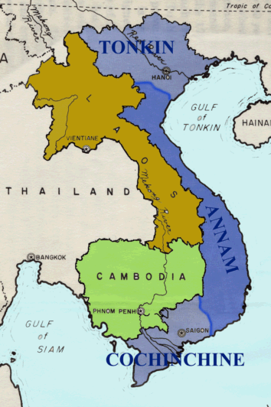
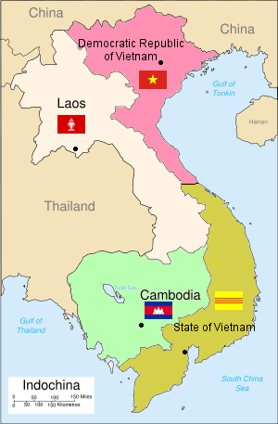
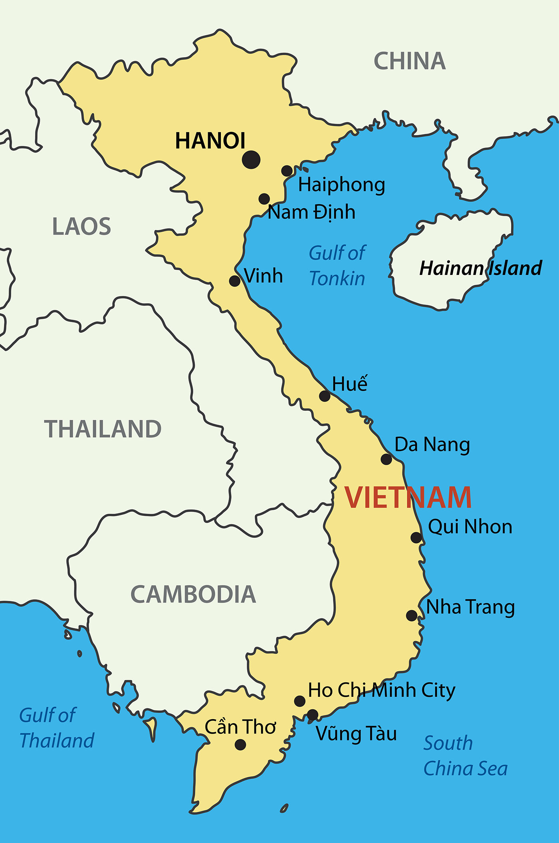
1945-1954
1954-1975
1975-Present

Slide 3
Early matters
1858 – French colonial rule begins
1930 – Ho Chi Minh founds the Indochinese Communist Party (ICP)
1941 - ICP organizes a guerrilla force, Viet Minh, in response to invasion by Japan during World War II

Slide 4
FDR to Secretary of State Hull, Jan. 24, 1944
“… Indo-China should not go back to France … France has had the country – thirty million inhabitants for nearly one hundred years, and the people are worse off than they were at the beginning. … I am wholeheartedly supported in this view by Generalissimo Chiang Kai-shek and by Marshal Stalin.”
“… the case of Indo-China is perfectly clear. France has milked it for one hundred years. The people of Indo-China are entitled to something better than that.”

Slide 5
General de Gaulle’s comments to U.S. Ambassador in France – March, 1945
“We have received word that our troops still fighting in Indochina have appealed for aid to your military authorities … they replied that under instructions no aid could be sent.”
“… We do not understand your policy. What are you driving at? Do you want us to become, for example, one of the federated states under the Russian aegis? The Russians are advancing apace as you well know. When Germany falls they will be upon us. If the public here comes to realize that you are against us in Indochina there will be terrific disappointment and nobody knows to what that will lead. We do not want to become Communist; we do not want to fall into the Russian orbit, but I hope that you to not push us into it.”

Slide 6
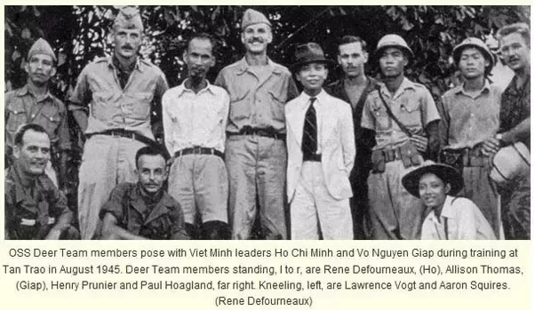

Slide 7
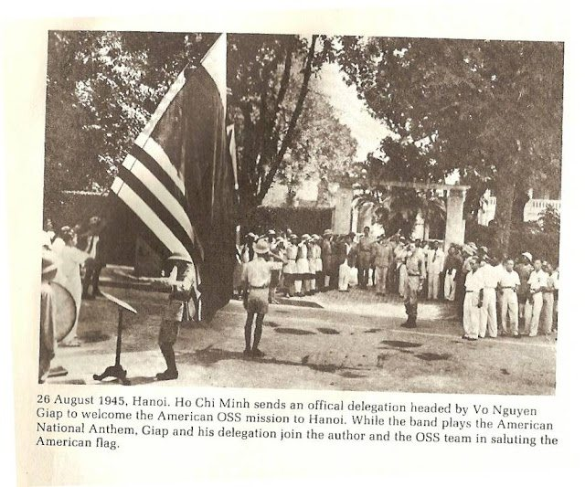

Slide 9
Proclamation of Independence of the Democratic Republic of Vietnam – September, 1945
“All people are created equal; they are endowed by their Creator with certain inalienable Rights; among these are Life, Liberty, and the pursuit of Happiness. …
Vietnam has the right to be a free and independent country – and in fact it is so already. And thus the entire Vietnamese people are determined to mobilize all their physical and mental strength, to sacrifice their lives and property in order to safeguard their independence and liberty.”

Slide 10
Truman wavers on U.S. policy toward Indochina – October, 1945
“[The] US has no thought of opposing the reestablishment of French control in Indochina … However, it is not the policy of this GOVT to assist the French to reestablish their control over Indochina by force and the willingness of the US to see French control reestablished assumes that the French claim to have the support of the population is borne out by future events.”

Slide 11
Meanwhile …
1946 – Stalin declares communism and capitalism incompatible; Churchill says an “iron curtain” has descended on Europe
1948 – Communists invade Czechoslovakia
1949 – Soviet Union tests its first atomic bomb
1949 – Chinese Communist Revolution, led by Chairman Mao Zedong, results in the proclamation of the People's Republic of China
1950 – Joseph McCarthy begins Communist witch hunt
1950 – Korean War begins

Slide 12
From the Pentagon Papers …
“The record shows that through 1953, the French pursued a policy which was based on military victory and excluded meaningful negotiations with Ho Chi Minh. … There was a basic incompatibility in the two strands of U.S. policy: (1) Washington wanted France to fight the anti-communist war and win, preferably with U.S. guidance and advice; and (2) Washington expected the French, when battlefield victory was assured to magnanimously withdraw from Indochina.”

Slide 13
Eisenhower on the strategic importance of Indochina – April 7, 1954
“You have a row of dominoes set up, you knock over the first one, and what will happen to the last one is the certainty that it will go over very quickly. So you could have a beginning of a disintegration that would have the most profound influences. …
… Asia, after all, has already lost some 450 million of its peoples to the Communist dictatorship, and we simply can't afford greater losses.”

Slide 14
From the Pentagon Papers …
“Secretary Dulles pursued a forthright, anti-communist policy and made it clear that he would not permit the ‘loss of Indochina,’ in the manner the Democrats had allegedly allowed the ‘loss of China.’ Dulles warned China not to intervene, and urged the French to drive toward a military victory. Dulles was opposed to a cease-fire and tried to dissuade the French from negotiations with the Viet Minh until they had markedly improved their bargaining position through action on the battlefield.”

Slide 15
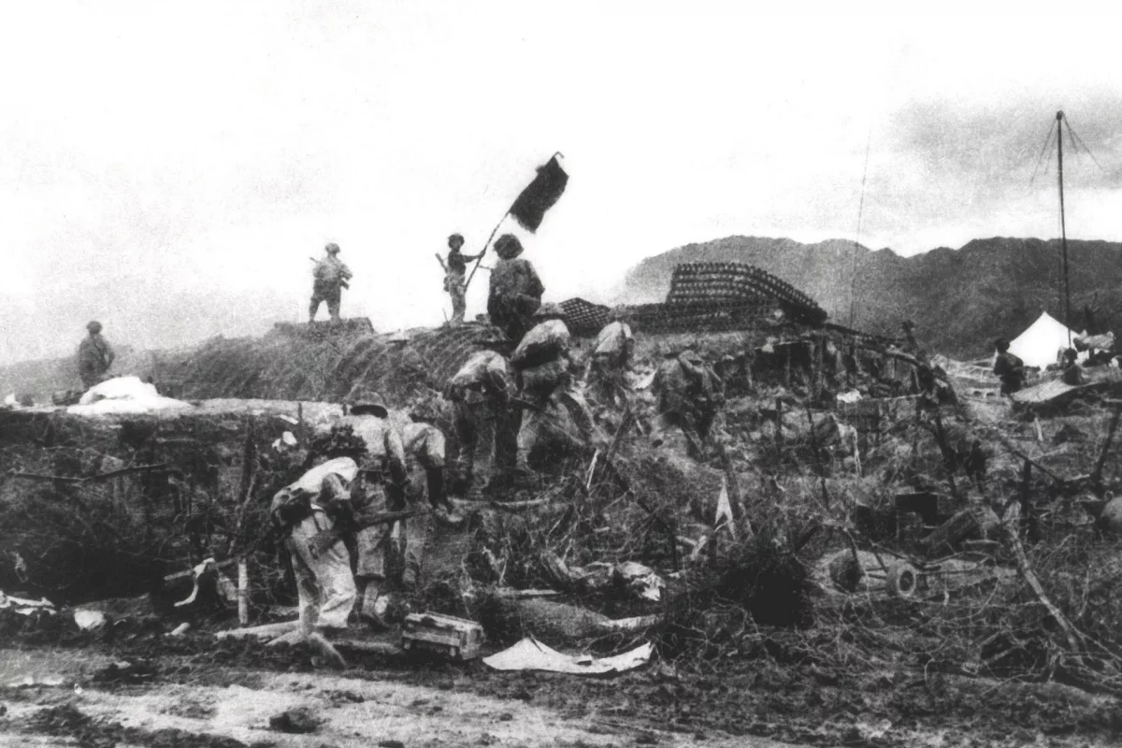
Battle of Dien Bien Phu
March 13 to May 7, 1954

Slide 16
1955-1956
U.S. begins shipment of military aid to Saigon; offers to train South Vietnamese army
Ho Chi Minh agrees to accept Soviet aid
Bao Dai replaced by Prime Minister Diem
Republic of South Vietnam is proclaimed
Communists begin severe repression in North
Deadline passes for unifying elections set by Geneva Conference

Slide 17
1955-1956
U.S. begins shipment of military aid to Saigon; offers to train South Vietnamese army
Ho Chi Minh agrees to accept Soviet aid
Bao Dai replaced by Prime Minister Diem
Republic of South Vietnam is proclaimed
Communists begin severe repression in North
Deadline passes for unifying elections set by Geneva Conference

Slide 18
1957-1959
1957 – Soviet Union proposes permanent division of Vietnam into North and South; U.S. rejects the proposal, unwilling to recognize Communist North Vietnam
Viet Minh guerrillas begin a widespread campaign of terror in South Vietnam including bombings and assassinations
1958 – Communists organize 37 armed companies in Mekong Delta
1959 - Ho Chi Minh declares a People's War to unite all of Vietnam under his leadership; 4,000 Viet Minh guerillas infiltrate South Vietnam
1959 – Two U.S. military advisors killed by Viet Minh at Bien Hoa

Slide 19
1960
Universal military conscription imposed in North Vietnam
South Vietnam President Diem cracks down on opposition; thousands flee to North Vietnam; many later return as part of People’s Liberation Armed Forces
Hanoi establishes National Liberation Front as Communist political organization for Viet Cong guerrillas in South Vietnam
American aid to Diem increases

Slide 20
1961
Krushchev pledges support for “wars of national liberation”
JFK sends 400 Green Beret “Advisors” to South Vietnam
26,000 Viet Cong batter South Vietnamese troops; Diem requests more military aid
Strategic hamlet program begins in South Vietnam
JFK rejects McNamara’s proposal to send 200,000 men
U.S. spends $1 million per day supporting South Vietnamese

Slide 21
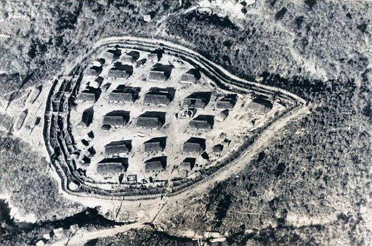

Slide 22
1962
U.S. pilots fly bombing raids against Viet-Cong controlled hamlets
U.S. and 13 other nations sign declaration on the neutrality of Laos; U.S. prohibited from attacking portions of Ho Chi Minh trail in eastern Laos
Viet Cong organize battalion-size units in central Vietnam
Secretary McNamara reports “We are winning the war”

Slide 23
1963
350 Viet Cong shatter large force of South Vietnamese troops at Ap Bac
Buddhists protest in South Vietnam
Diem overthrown and assassinated with U.S. complicity
JFK assassinated
16,300 U.S. military advisors in South Vietnam by year end

Slide 24
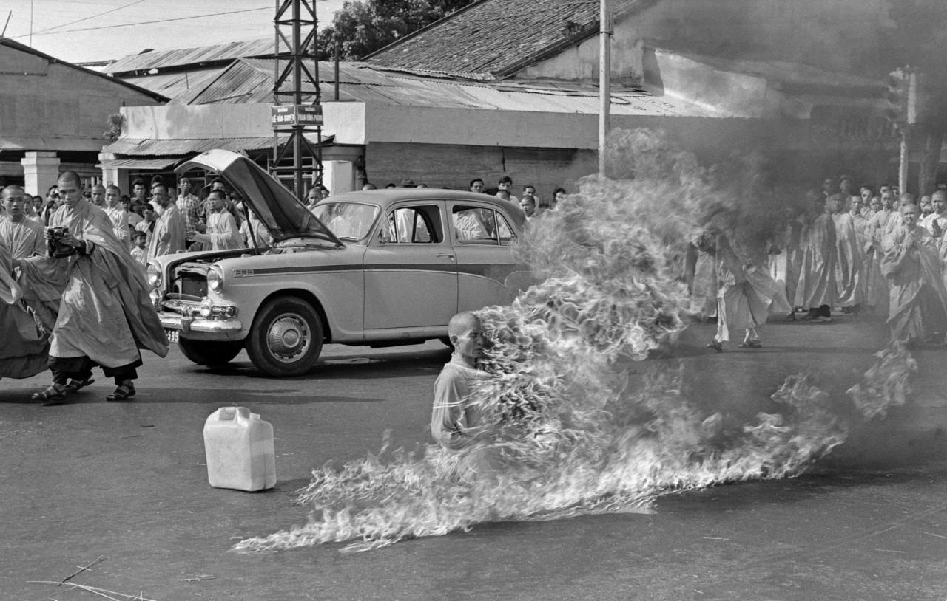

Slide 25
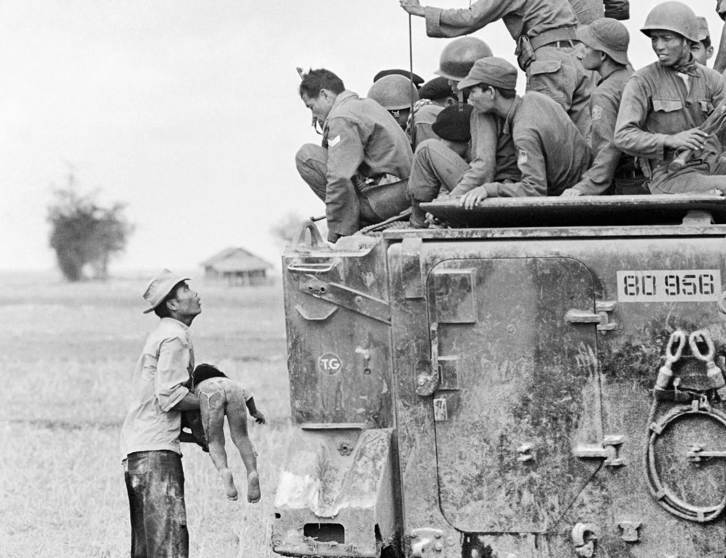

Slide 26
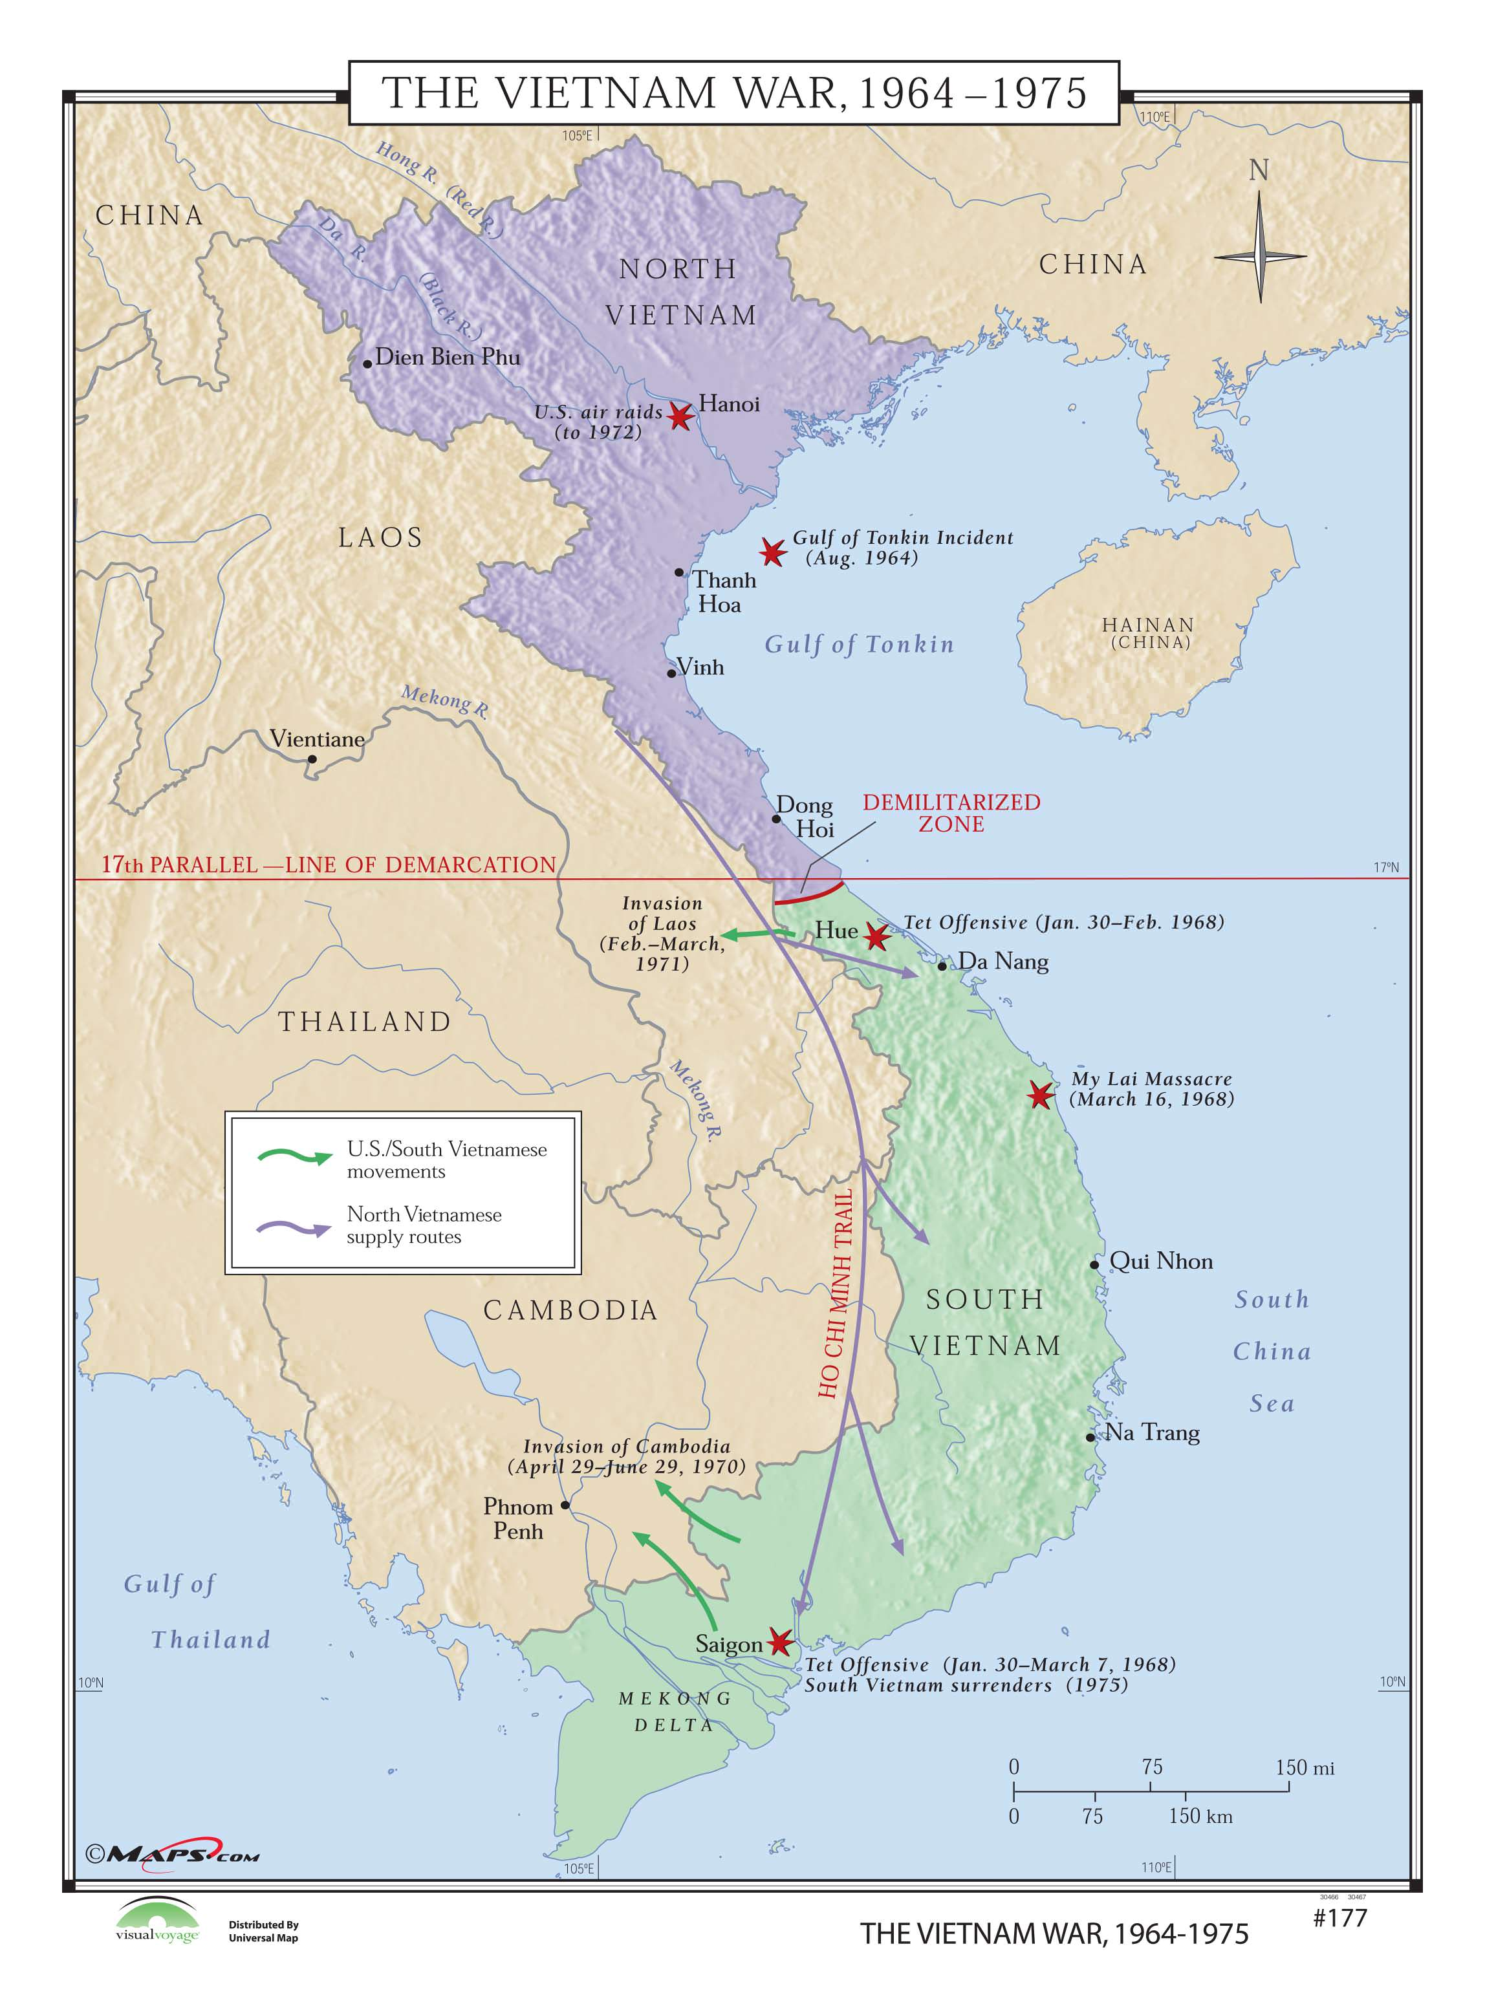

Slide 27
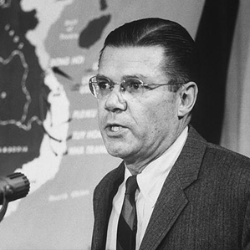
“The U.S. role in South Vietnam, then, is first, to answer the call of the South Vietnamese … to help them save their country for themselves; second, to help prevent the strategic danger which would exist if communism absorbed Southeast Asia's people and resources; and third, to prove in the Vietnamese test case that the free-world can cope with communist 'wars of liberation.’”
Robert S. McNamara
Secretary of Defense
“United States Policy in Vietnam”
March 26, 1964

Slide 28
U.S. Military
8.7 U.S. million military personnel on active duty from 1965 to 1973
2,709,918 served in uniform in Vietnam
79% high school education or higher
Two-thirds of men were volunteers
1.8 million were drafted
240 men awarded Medal of Honor for actions in Vietnam

Slide 29
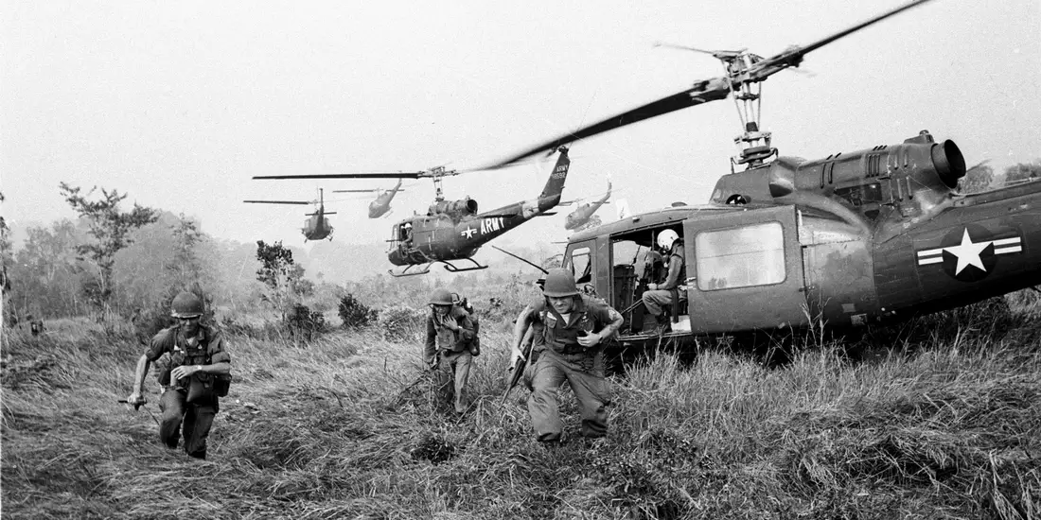

Slide 30
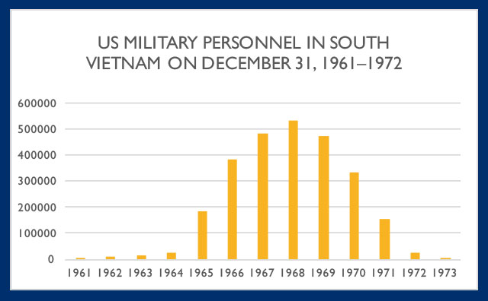

Slide 31
The Vietnam War death toll
2.2 million civilians
1.1 million North Vietnamese and Viet Cong fighters
250,000 South Vietnamese soldiers
58,220 Americans; 1,611 Americans still unaccounted for
4,886 South Korean, Thai, Australian and New Zealand soldiers

Slide 32
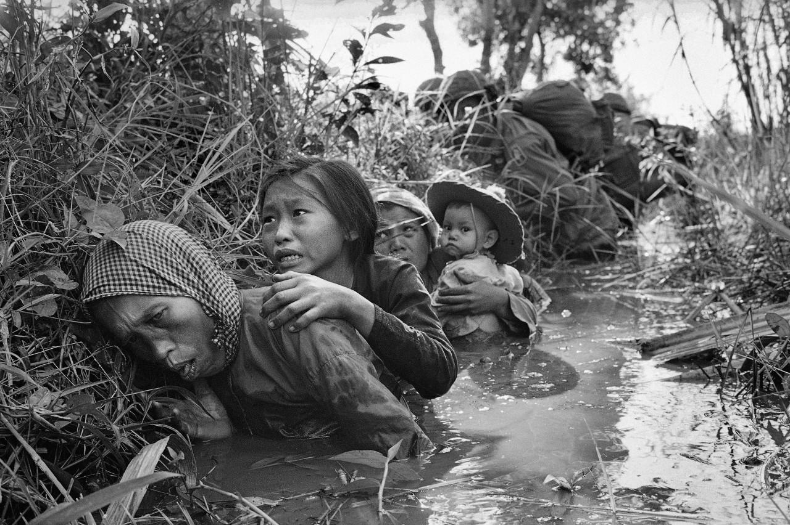

Slide 33
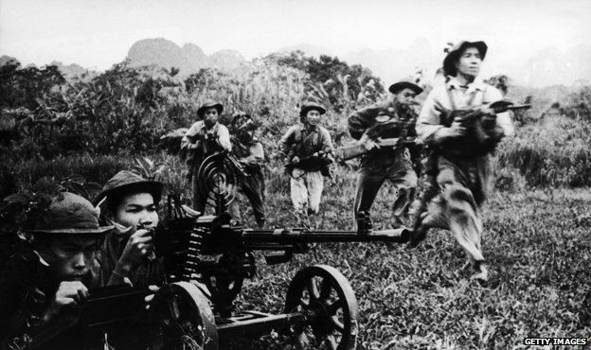

Slide 34
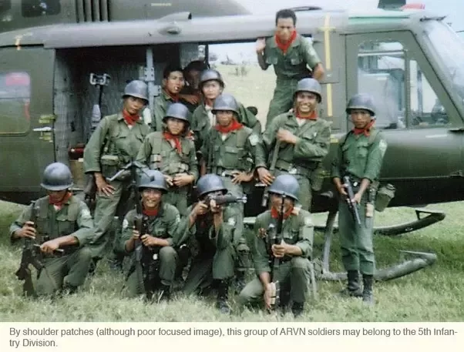

Slide 35
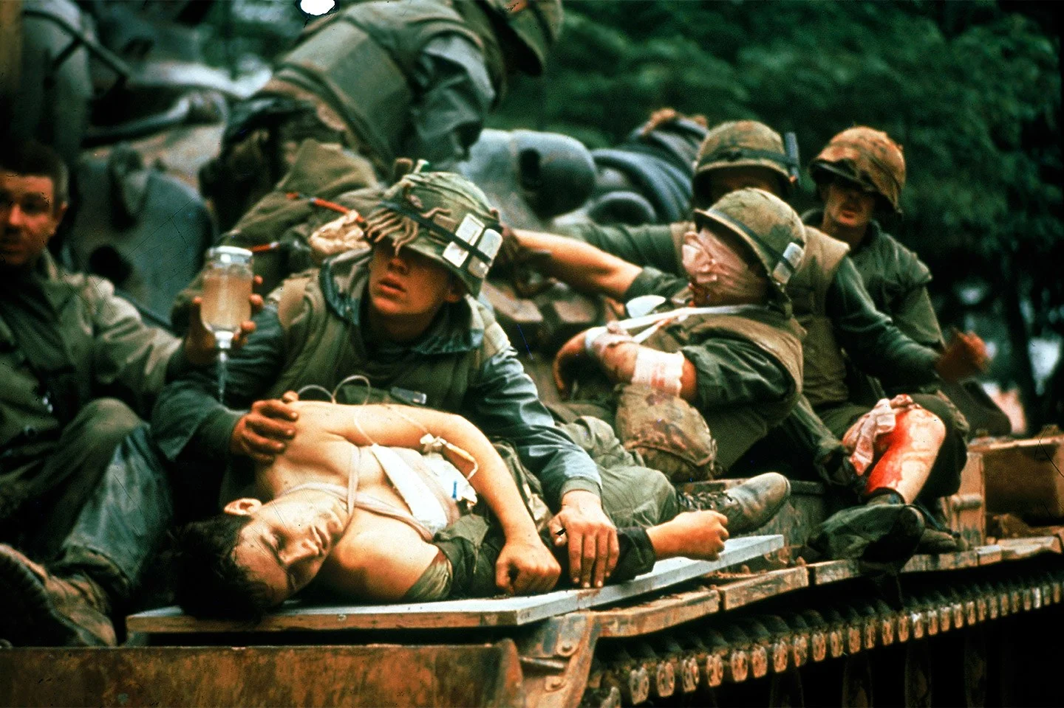

Slide 36
U.S. Casualties
58,220 killed
86% Caucasian; 12.5% Black; 1.2% Other
Average age was 23.1 years; 17,539 were married (30%)
61% killed were younger than 21
70% of men killed were volunteers
6,598 were officers; 50,274 were enlisted men
114 servicemen died in captivity

Slide 37
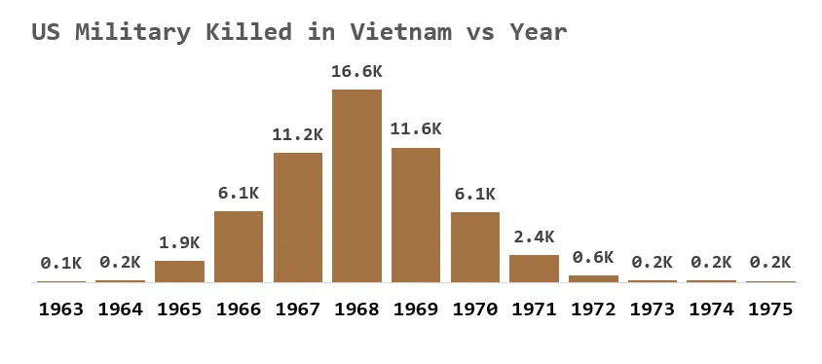

Slide 38
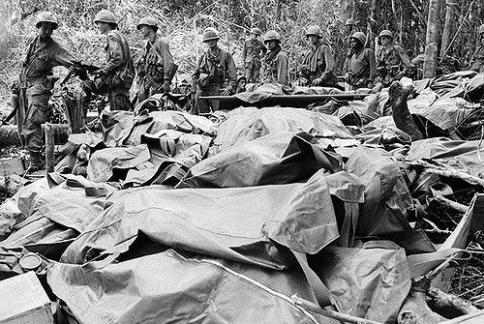

Slide 39
U.S. Deaths in Vietnam War by Category
HOSTILE DEATHS 47,434
NON HOSTILE DEATHS 10,786
ACCIDENT 9,107
DECLARED DEAD 1,201
DIED OF WOUNDS 5,299
HOMICIDE 236
ILLNESS 938
KILLED IN ACTION 40,934
PRESUMED DEAD (REMAINS RECOVERED) 32
PRESUMED DEAD (NOT RECOVERED) 91
SELF-INFLICTED 382
Total Records 58,220

Slide 40
U.S. Wounded
304,000 servicemen were wounded
75,000 veterans severely disabled
23,314 veterans 100% disabled
5,283 lost limbs
1,081 sustained multiple amputations
Surveys suggest 271,000 veterans (11%) suffer from full post traumatic stress disorder
At least 430 veterans have died from complications related to Agent Orange

Slide 41
Medical Care
Over 900,000 U.S. and ARVN airlifted by MEDEVAC helicopters
MEDEVAC helicopters flew nearly 500,000 missions
Average time lapse from injury to hospitalization less than 1 hour
Less than 1% of men who survived first 24 hours died
Hospital mortality rate was 2.6 per 1,000 patients
Nearly 10,000 women in uniform served in Vietnam, most as nurses
79% of nurses were female
2,096 Army medics and Navy corpsmen died or were MIA
Eight female nurses died in Vietnam
15 Army medics received the Medal of Honor

Slide 42
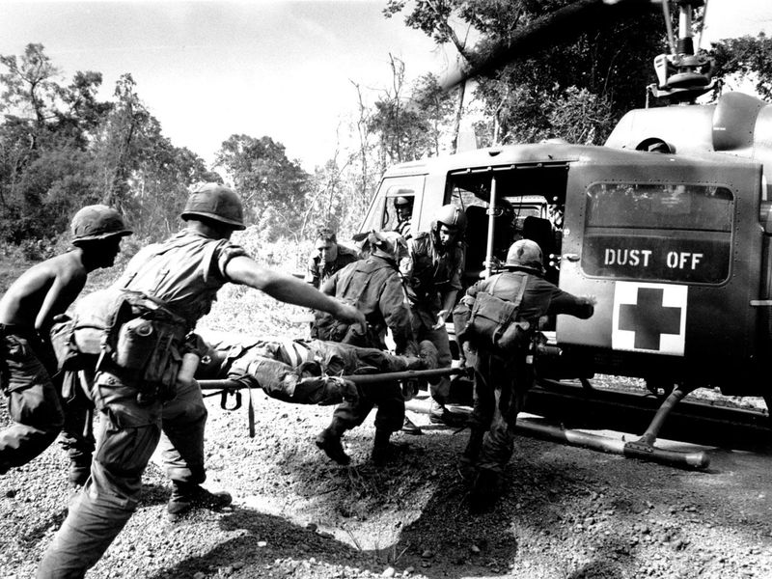

Slide 43
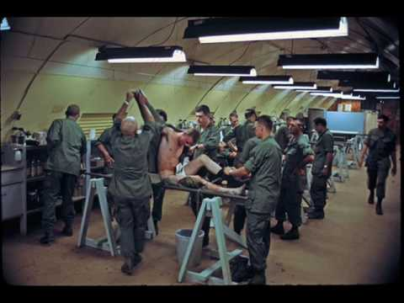

Slide 44
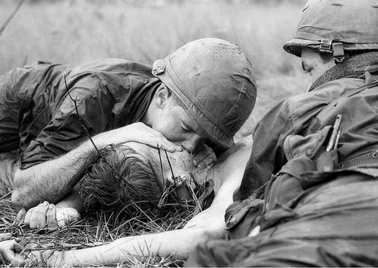

Slide 45
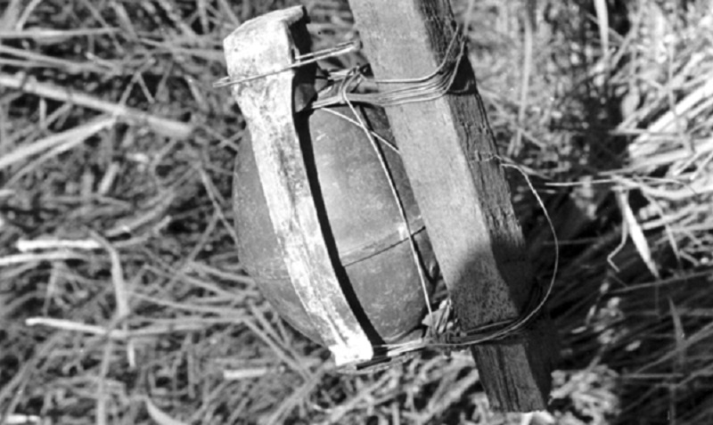

Slide 46
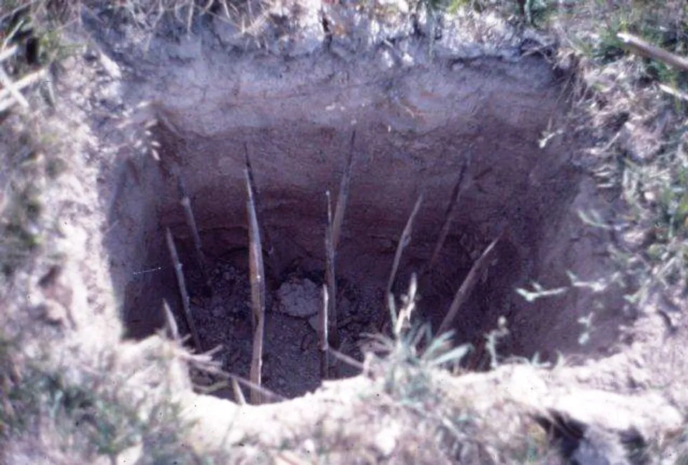

Slide 47
Vietnam War financial cost
$168 billion total according to Department of Defense
$111 billion on military operations (1965-1972)
28.5 billion on economic and military aid to Saigon regime (1953-1975)
$2.6 billion in aid to French (1950-1954) not included in above

Slide 48
1964
U.S. begins secret bombing raids on Ho Chi Minh trail in Laos
Gulf of Tonkin incident; U.S. responds by attacking targets in North Vietnam; Gulf of Tonkin Resolution passes in Congress
China tests Atomic Bomb and masses troops on Vietnam border
Viet Cong attack Americans at Bien Hoa air base
War cost rises to $2 million per day
23,000 U.S. “advisors” in Vietnam at year end
170,000 Viet Cong and NVA fighters in South Vietnam

Slide 49
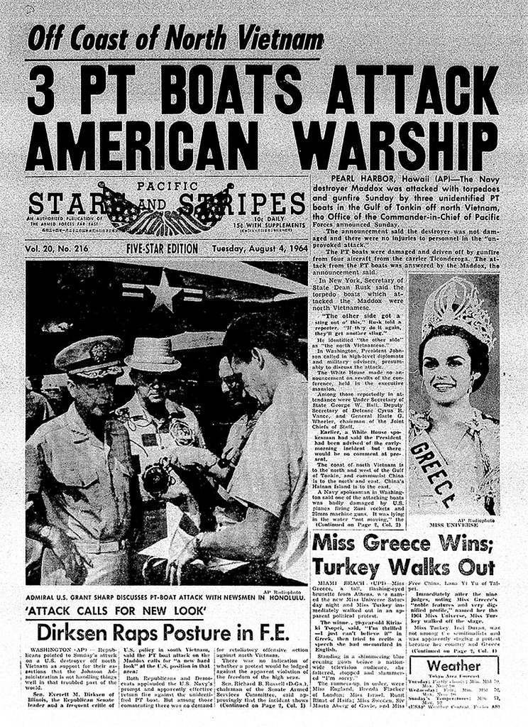
Gulf of Tonkin incident, Aug. 2, 1964

Slide 50
Gulf of Tonkin Resolution, Aug. 7, 1964
“Congress approves and supports the determination of the President, as Commander in Chief, to take all necessary measures to repeal any armed attack against the forces of the United States and to prevent any further aggression.”

Slide 51
1965
LBJ aides recommend military escalation or withdrawal
Viet Cong guerrillas attack U.S. compound at Pleiku in Central Highlands
Russians agree to provide surface-to-air missiles to Hanoi
General Westmoreland requests two battalions of Marines to protect airbase at Da Nang
March 8, 1965 - 3,500 Marines arrive in Vietnam

Slide 52
1965 (cont.)
November 14-16: Battle of Ia Drang Valley, 79 Americans killed
November 17: Ambush at Landing Zone Albany; 155 Americans killed
Secretary McNamara predicts American death rate of 1,000 soldiers per month
Estimated South Vietnamese Army desertions in 1965: 90,000
Estimated number of NVA who arrived in South Vietnam along Ho Chi Minh trail in 1965: 35,000

Slide 53
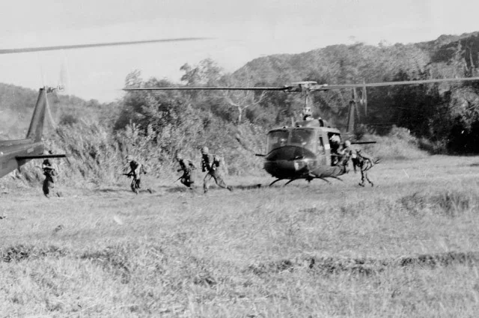

Slide 54
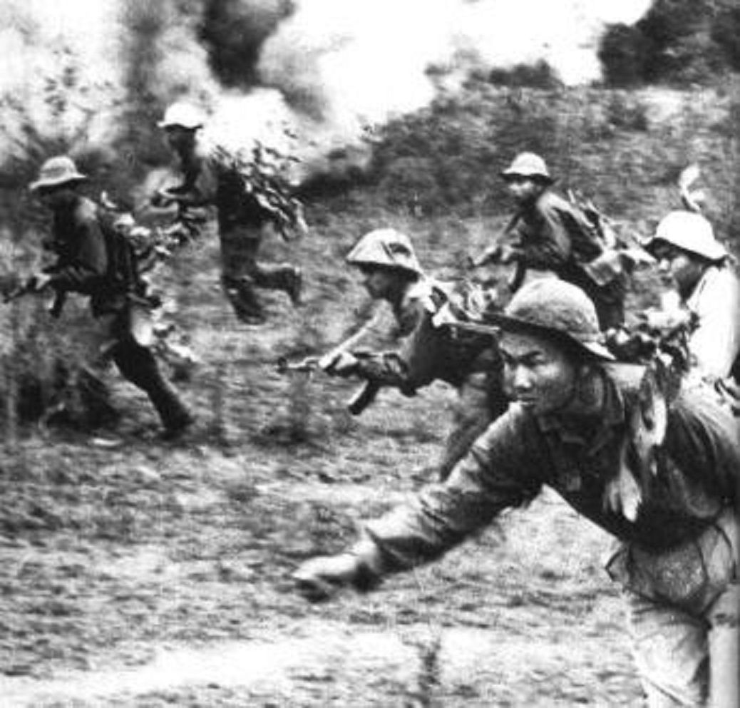

Slide 55
1965 (cont.)
15,000 students gather in Washington to protest bombing campaign
LBJ announces 44 combat battalions to be sent to Vietnam, increasing troop strength to 125,000; monthly draft increases to 35,000
CBS broadcast of destruction of suspected Viet Cong villages by Marines generates controversy in U.S.
Operation Starlite beings first major ground operation by U.S. Marines
Anti-war rallies occur in 40 American cities

Slide 56
The Air War
Operation Rolling Thunder (March, 1965) initiates three years of bombing raids on North Vietnam
U.S. will drop 6.1 million tons of bombs in Vietnam War, compared to 2.1 tons in World War II.
500 jets will be lost attacking the Ho Chi Minh trail, which is continually rebuilt by female construction crews
U.S. planes drop 20 million gallons of herbicides

Slide 57
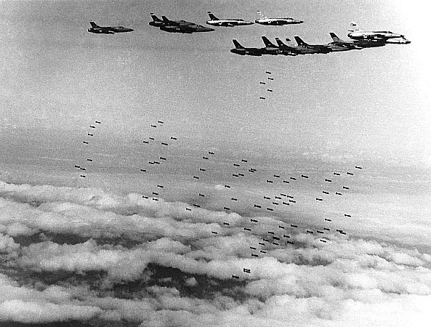
Operation Rolling Thunder
March, 1965 to November, 1968

Slide 58
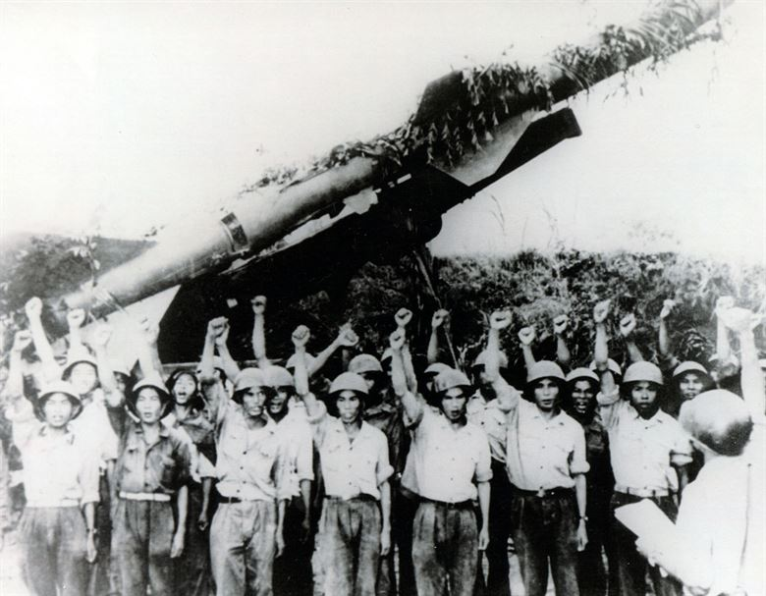

Slide 59
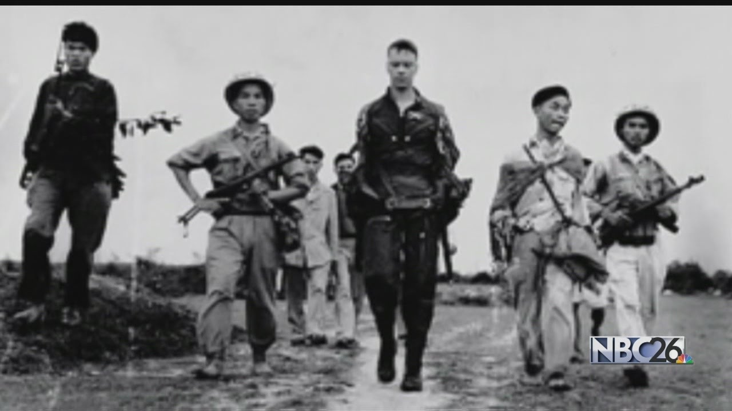

Slide 60
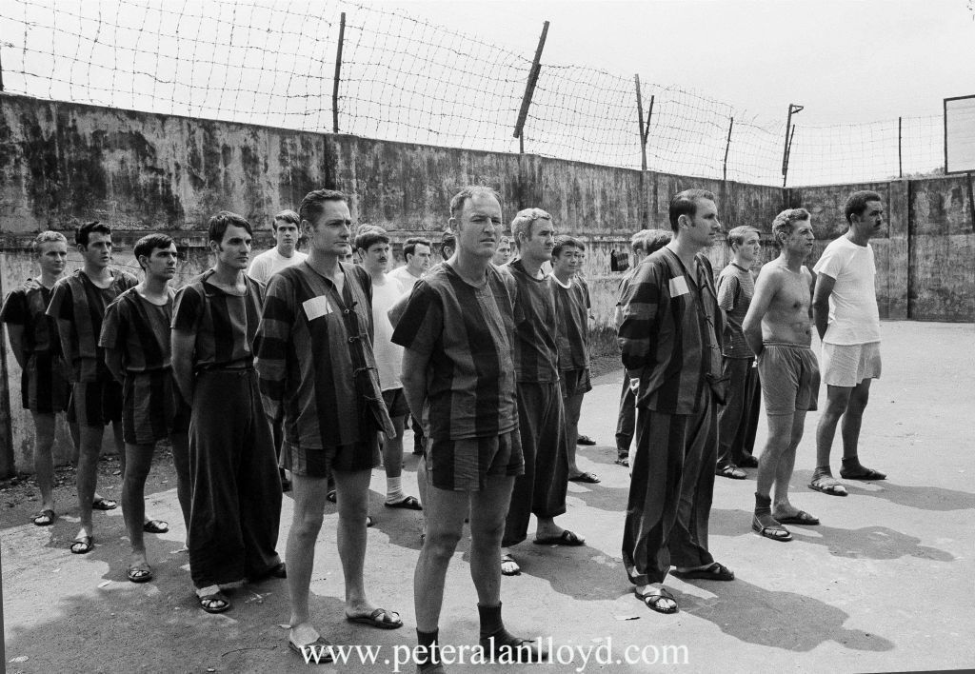

Slide 61
1966
Antiwar protests held in numerous major U.S. cities
B-52 bombers attack targets in North Vietnam
Captive U.S. pilots paraded through Hanoi
Major military operations:
Operation Masher, 228 American KIA, 788 wounded, NVA losses 1342
Operation Hastings, 128 Americans KIA, NVA losses 800
Operation Attleboro, 155 American KIA, 494 wounded, NVA losses 1106
U.S. troop levels at yearend: 389,000

Slide 62
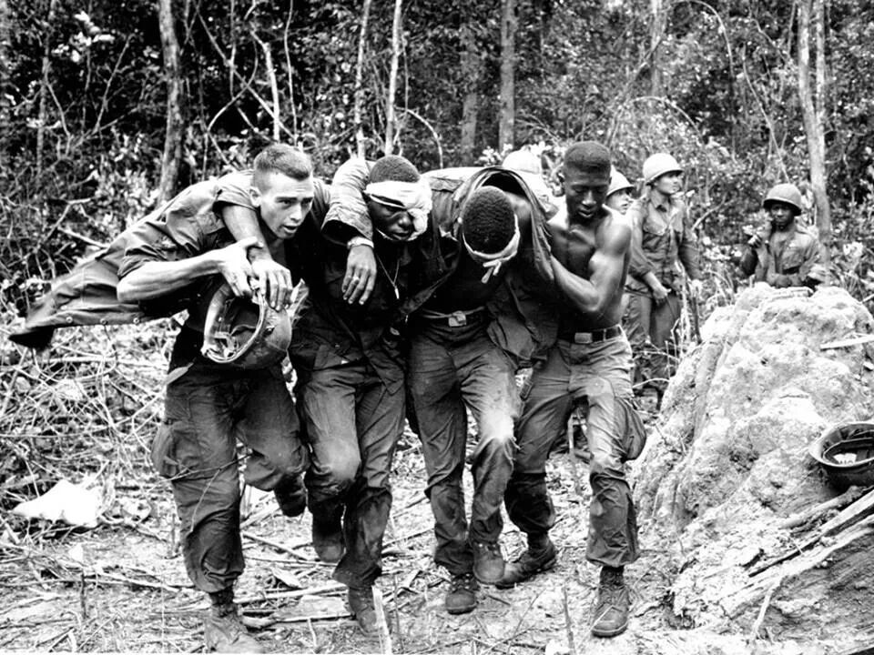

Slide 63
1967
U.S. bombers target Haiphong harbor in North Vietnam
Westmoreland requests 200,000 reinforcements to join 475,000 men schedule to be sent to Vietnam; LBJ agrees to 45,000
McNamara becomes fourth LBJ aide to resign ( after Moyers, Bundy, Ball)
Yearend troop levels: 463,000; 16,000 combat deaths to date
90,000 NVA infiltrate in 1967; Viet Cong/NVA strength estimated to be 300,000

Slide 64
1967 Major Military Operations
Operation Cedar Falls – Viet Cong avoid battle with 16,000 American and 14,000 South Vietnamese in “Iron Triangle”
Operation Junction City, 282 American KIA, 1576 wounded, 2728 Viet Cong KIA
Battles rage around Khe Sanh, 155 Americans KIA, 425 wounded, 940 NVA KIA
Marines besieged and bombarded at Con Thien, near DMZ
Dak To, 289 Americans KIA, 1644 NVA

Slide 65
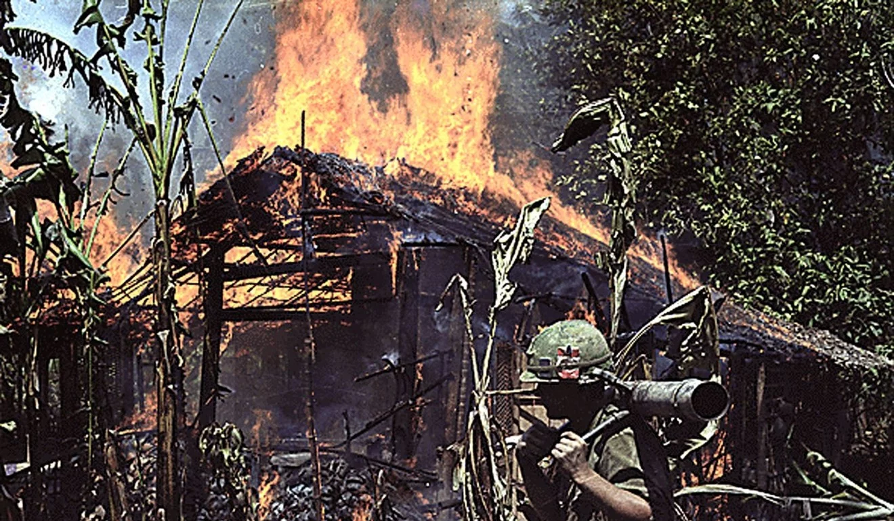

Slide 66
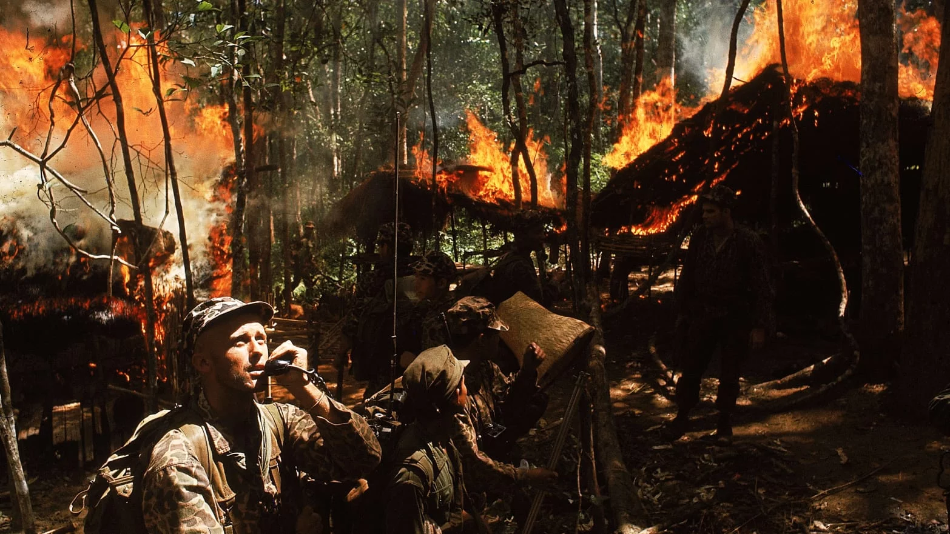

Slide 67
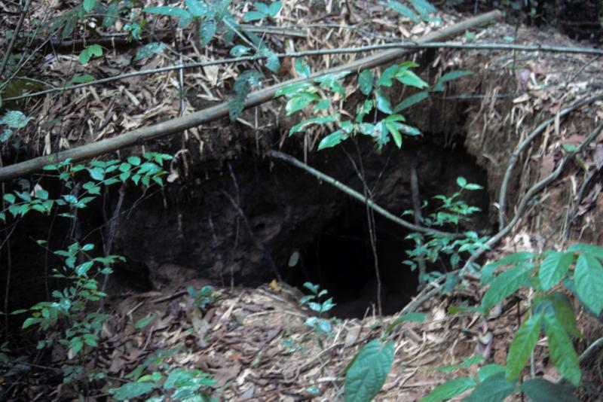
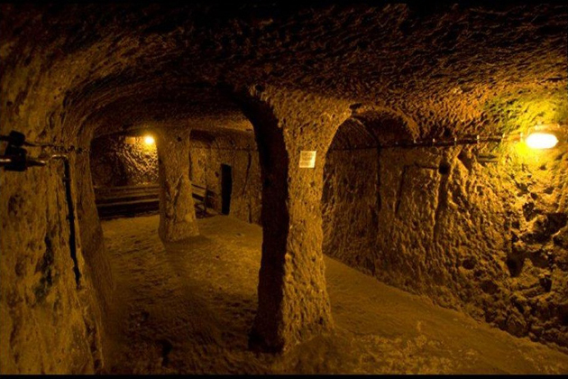
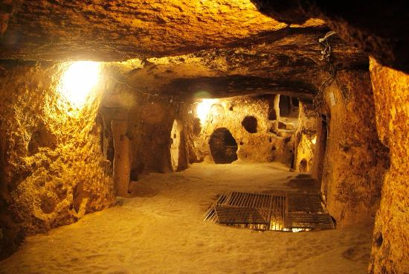
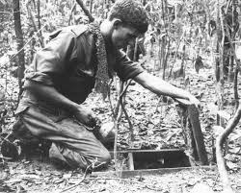
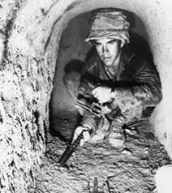
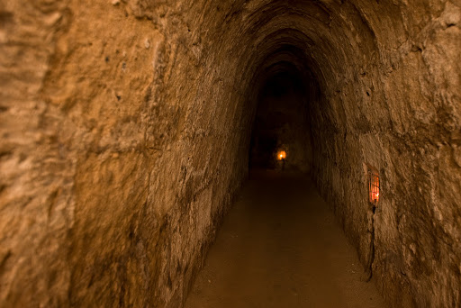

Slide 68
1968
77-day siege of Khe Sanh
Tet Offensive launched by 84,000 Viet Cong and NVA troops
12,000 NVA and Viet Cong storm Hue and execute 3,000 “enemies of the people”
Battle for Hue: 216 Americans KIA, 507 wounded; 384 ARVN KIA, NVA losses over 5,000
My Lai massacre (March 16)
LBJ announces he will not run for reelection (March 31)
MLK assassinated (April 4)
RFK assassinated (June 5)

Slide 69
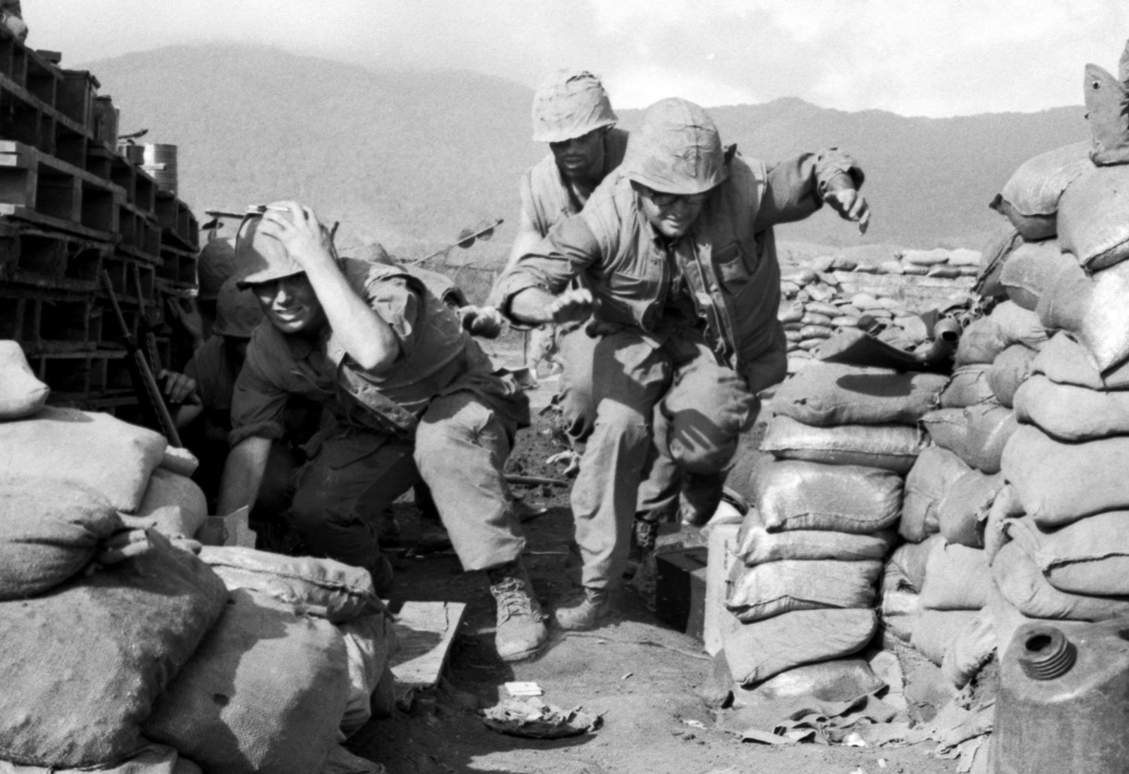

Slide 70
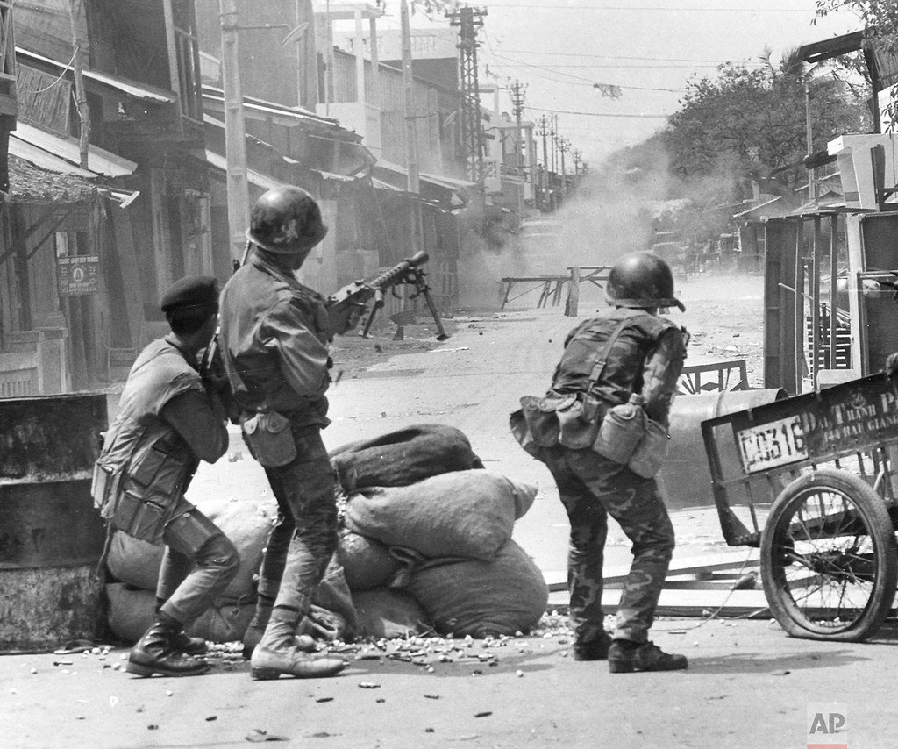

Slide 71
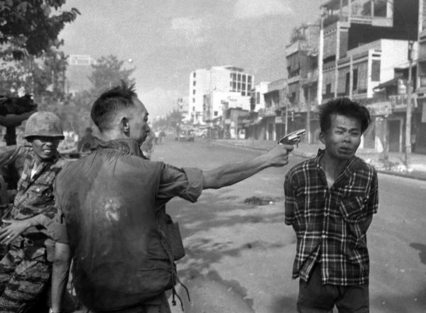

Slide 72
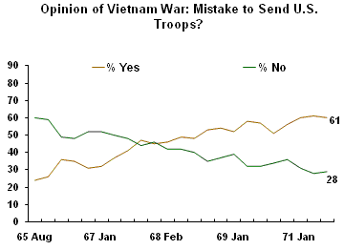

Slide 73
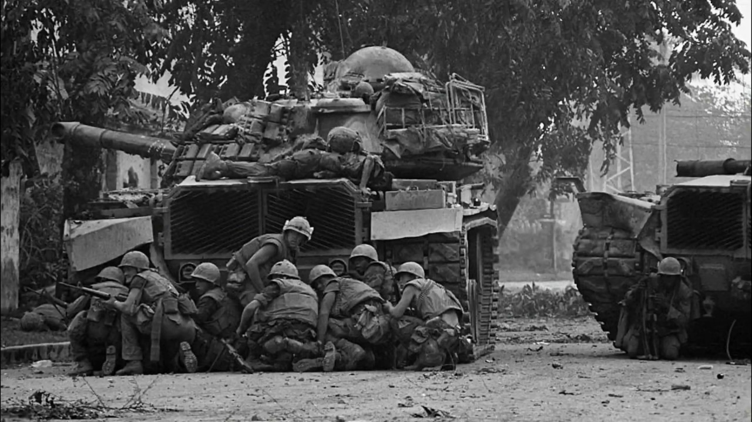

Slide 74
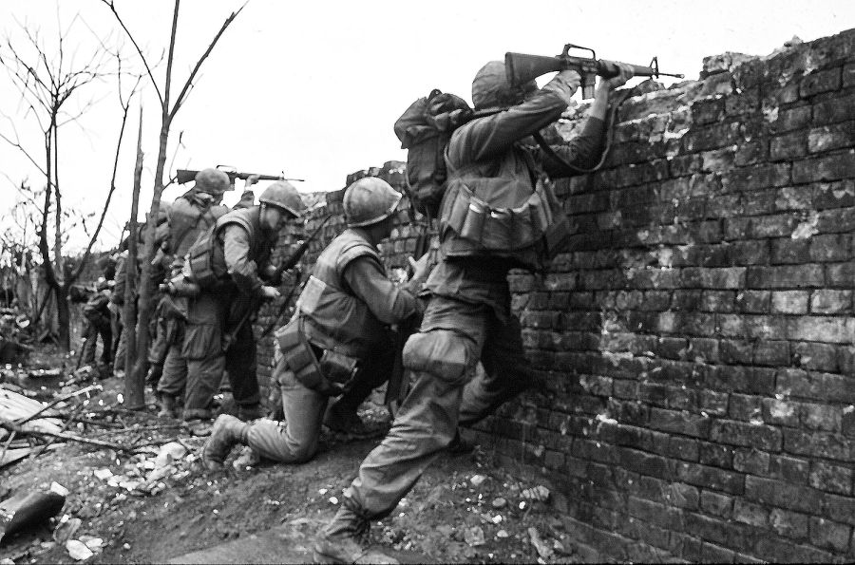

Slide 75
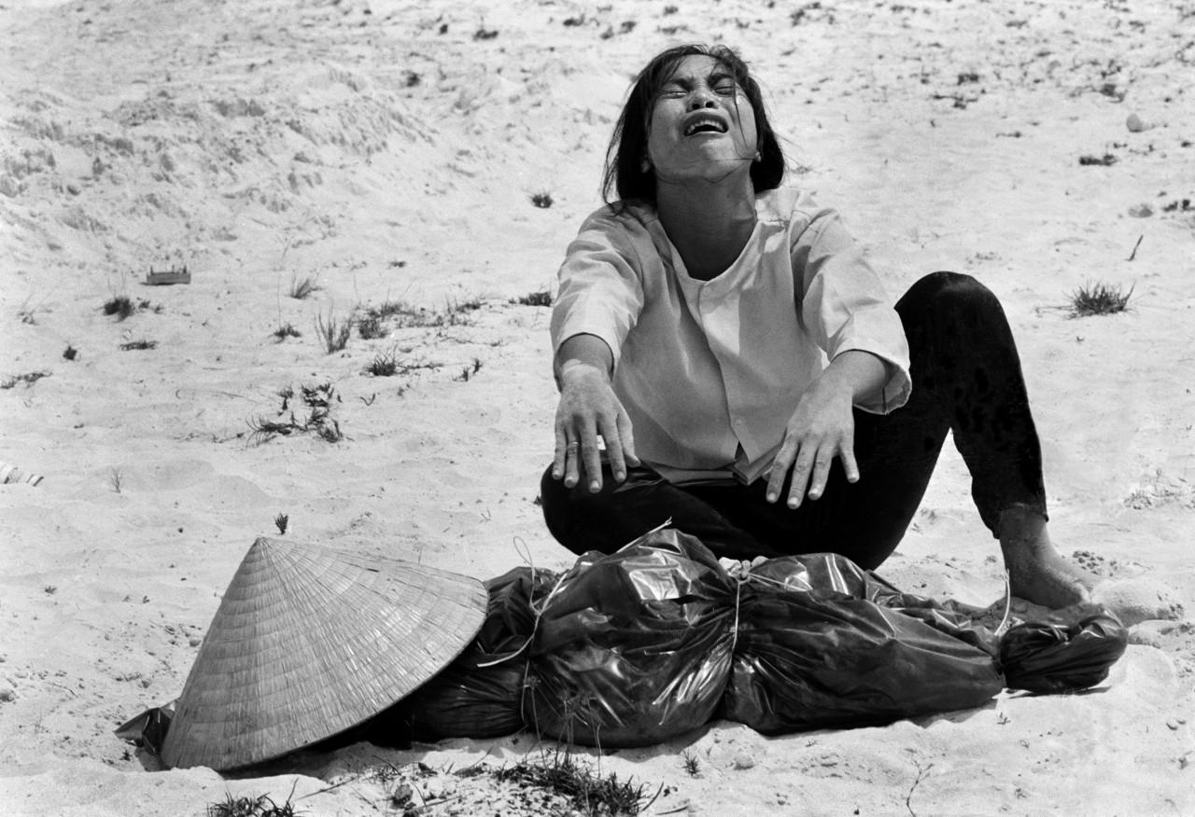

Slide 76
1968 (cont.)
Peace talks begin and immediately stall
Westmoreland replaced by Creighton Abrams
26,000 police and national guard oppose 10,000 anti-war protestors at Democratic Convention in Chicago
Operation Rolling Thunder ends after 922 U.S. aircraft shot down, 1 million tons of bombs dropped on North Vietnam; estimated 52,000 civilians killed
150,000 NVA infiltrate South Vietnam during 1968

Slide 77
1969
Nixon takes office on pledge of “peace with honor”
Paris peace talks resume
Nixon authorizes secret bombing of Cambodia by B-52s
Troop levels peak at 543,400; 33,641 Americans KIA
Battle of Hamburger Hill: 56 U.S. KIA, 420 wounded, hill abandoned
My Lai massacre exposed; Lt. William Calley charged
250,000 antiwar protestors gather in Washington
Troop withdrawals reduce U.S. forces by 115,000
40,024 Americans KIA to date

Slide 78
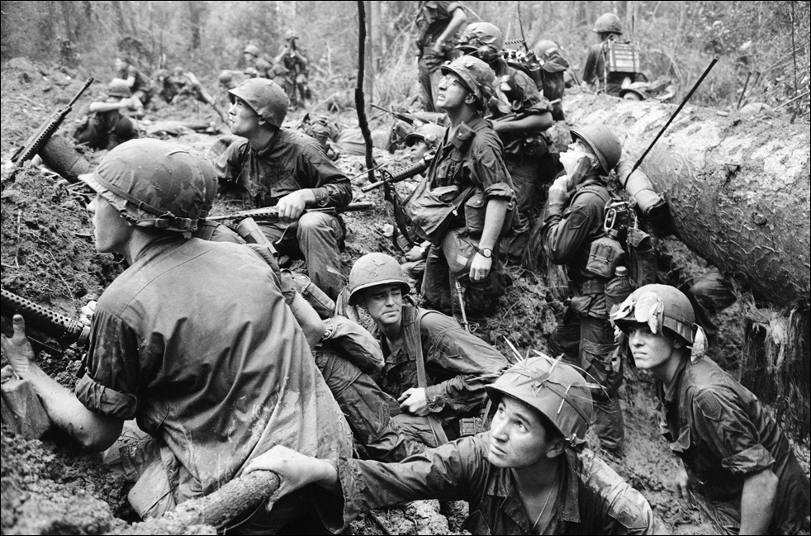

Slide 79
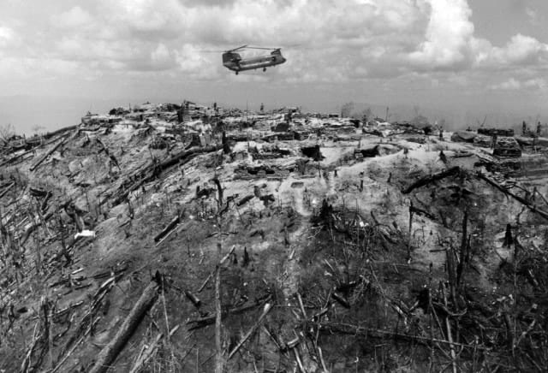

Slide 80
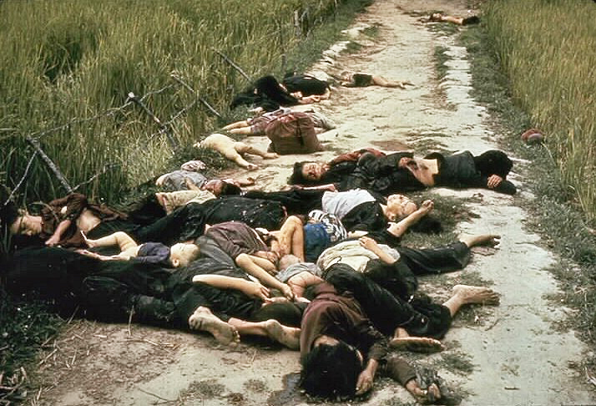

Slide 82
Nixon announces “Vietnamization” of War,
“We have adopted a plan which we have worked out in cooperation with the South Vietnamese for the complete withdrawal of all U.S. combat ground forces, and their replacement by South Vietnamese forces on an orderly scheduled timetable.”
November 3, 1969

Slide 83
1970
Kissinger begins two years of secret talks with Le Duc Tho
Cambodia taken over by Khmer Rouge Communist forces
Nixon announces U.S. and South Vietnamese incursion into Cambodia
Anti-war sentiment and protests increase dramatically
May 4 – National Guardsmen kill four students and wound nine others at Kent State University
Senate repeals Gulf of Tonkin resolution
Congressional appropriation bill forbids the use of U.S. ground troops in Laos or Cambodia

Slide 88
1971
B-52s conduct air strikes in Laos and Cambodia
Operation Lam Som inside Laos results in 7,862 South Vietnamese casualties; 215 U.S. KIA, over 100 helicopters lost and 600 damaged; NVA losses estimated up to 20,000
Vietnam Veterans against the War begin a week-long protest
200,000 people demonstrate in Washington; 12,000 arrested
Last marine combat units depart from Vietnam
Members of 1st Air Cavalry Division refuse to go out on patrol; other such incidents occur
Pentagon Papers are published by NY Times, Washington Post
U.S. admits 30,000 CIA “irregulars” are operating in Laos
U.S. troop levels drop to 156,800

Slide 94
1972
ARVN pilots drop napalm on civilians and their troops in Trang Bang
Nixon visits China
U.S. stages boycott of Paris Peace talks
200,000 NVA troops begin major offensive
U.S. bombards DMZ and B-52s strike North Vietnam
President Thieu publicly denounces Kissinger's peace proposal
Nixon reelected in biggest landslide to date
U.S. “Christmas bombings” denounced by politicians and press

Slide 95
1973
Threatened with a total cut-off of American aid to South Vietnam, President Thieu accepts peace agreement that allows North Vietnamese troops to remain in South Vietnam
Nixon announces agreement has been reached that will "end the war and bring peace with honor”; Paris Peace Accords signed January 27
Draft ends
January 27, 1973 - last American soldier to die in combat in Vietnam is killed
Operation Homecoming begins release of 591 American POWs from Hanoi.
March 29, 1973 - Last remaining American troops withdraw
Case-Church Amendment forbids any further U.S. military involvement in Southeast Asia

Slide 96
1974
August 9 - Nixon resigns as a result of Watergate scandal
Ford announces clemency program for draft evaders and military deserters
Secretary of Defense James Schlesinger testifies that the U.S. is not living up to its earlier promise to South Vietnam's President Thieu of “severe retaliatory action” in the event North Vietnam violated the Paris peace treaty
President Ford states the U.S. is unwilling to re-enter the war
NVA final offensive begins
South Vietnamese soldiers and civilians begin chaotic mass exodus

Slide 97
April 21, 1975
President Thieu resigns and condemns the Paris Peace Accords, Henry Kissinger, and the U.S., and "The United States has not respected its promises. It is inhumane. It is untrustworthy. It is irresponsible."

Slide 98
April 30, 1975

Slide 101
U.S. embargo on Vietnam partially lifted in 1994
Diplomatic relations normalized in 1995
U.S. embargo fully lifted in 2014

