Slide 1
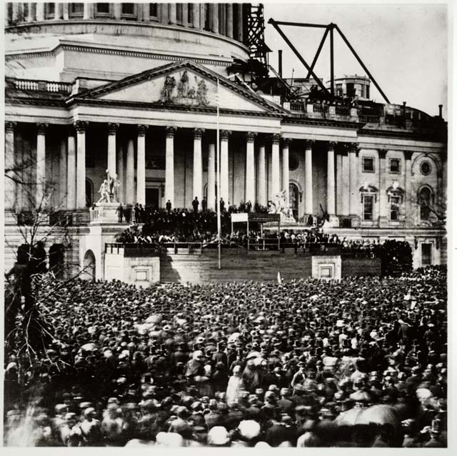
"I have no purpose, directly or indirectly, to interfere with the institution of slavery in the States where it exists. I believe I have no lawful right to do so, and I have no inclination to do so...“
Abraham Lincoln
First Inaugural Address
March 4, 1861

Slide 2
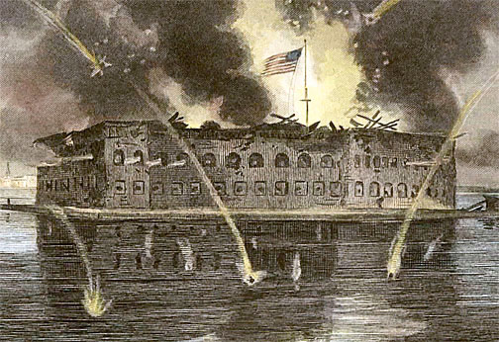
Attack on Fort Sumter, April 12, 1861

Slide 4
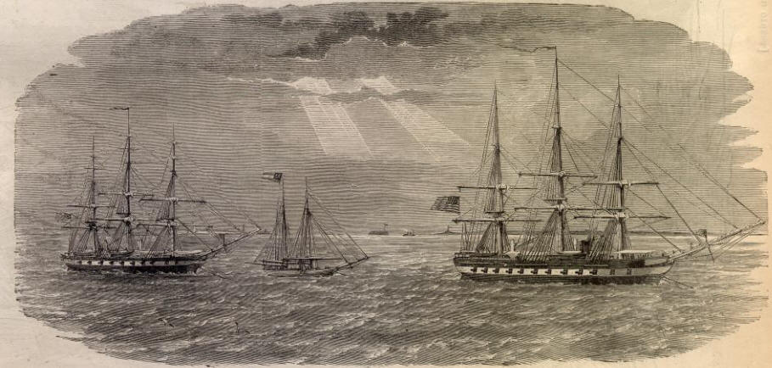
Union blockade of southern ports choked off commercial activity

Slide 5
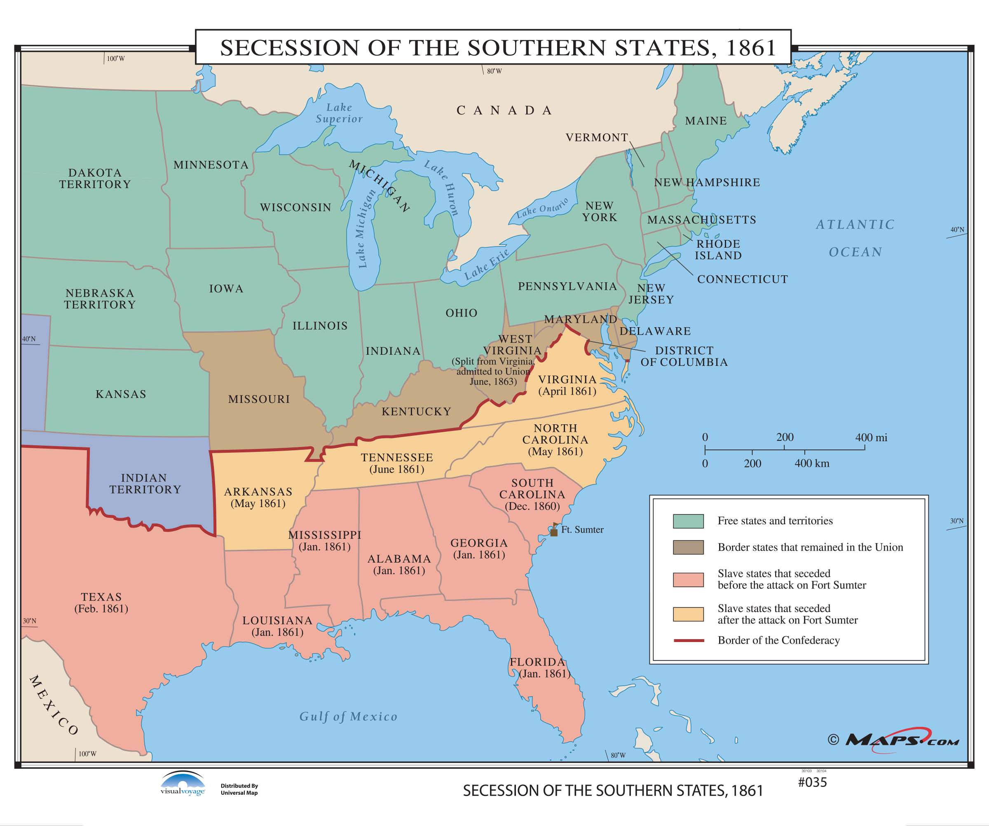

Slide 6
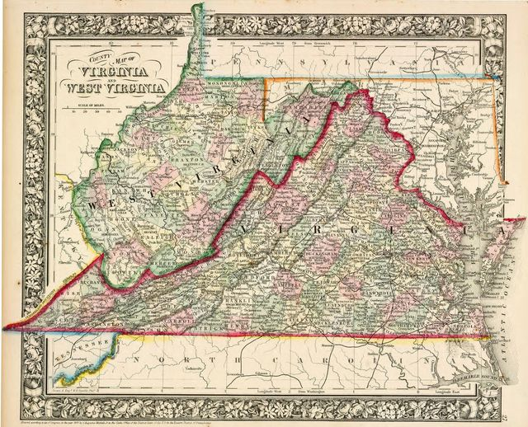
In 1861, 39 western counties in Virginia voted to remain in Union.
West Virginia admitted as 35th state on June 20, 1863.

Slide 7
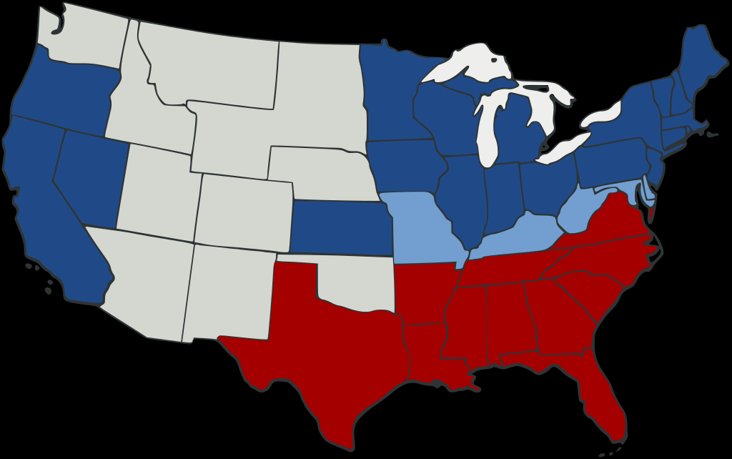
Union Advantages
Greater population
Far more industry
More extensive transportation networks
Better financial resources
Navy
23 states in Union; 11 states in Confederacy

Slide 8
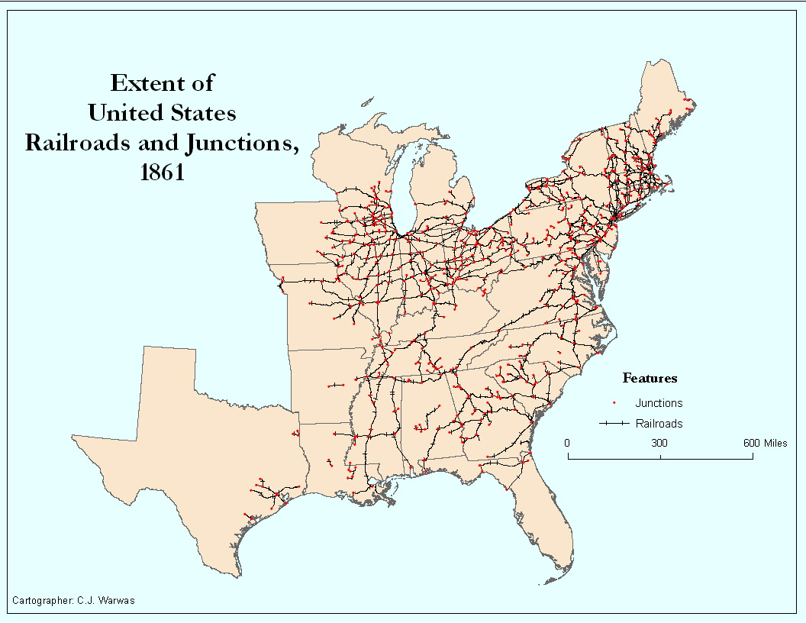

Slide 9
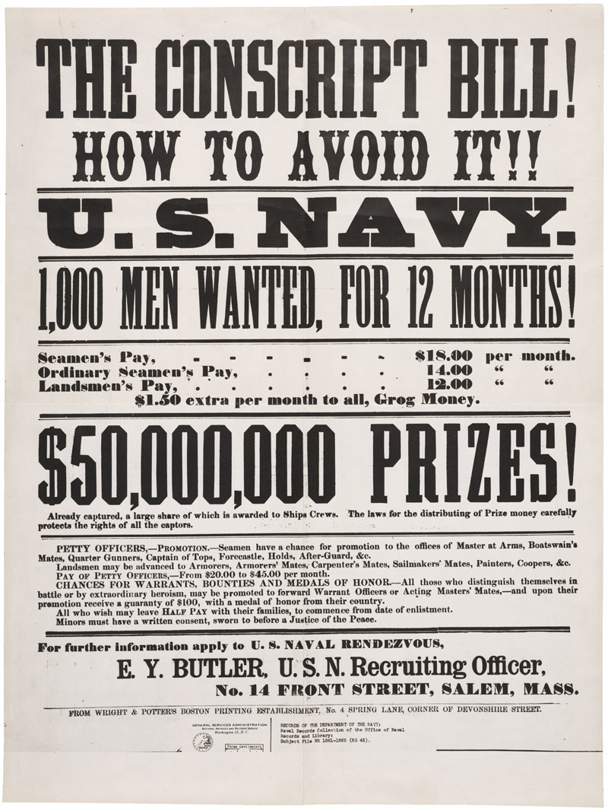
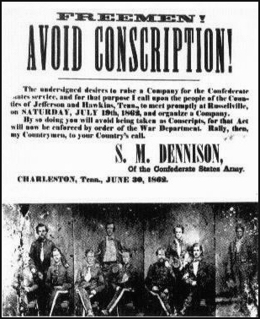

Slide 10
“A rich man’s war but a poor man’s fight”

Slide 11
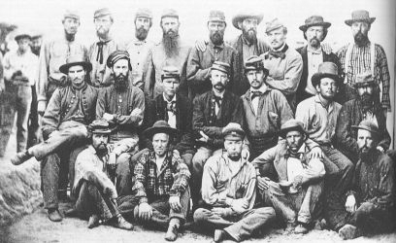
What did they fight for?

Slide 12
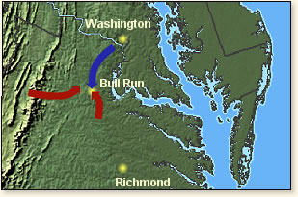

Slide 13
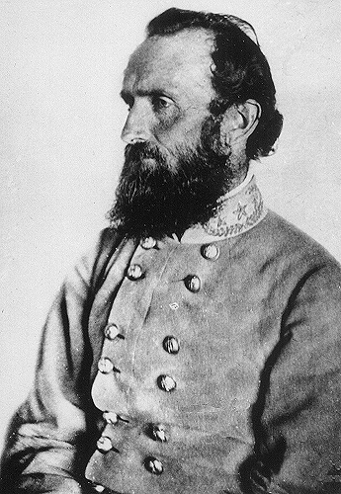
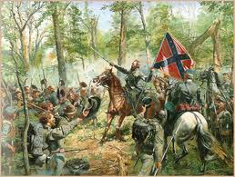
Stonewall Jackson – Confederate hero at Bull Run/First Manassas

Slide 14
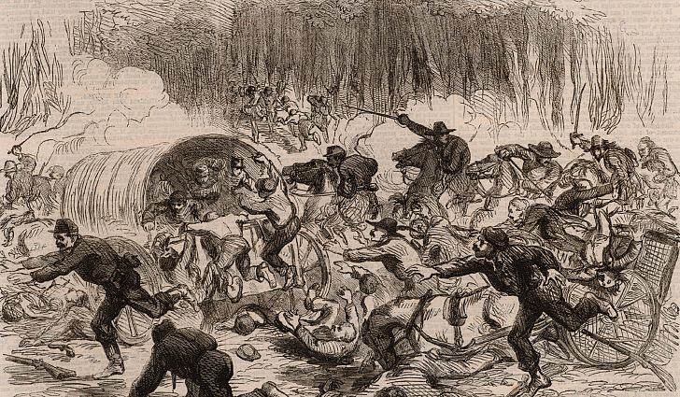

Slide 15
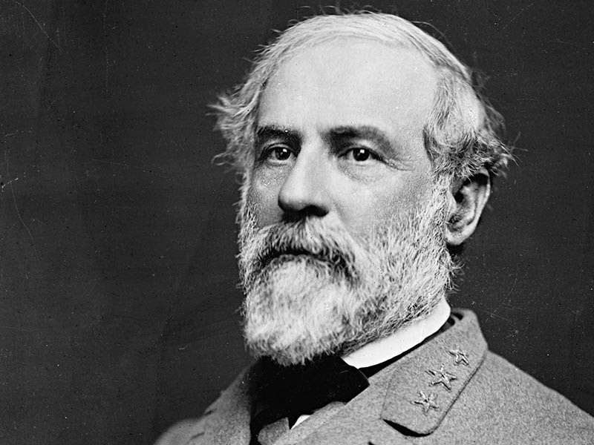

Slide 16
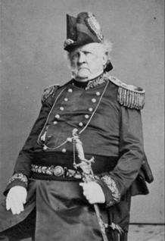
Lieutenant General Winfield Scott
Developer of the Union’s ‘Anaconda Strategy”

Slide 17
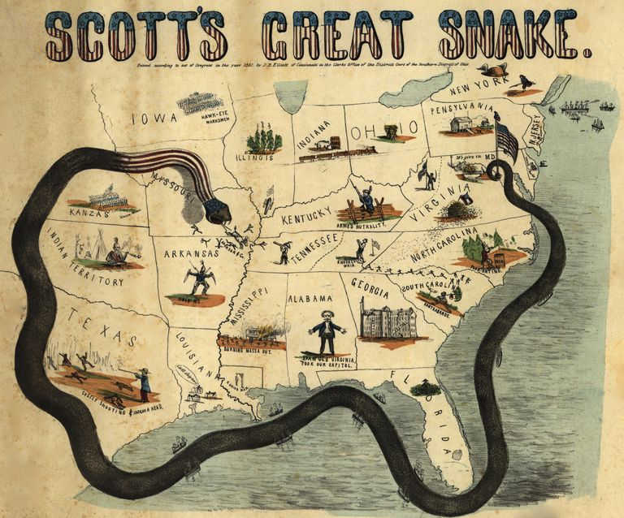

Slide 18
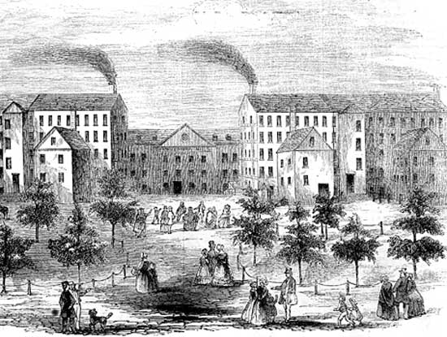
British cotton textile mills

Slide 19
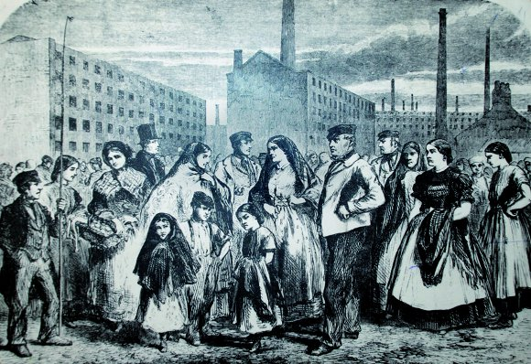
Victim’s of England’s “Cotton Famine”

Slide 20
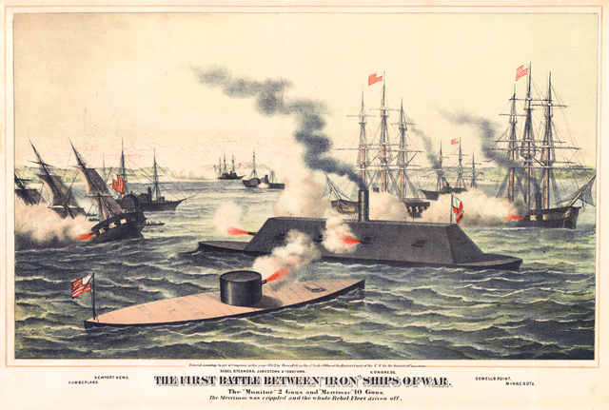

Slide 21
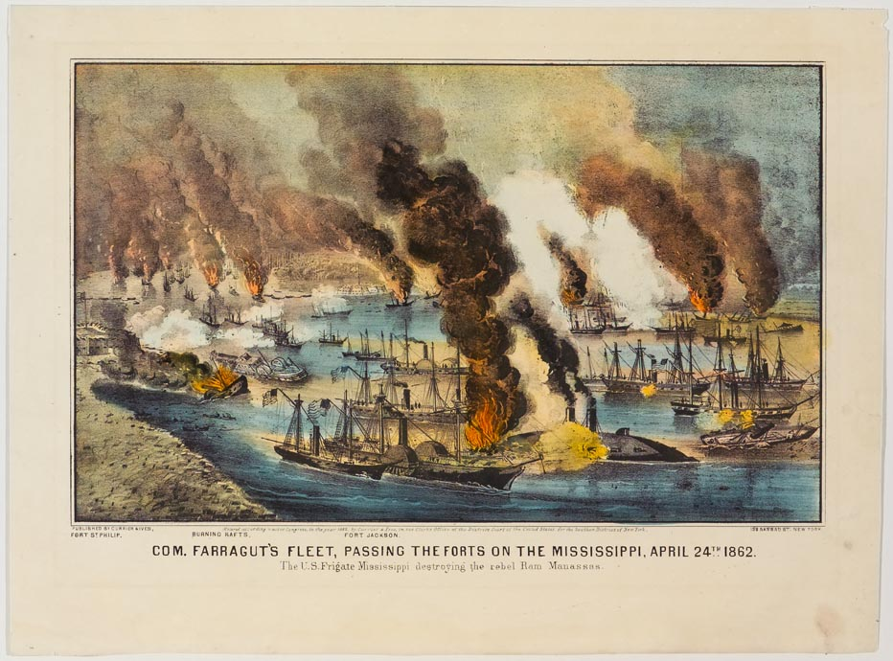

Slide 22
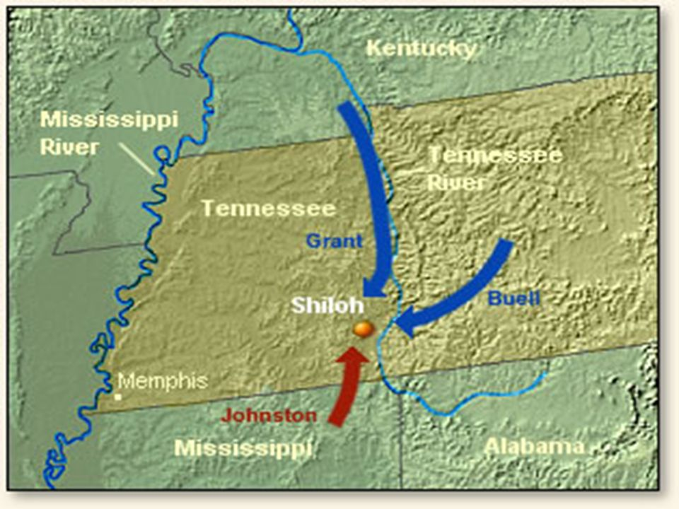
Ulysses Grant defeats Sidney Albert Johnston at Shiloh in SW Tennessee, April 1862
Over 20,000 casualties

Slide 23
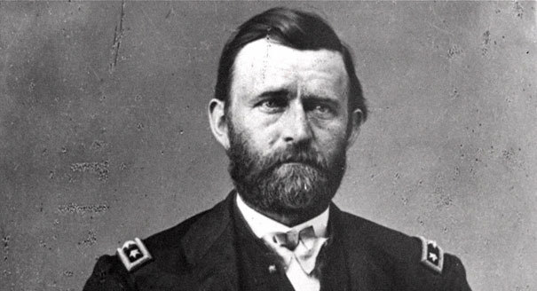

Slide 24
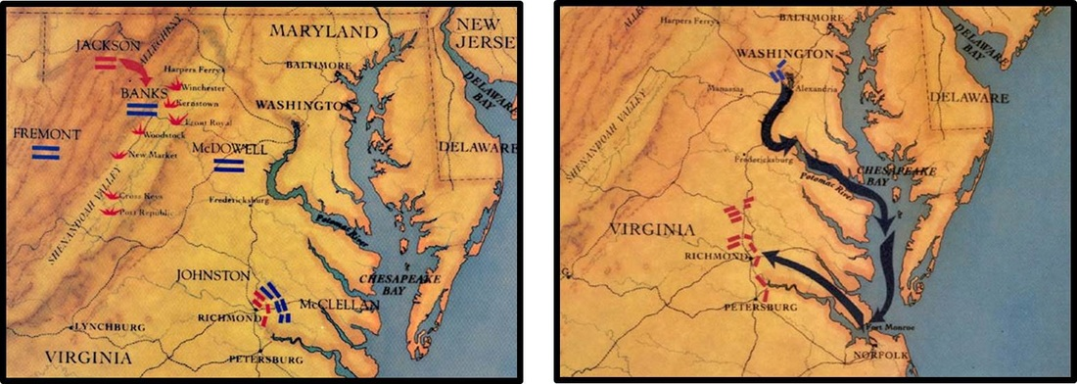
Stonewall Jackson threatens Washington as McClellan fails to take Richmond

Slide 25
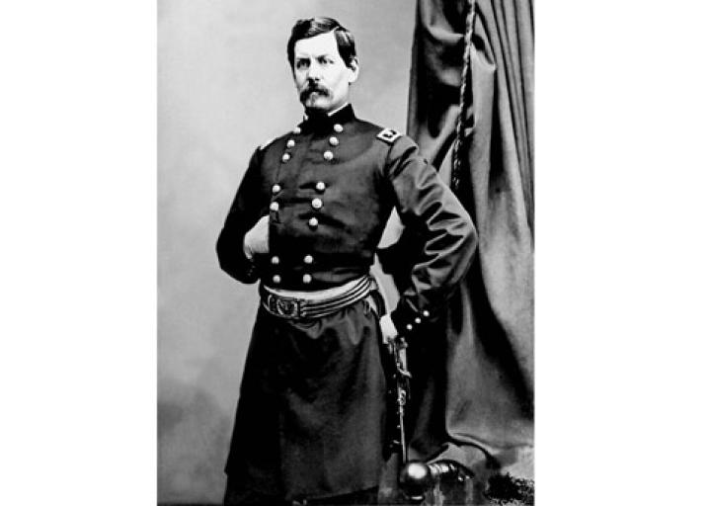
“Little Napoleon,” George McClellan
Commander of Union Armies
1864 Presidential Candidate

Slide 26
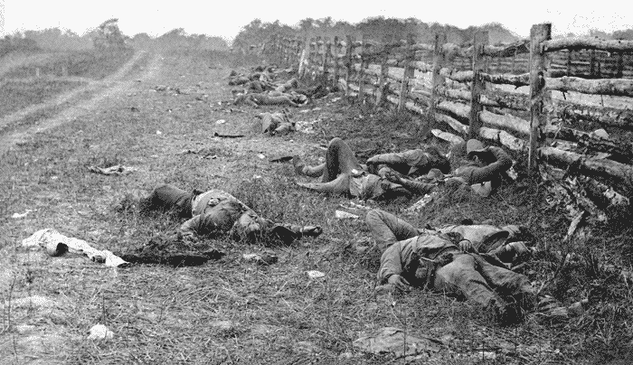
Antietam – September 1862 – Bloodiest single day in the Civil War

Slide 27
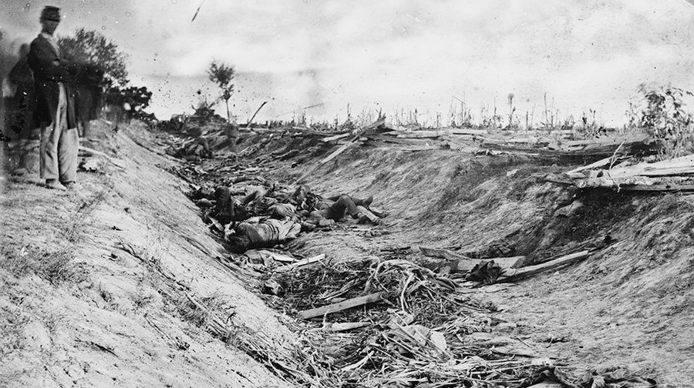

Slide 28
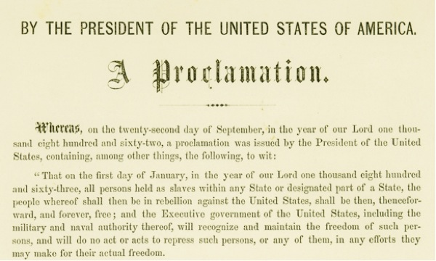

Slide 29
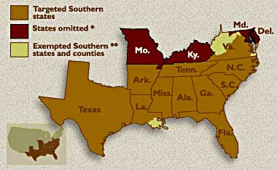

Slide 30
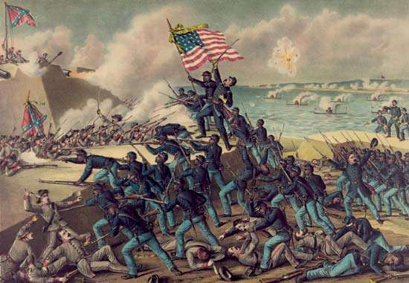
The Massachusetts 54th assaults Fort Wagner, SC

Slide 31
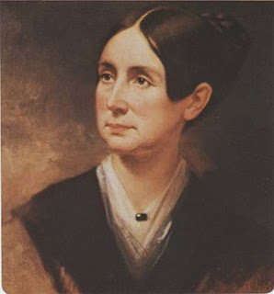
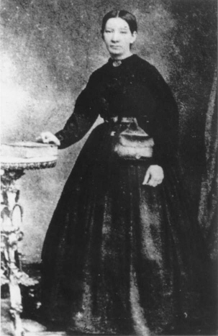
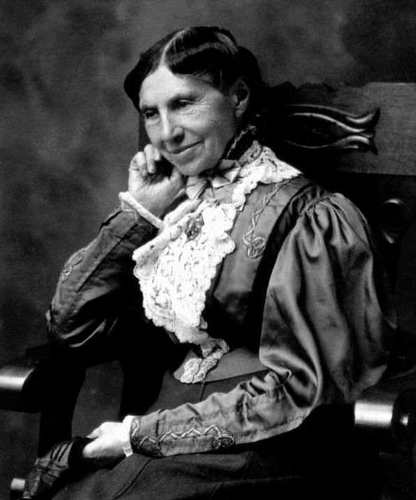
Clara Barton
Dorothea Dix
Sally Tompkins

Slide 32
Republican Wartime Legislation
Protective Tariff
Transcontinental Railroad
Homestead Act
Legal Tender Act
Internal Revenue Act

Slide 33
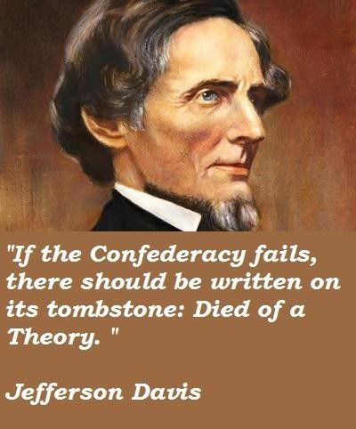

Slide 34
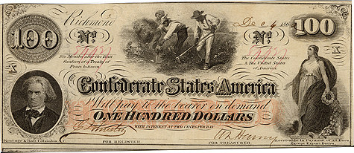

Slide 35
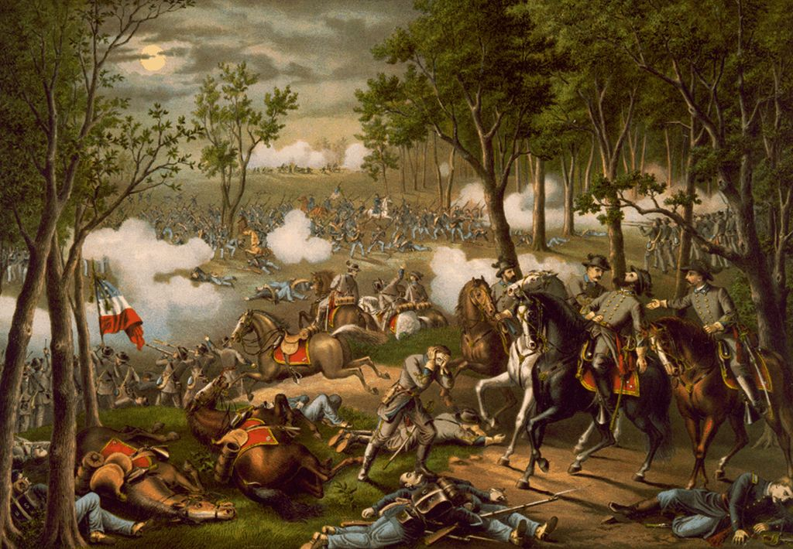
Stonewall Jackson fatally wounded at Chancellorsville

Slide 36
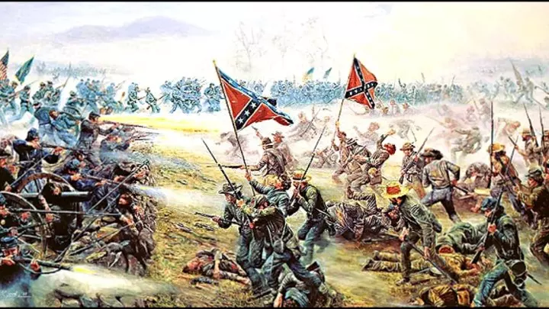

Slide 37
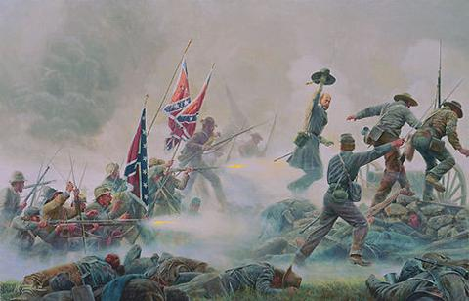

Slide 38
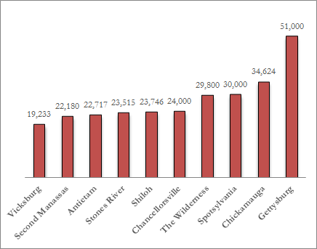

Slide 40
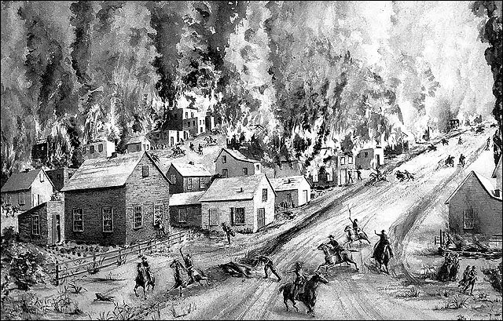
Quantrill’s raid on Lawrence, Kansas
August 21, 1863

Slide 41
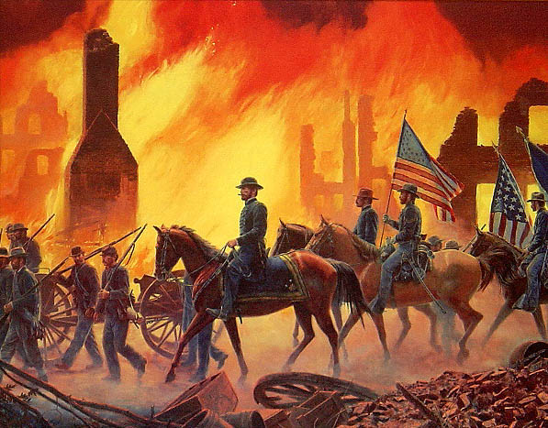
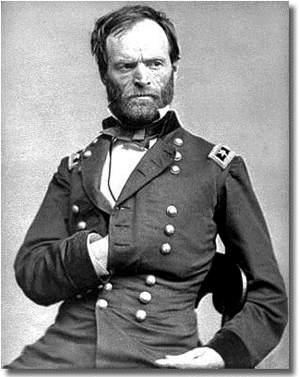
Sherman’s March,
Atlanta to Savannah, 1864

Slide 42
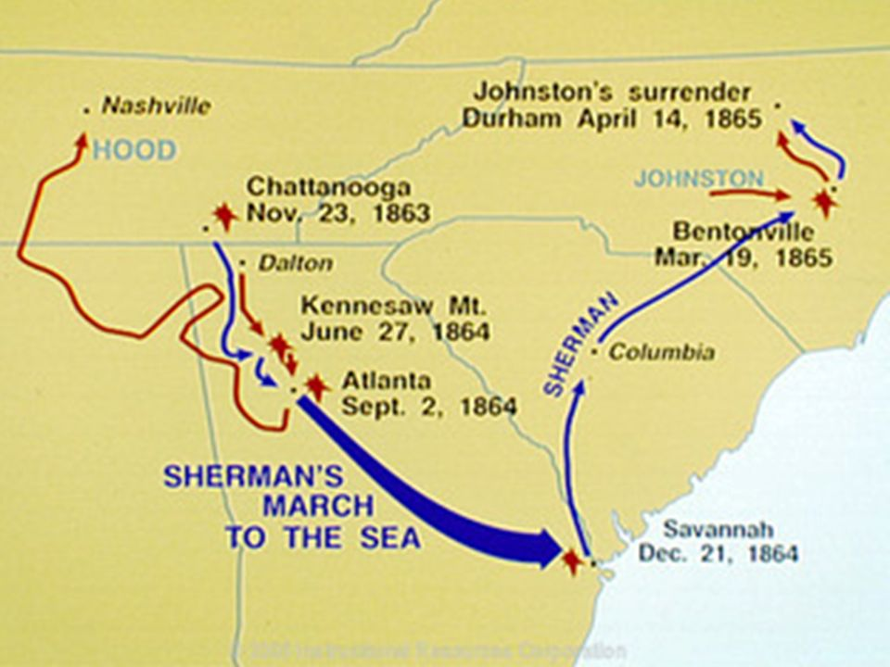

Slide 43
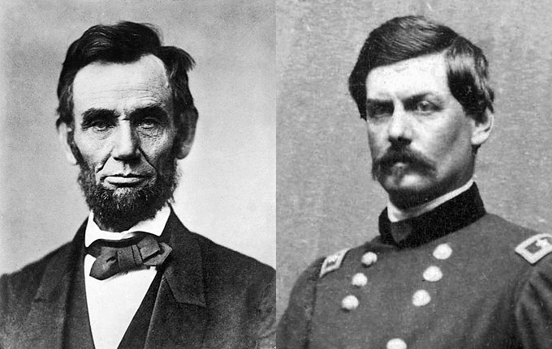

Slide 44
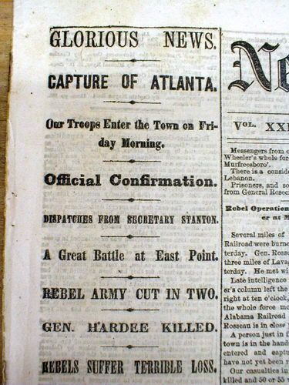
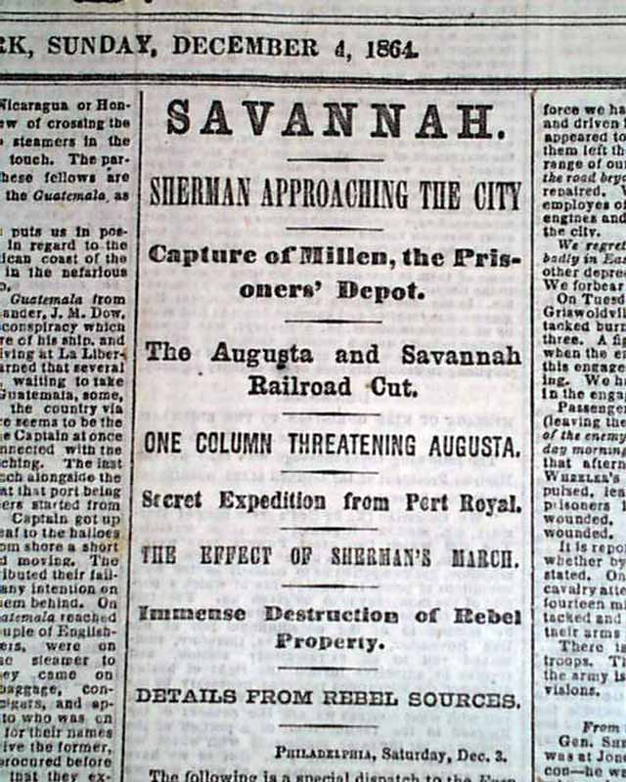
Good news from Georgia
September 1864
and December 1864

Slide 45
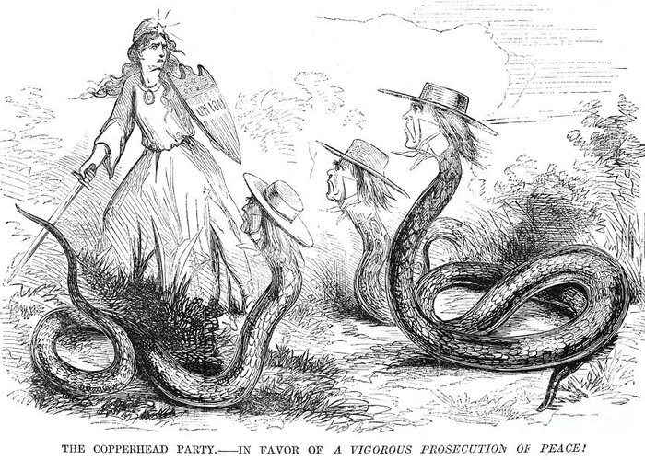

Slide 46
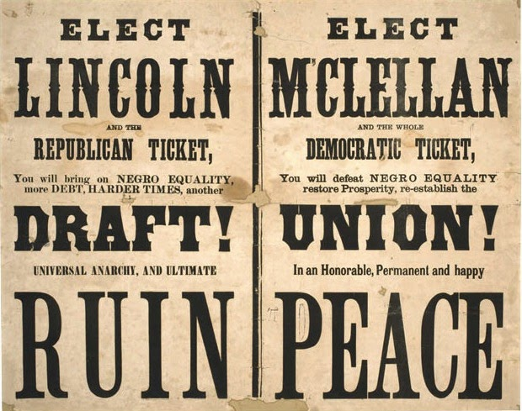

Slide 47
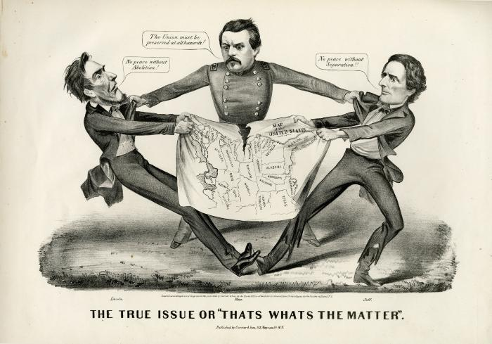

Slide 48
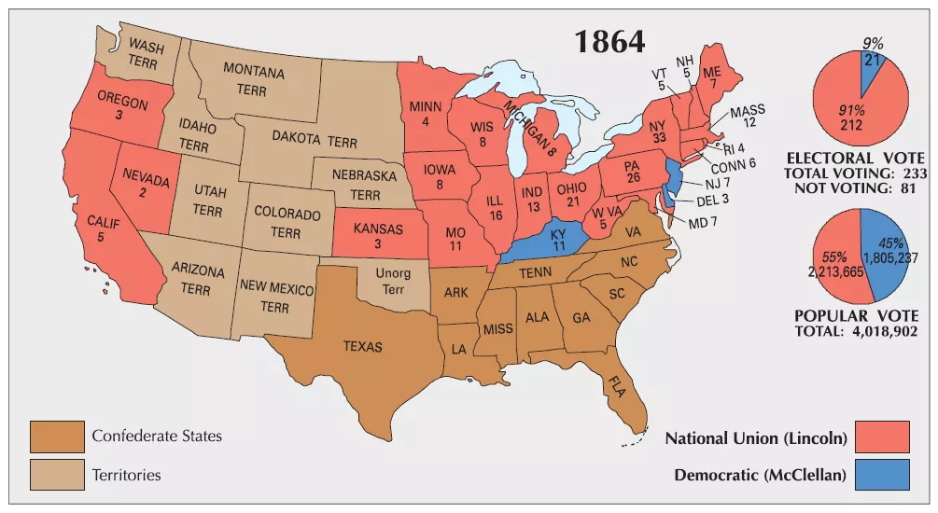

Slide 50
Appomattox Court House, April 9, 1865 – Lee surrenders to Grant

Slide 51
Civil War facts
Over 600,000 men died
One out of every 12 men served in the war
Technological advances in weaponry increased the number of casualties
American losses were greater than in WWII
Disease caused more deaths than battle injuries

