Slide 1
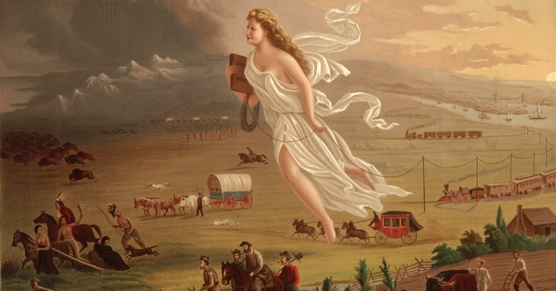
“Manifest Destiny”

Slide 2
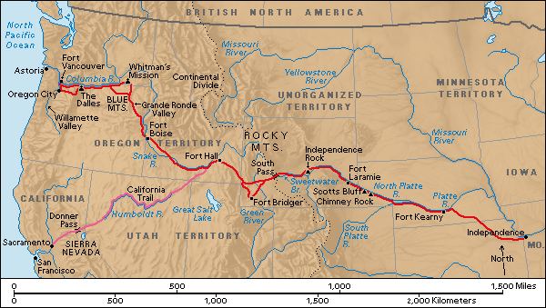
Oregon Trail – Independence, Missouri to Oregon City

Slide 3
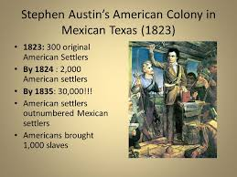

Slide 5
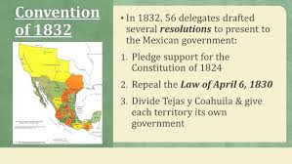

Slide 6
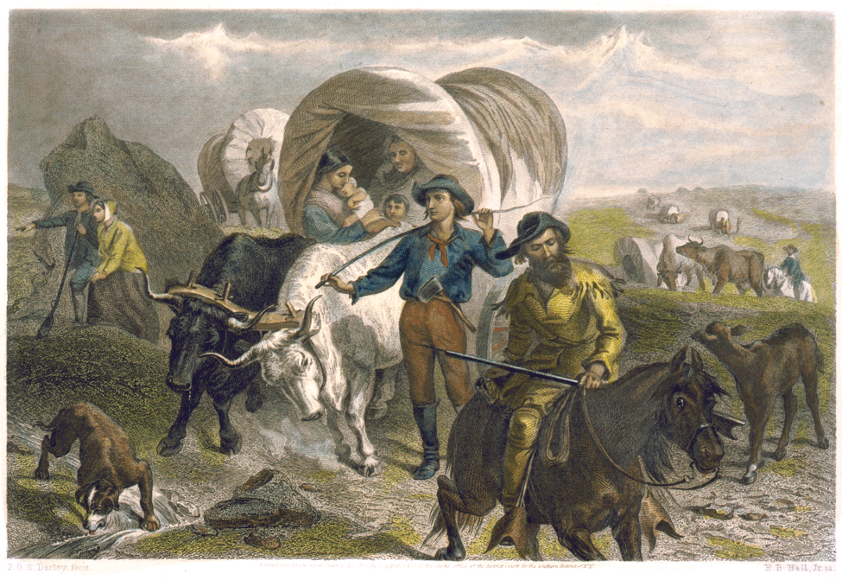
Americans flow into Mexico.
Some brought slaves.
Many called for self-rule rather than obey laws passed by Mexican Congress.

Slide 7
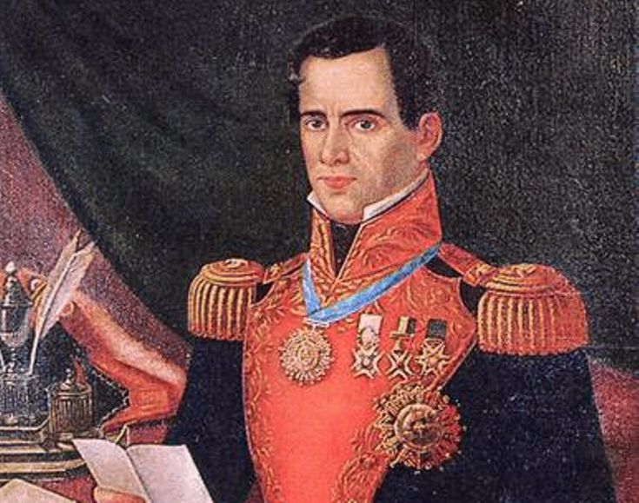
General Antonio Lopez de Santa Anna,

Slide 8
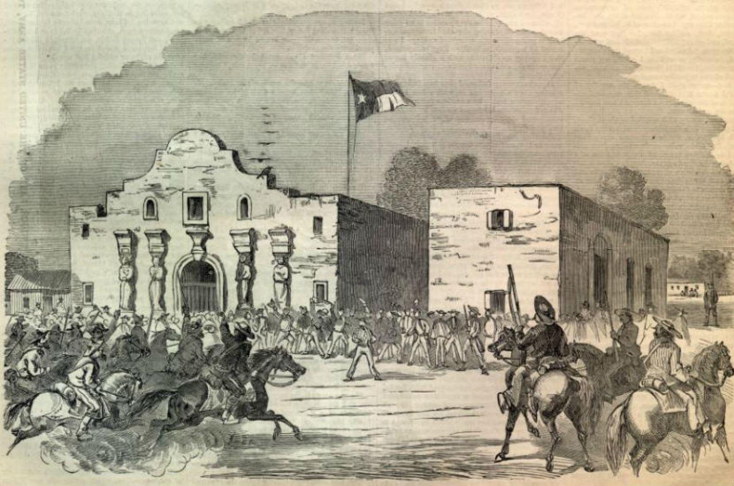
Battle of the Alamo, Feb. 23 to March 6, 1836

Slide 9
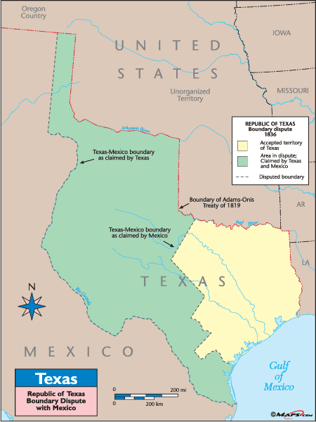
Texas declares independence, March 2, 1836

Slide 12
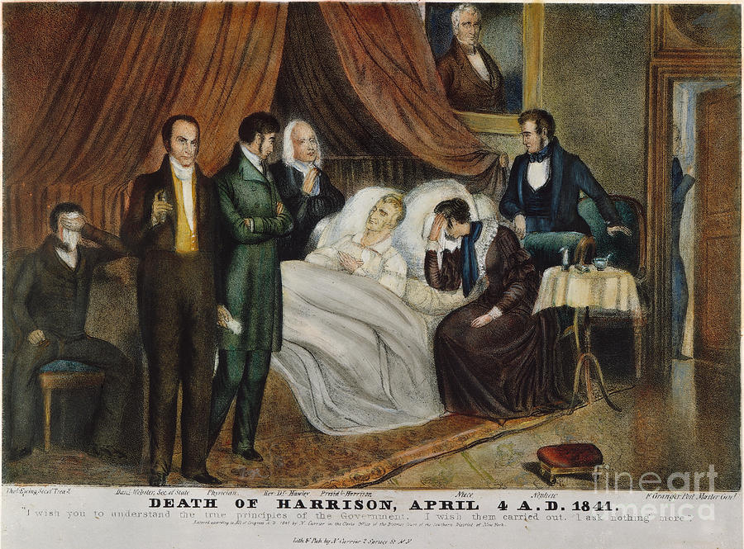

Slide 13
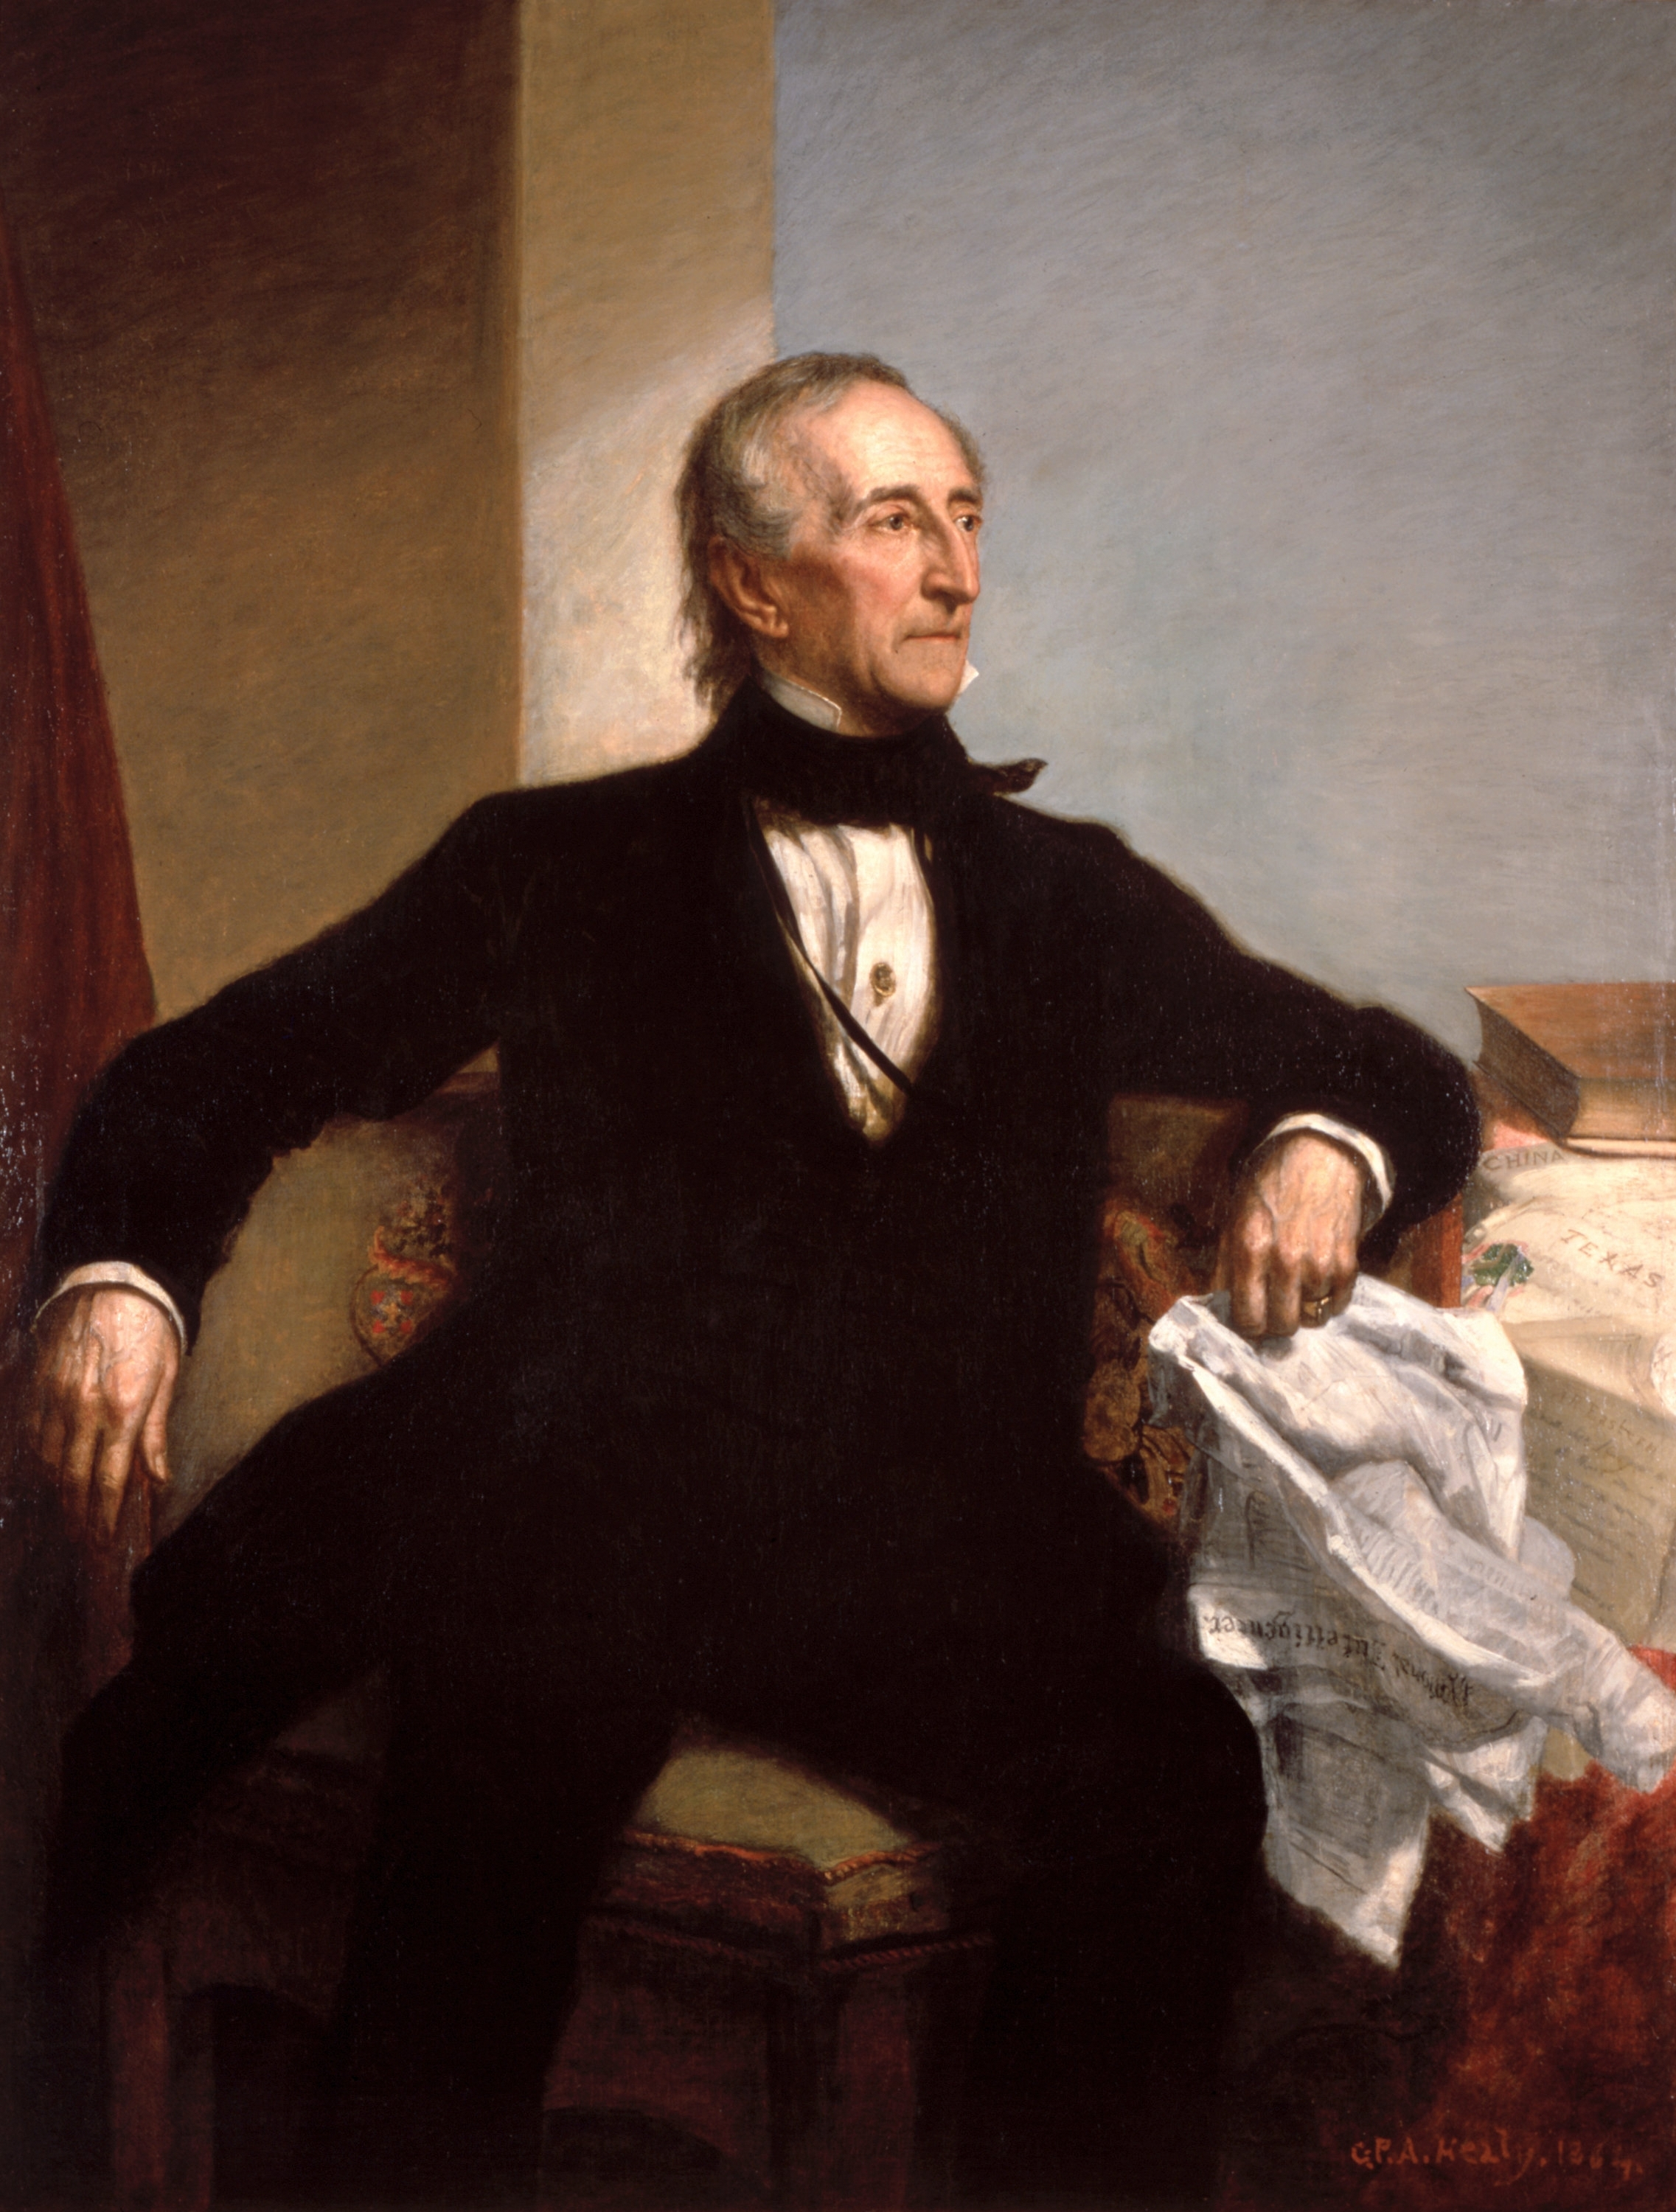
John Tyler
Became president when Harrison died
Former Democrat
Blocked Whig agenda
Cabinet resigned (except Webster)
Expelled from Whig party, 1841
“President without a party”

Slide 14
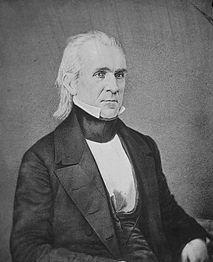
James Polk
Democrat, elected President in 1844
Expansionist
Wanted to annex Texas immediately
Wanted to seize Oregon territory

Slide 17
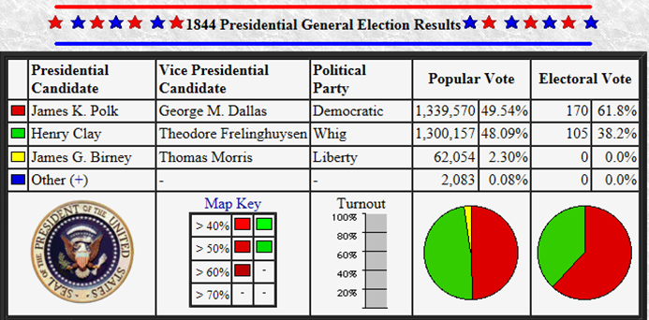

Slide 18
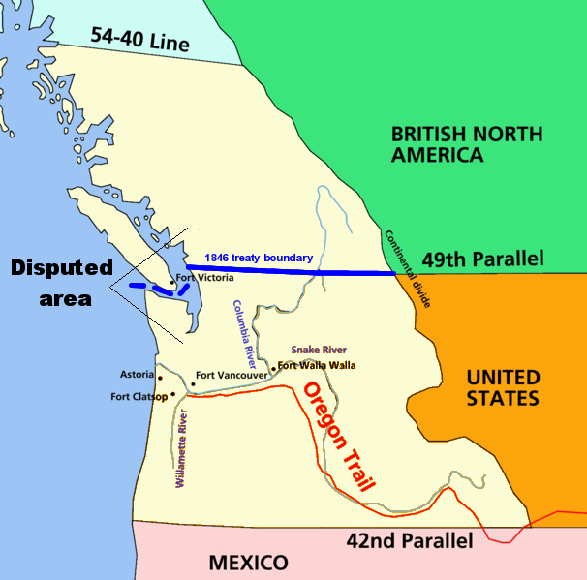
1846 Orgeon Treaty settled Oregon boundary dispute by establishing border at 49th parallel

Slide 20
1846

Slide 21
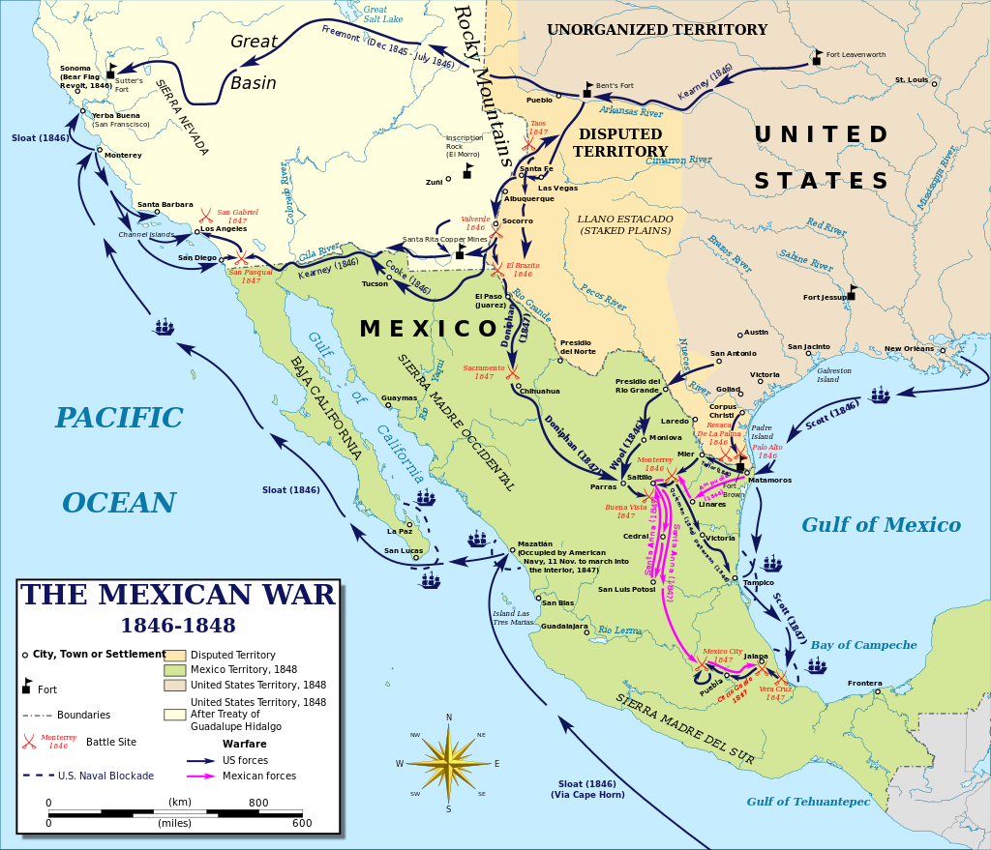

Slide 22
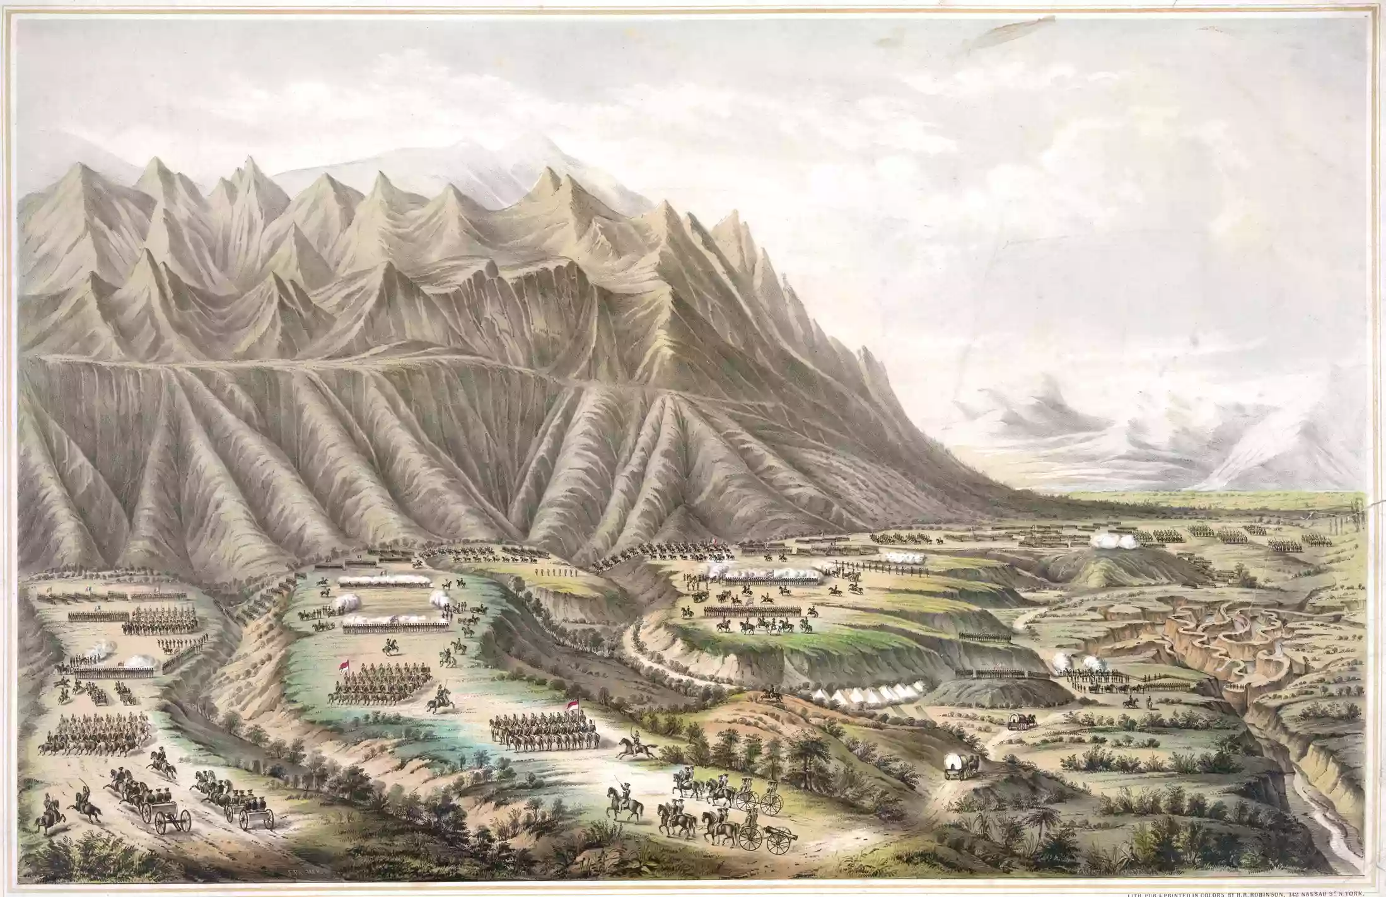

Slide 23
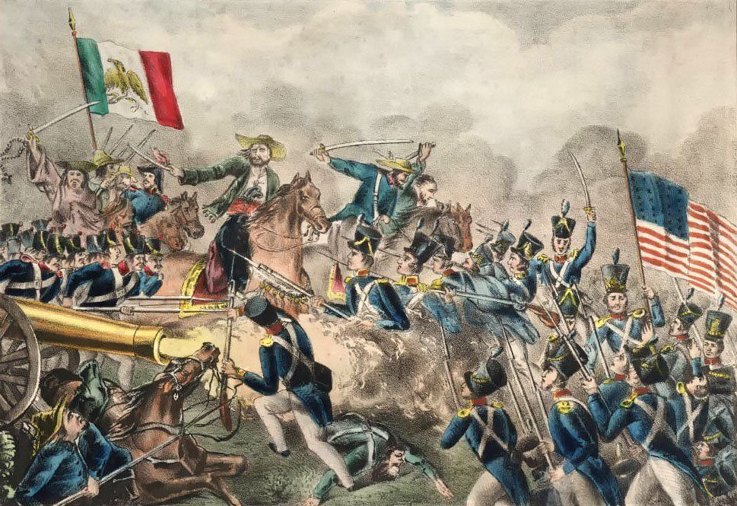

Slide 24
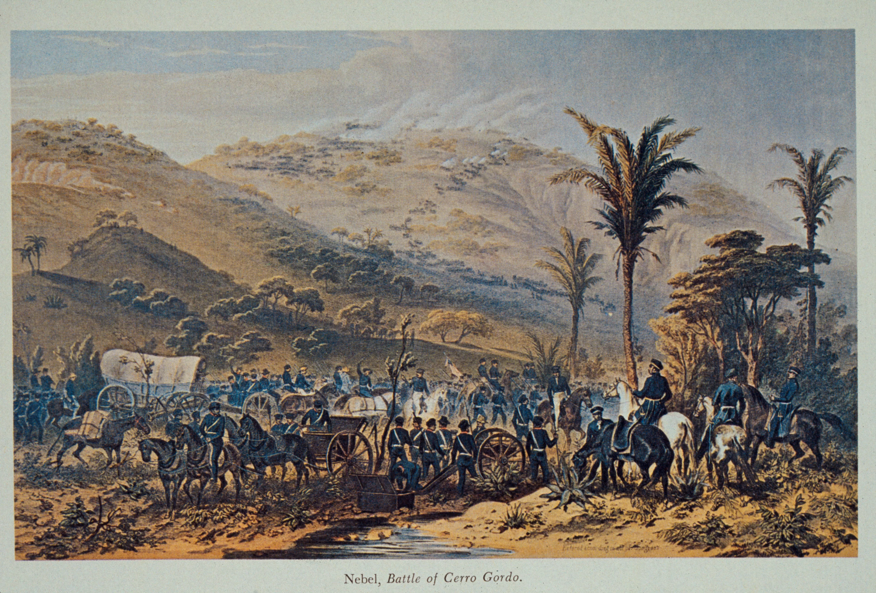

Slide 25
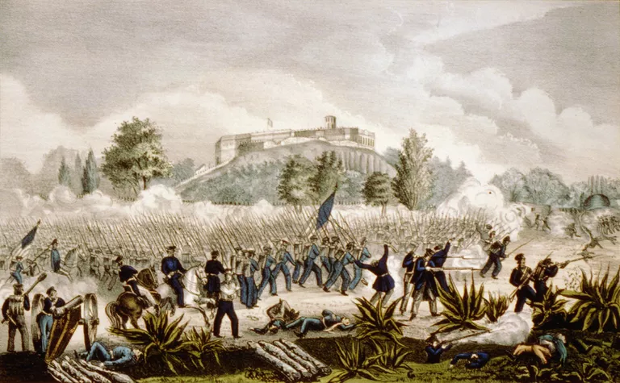

Slide 26
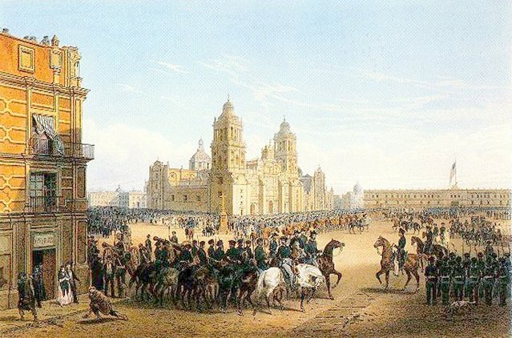

Slide 27
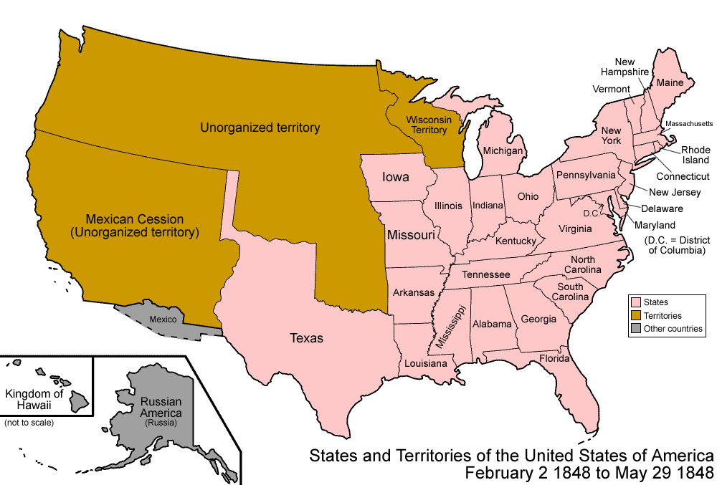

Slide 30
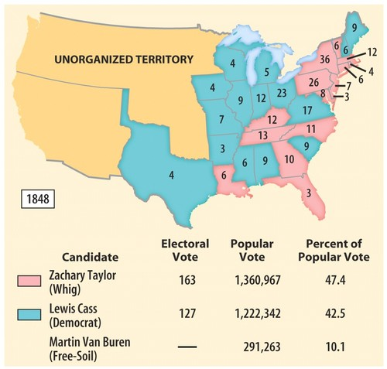
Election of 1848
Taylor (Whig) defeats Cass (Democrat)
and Van Buren
(Free Soil)

Slide 32
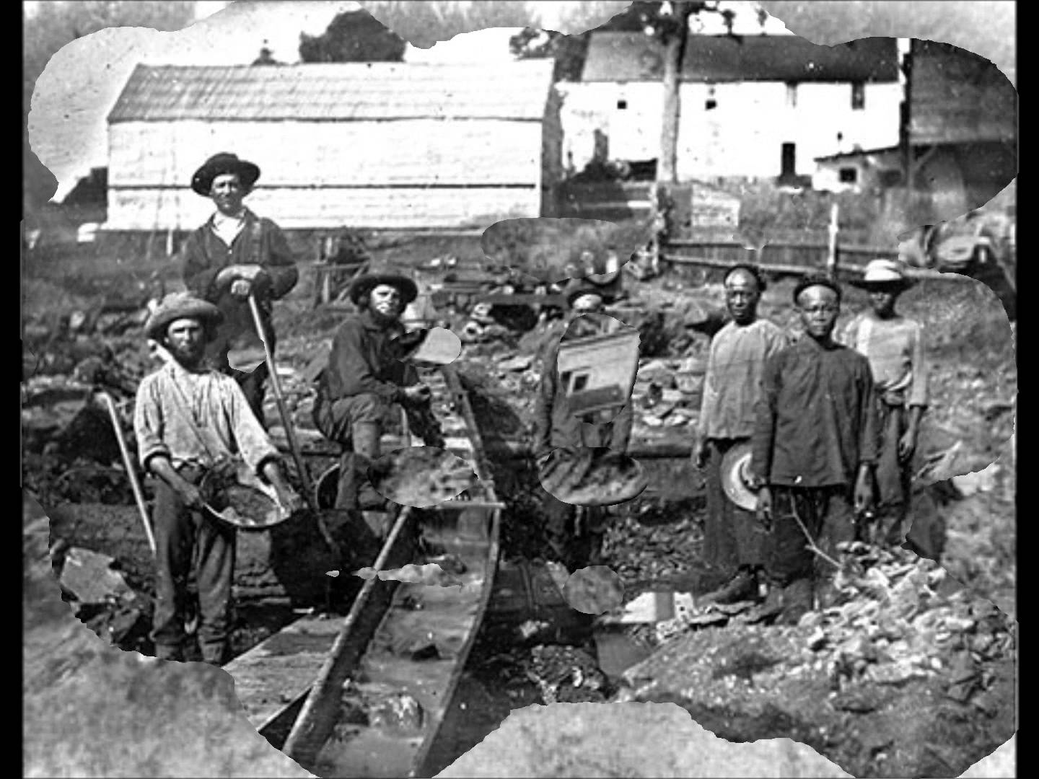

Slide 33
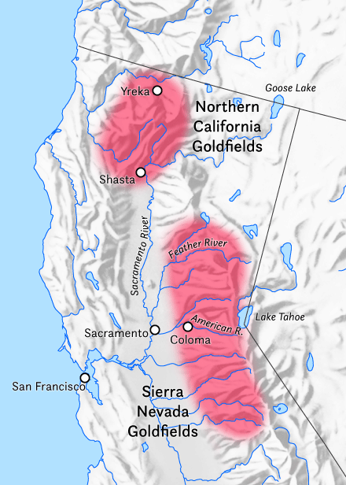

Slide 34
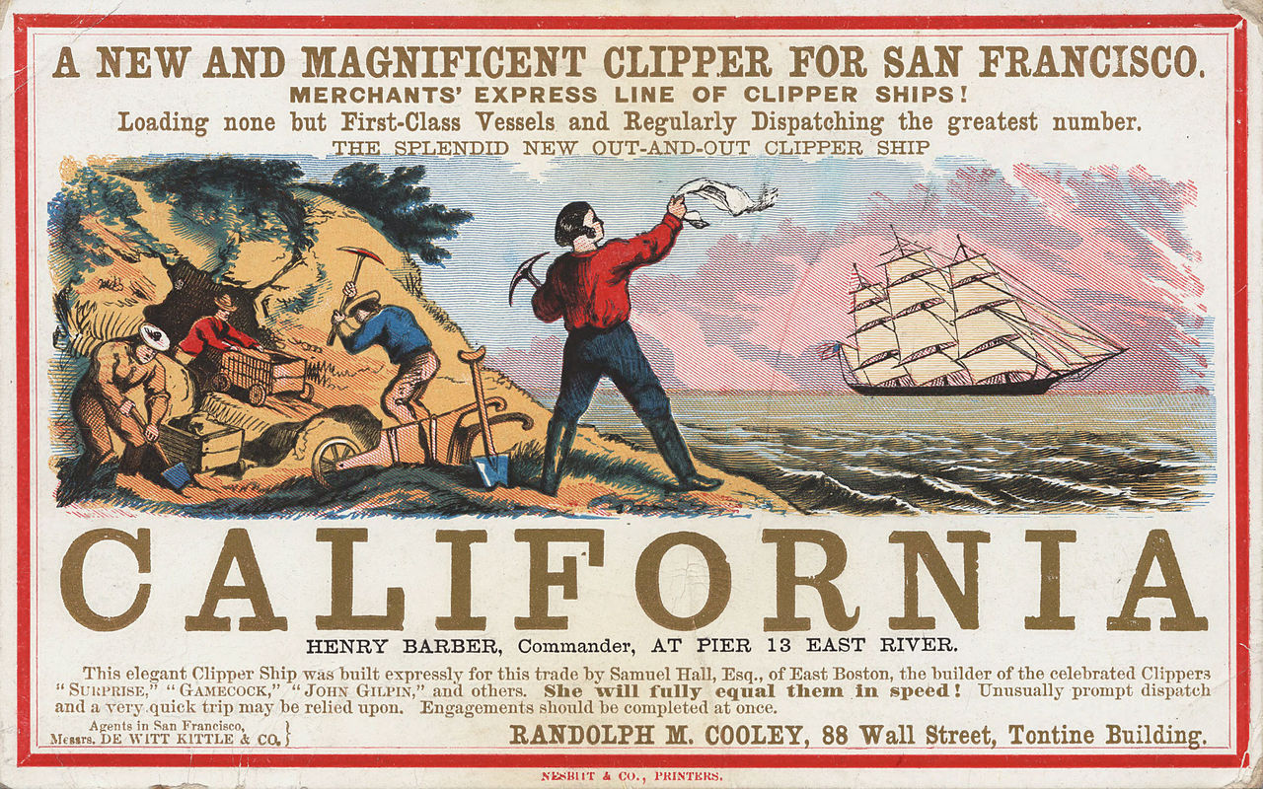

Slide 35
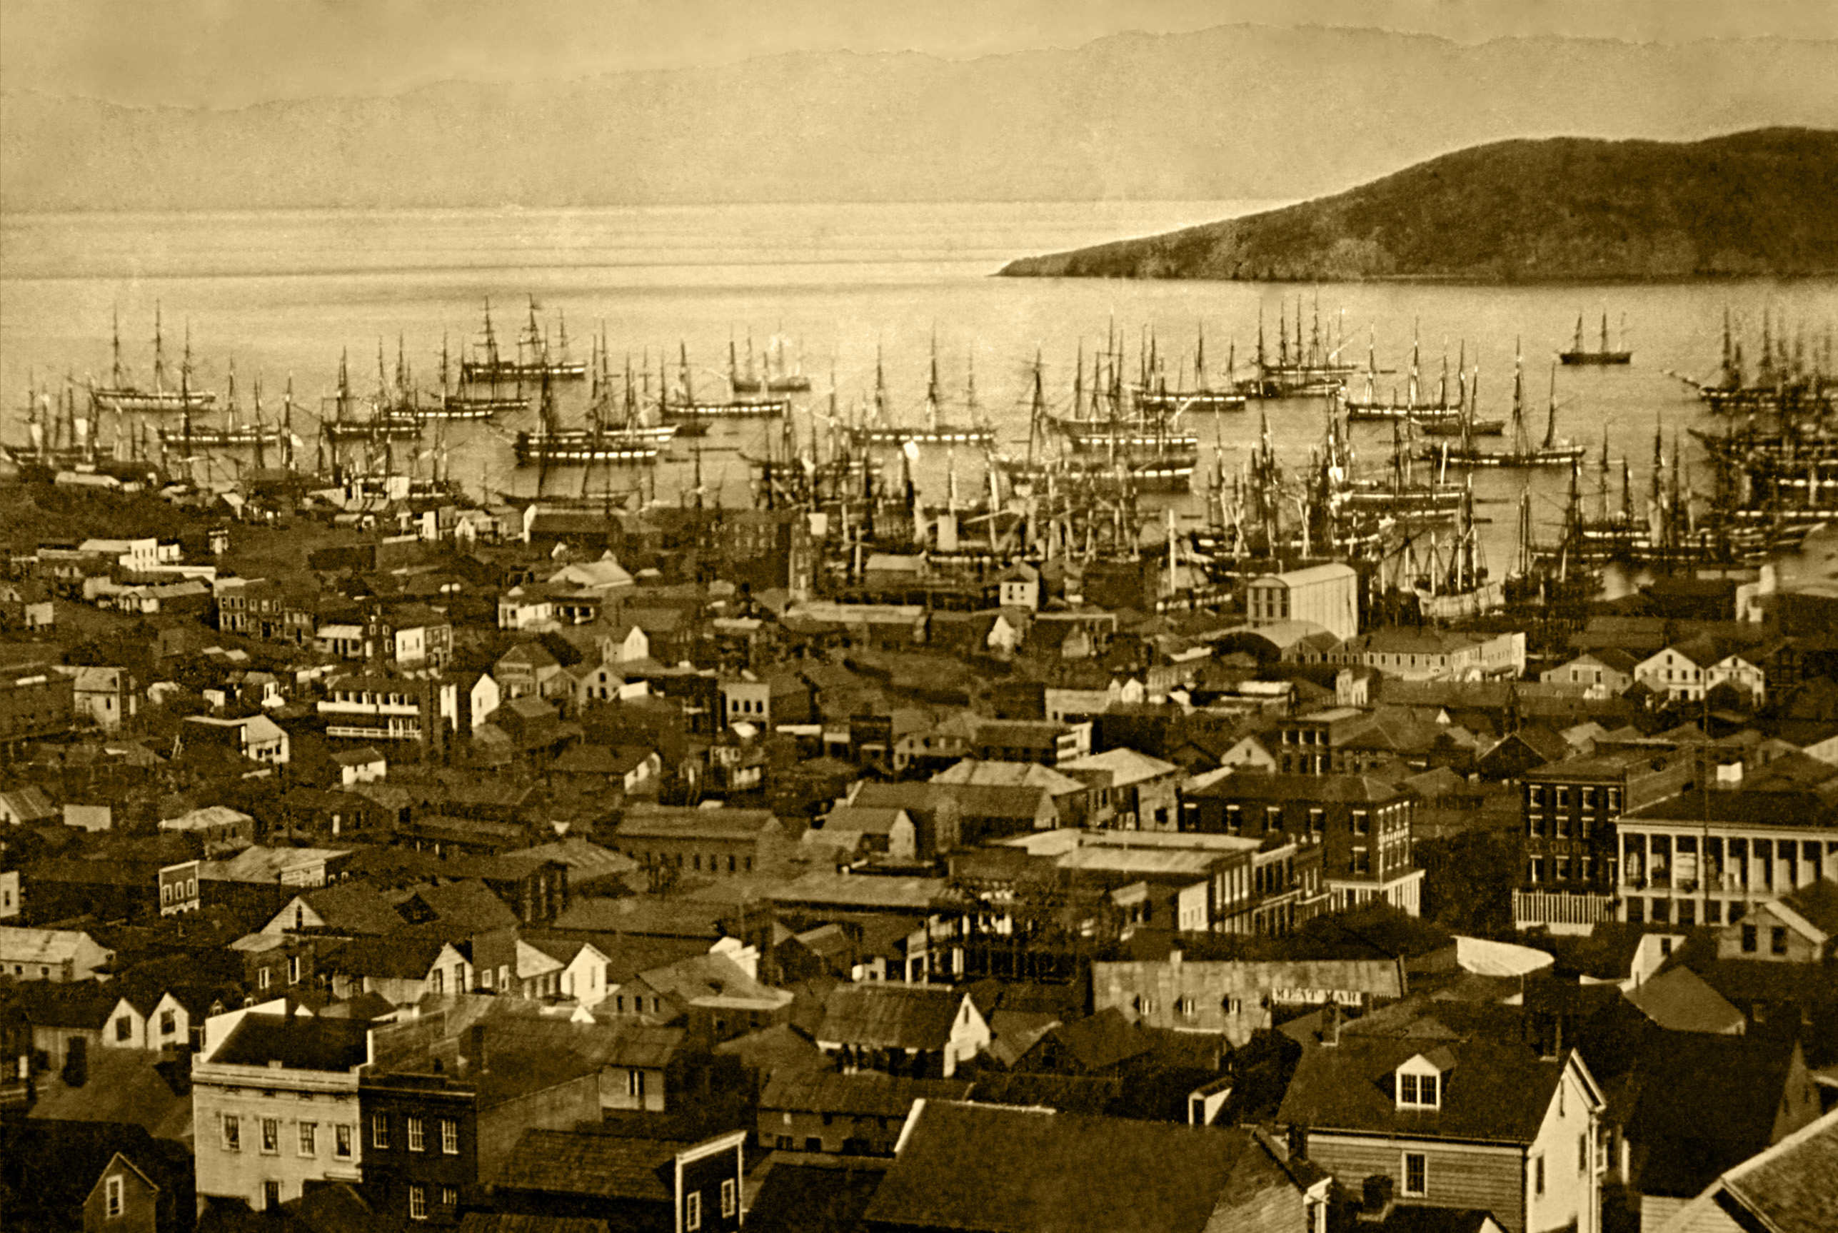
San Francisco, 1851

Slide 36
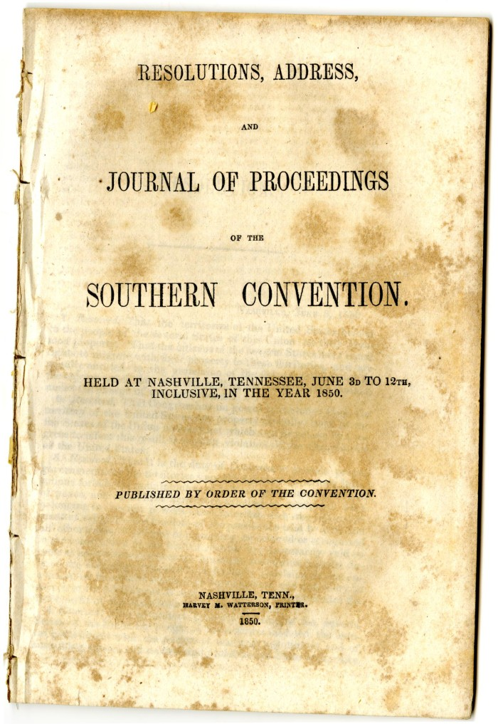
Nashville
States Rights Convention, 1850

Slide 38
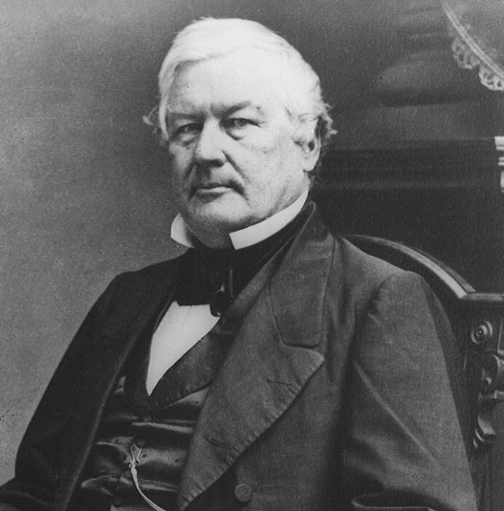
Millard Fillmore
Succeeded Zachary Taylor as President, 1850

Slide 39
Compromise of 1850
- California to be admitted as a FREE state
- New Mexico and Utah to become territories
without any restriction as to slavery
- Boundaries of Texas firmly established (Texas
compensated for land it cedes)
- New Fugitive Slave Act passed
- Slave trade abolished in District of Columbia

Slide 40
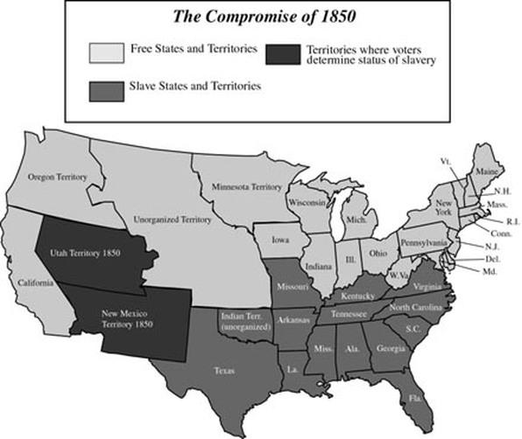

Slide 41
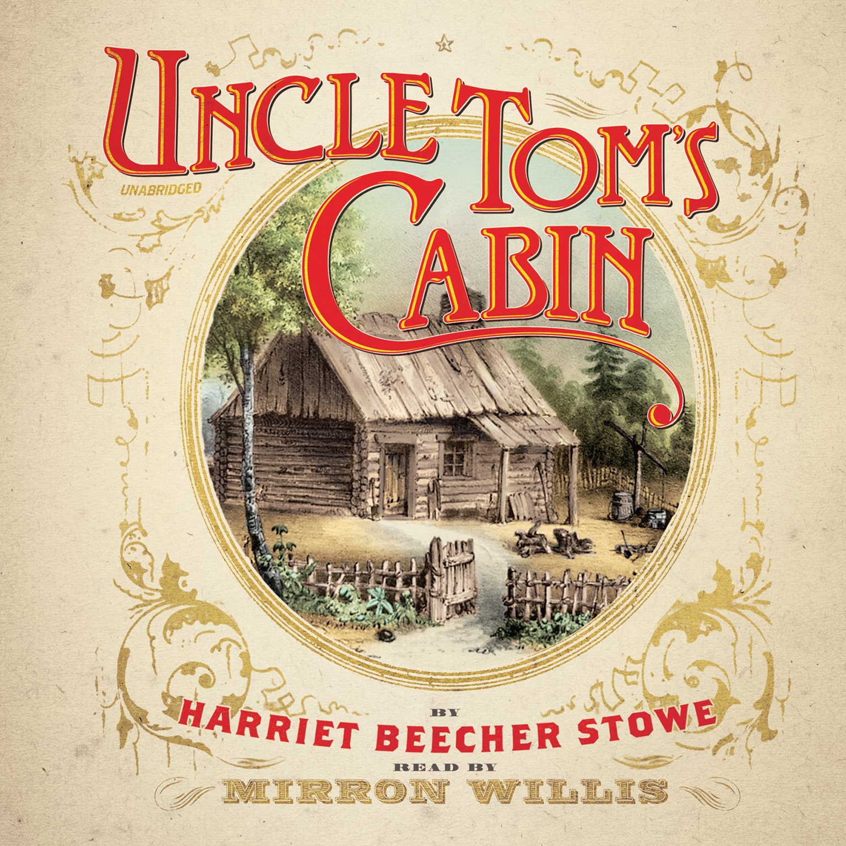
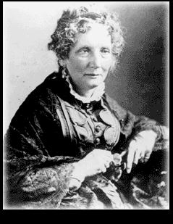

Slide 42
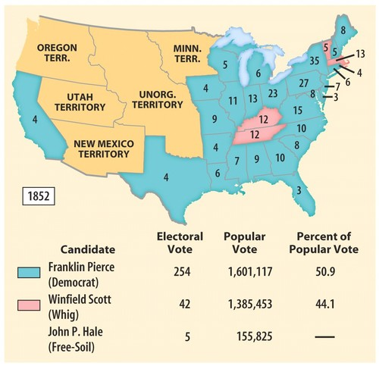

Slide 44
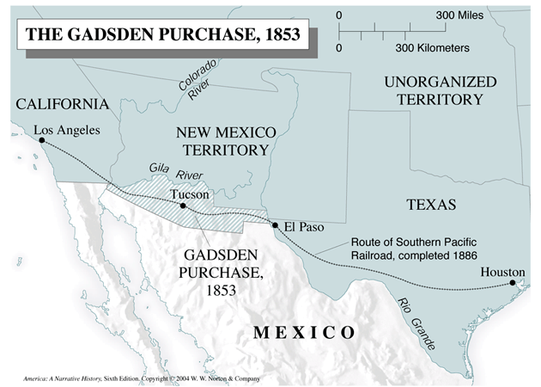

Slide 45
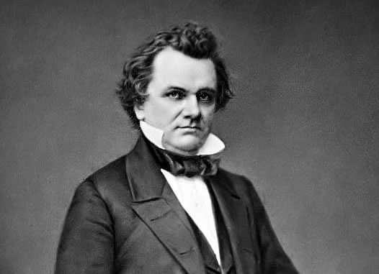
Senator Stephen Douglas of Illinois

Slide 47
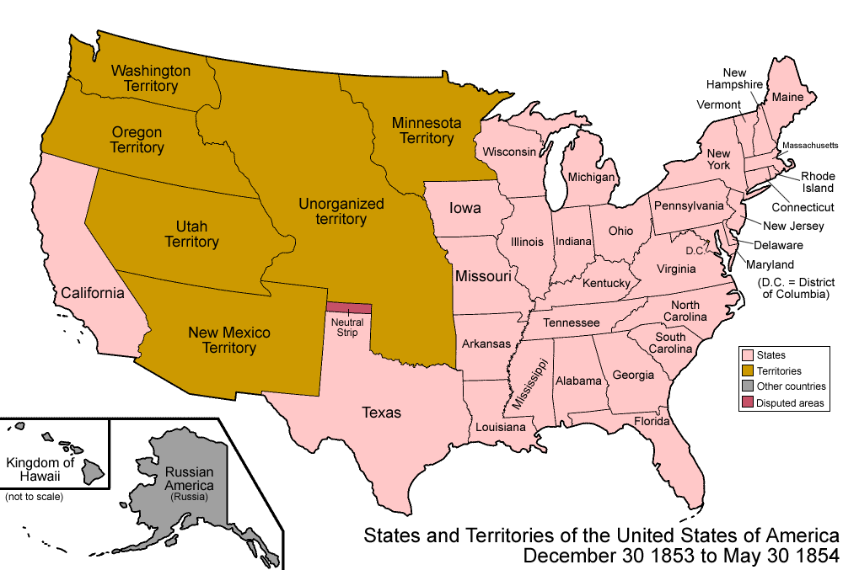

Slide 49
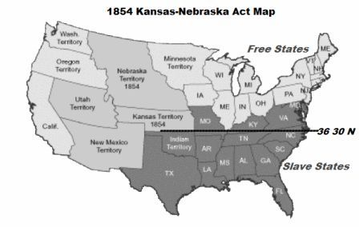
Northerners opposed the Kansas-Nebraska Act because it basically repealed the Missouri Compromise ban on slavery north of 36’30

Slide 50
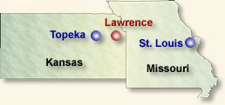

Slide 51
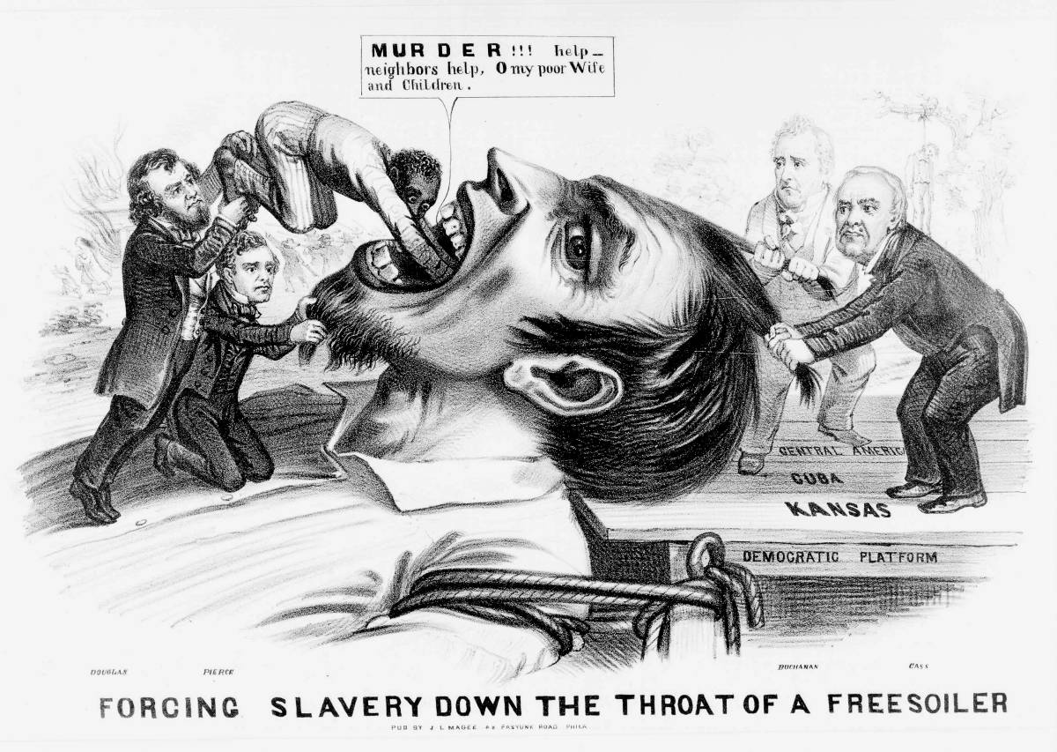

Slide 52
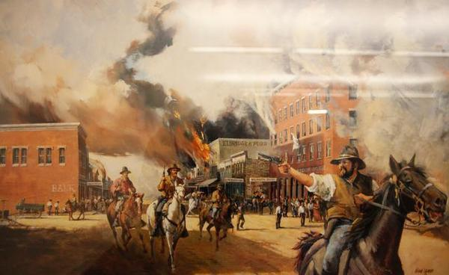

Slide 53
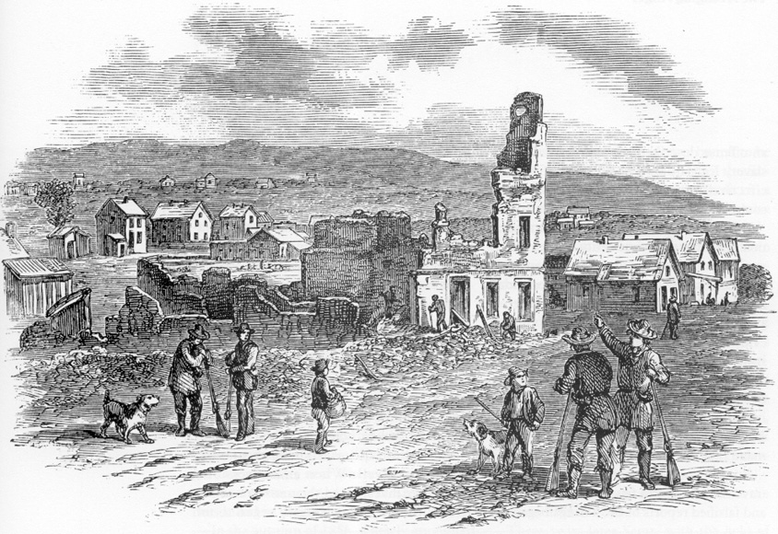

Slide 54
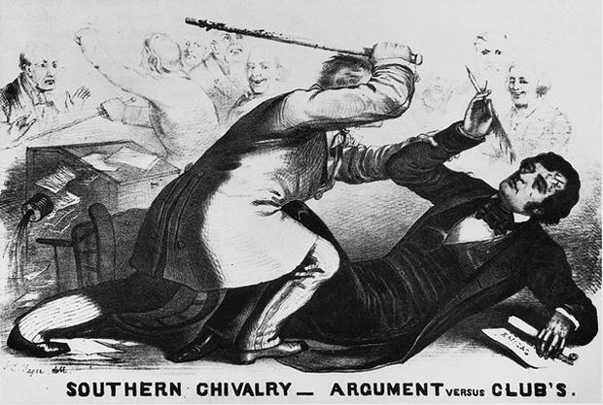

Slide 57
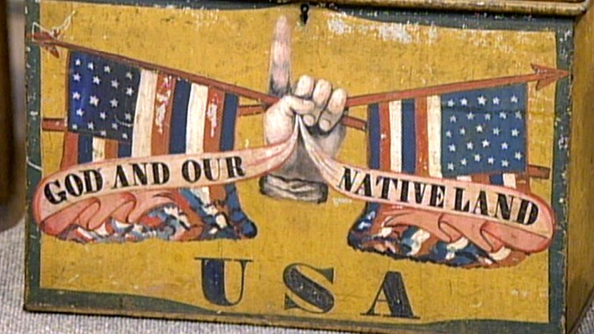
1854 American/Know-Nothing Party promotional tin box

Slide 58
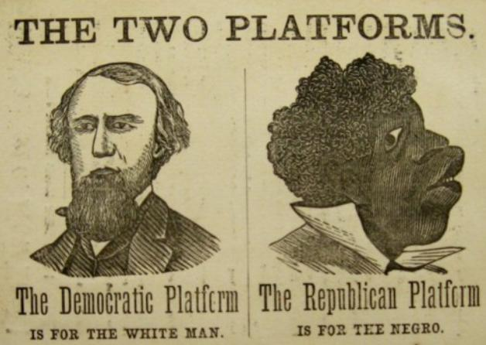
1856 Anti-Republican election poster

Slide 59
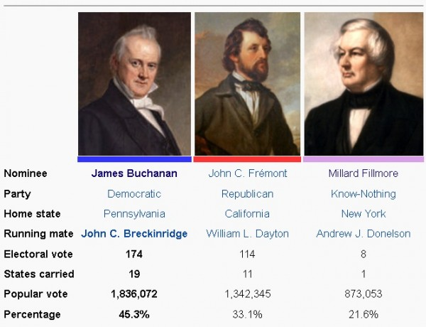
1856 Election
Buchanan (Democrat) defeats Fremont (Republican) and
Fillmore (Know-Nothing)

Slide 62
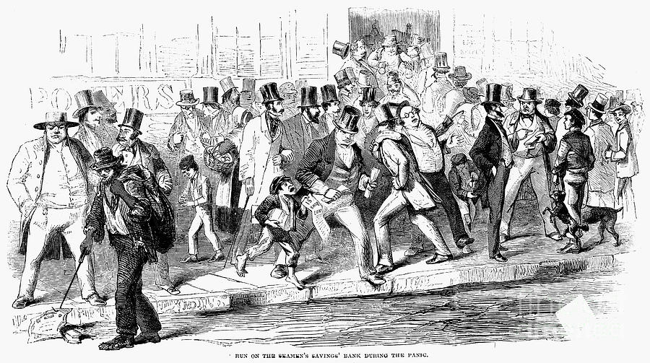

Slide 63
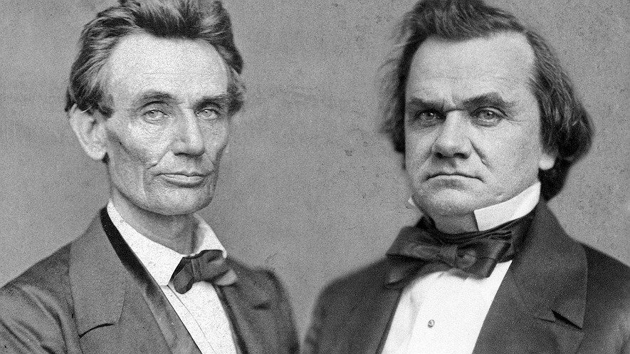

Slide 64
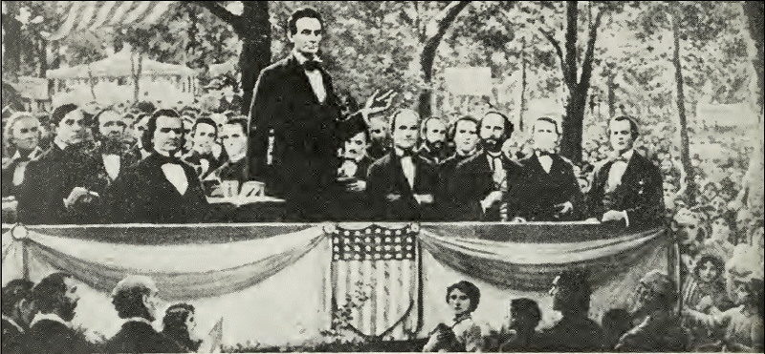
Though Stephen Douglas won the Illinois Senate race, the Lincoln-Douglas debates improved Lincoln’s chances in the upcoming 1860 Presidential election.

Slide 65
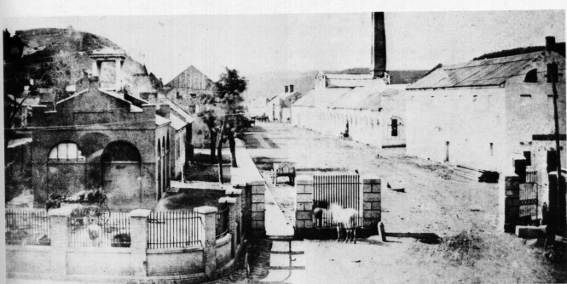
Federal Arsenal at Harper’s Ferry, Virginia

Slide 66
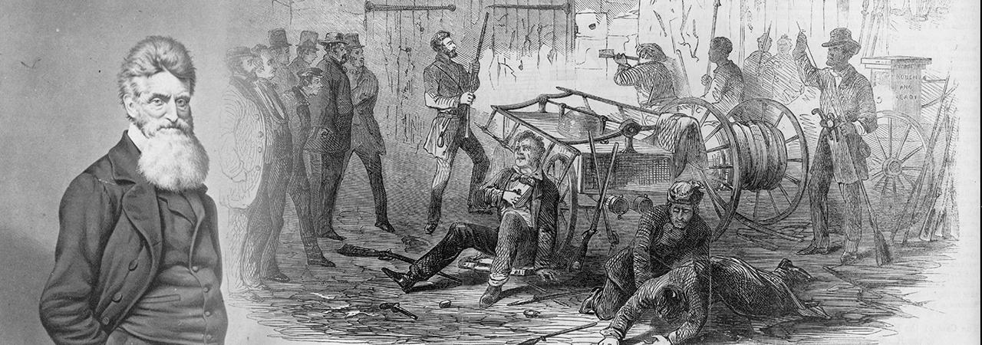
John Brown’s 1859 attempt to arm slaves with weapons seized at the Harper’s Ferry arsenal in Virginia failed; ten of Brown’s men died and he was later hanged for treason

Slide 67
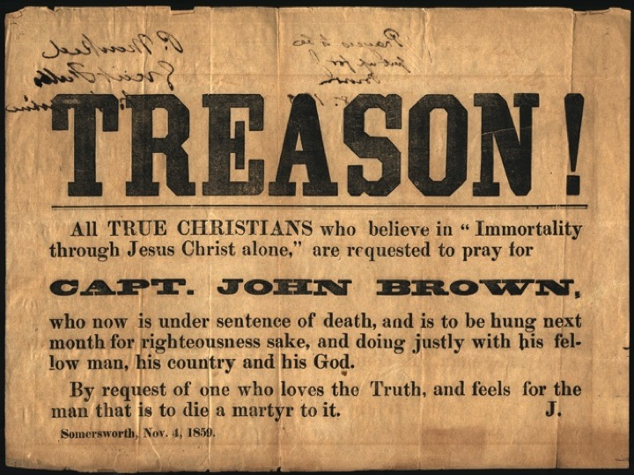

Slide 68
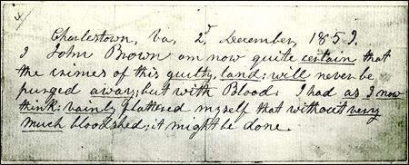
“I John Brown am now quite certain that the crimes of this guilty land will never be purged away but with Blood. I had as I now think vainly flattered myself that without very much bloodshed it might be done.”

Slide 74
Presidential Election of 1860

Slide 75
Lincoln wins election by sweeping the free states

Slide 76
Crittenden Compromise
Proposed Dec. 18, 1860, just after Lincoln won the Presidential election
Crittenden proposed series of amendments that would have allowed slavery in the territories south of 36’30 and guaranteed continuance of slavery where it already existed

Slide 78
Following Lincoln’s election, seven states secede because Southerners fear that Lincoln and his fellow Republicans will try to abolish slavery.
South Carolina secedes on December 20, 1860.

Slide 80
President James Buchanan did nothing in response to secession

Slide 81
"I have no purpose, directly or indirectly, to interfere with the institution of slavery in the States where it exists. I believe I have no lawful right to do so, and I have no inclination to do so...“
Abraham Lincoln
First Inaugural Address
March 4, 1861

