Slide 1
The “Market Revolution”
Transition from subsistence/barter economy to cash economy.
Goods and crops transported via new roads, canals, and railroads and sold in distant markets.
More and more farmers grew crops for profitable export.
Large-scale manufacturing decreased dependence on foreign imports and increased the number of wage laborers.
Coastal cities grew; new cities sprang up in the interior.
New middle class emerged; immigration soared.
New inventions increased productivity, created opportunities, and changed people’s lives.

Slide 2
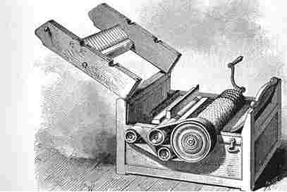
Eli Whitney’s Cotton Gin, 1793

Slide 3
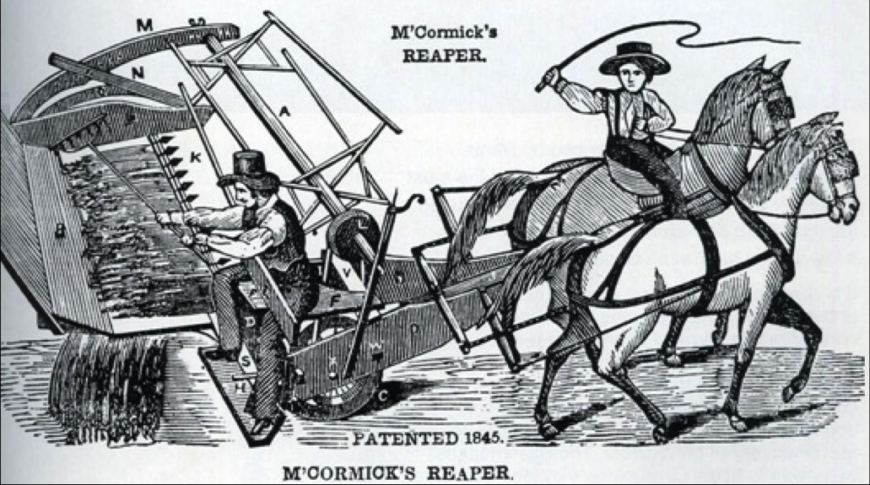

Slide 4
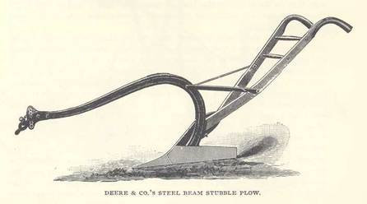
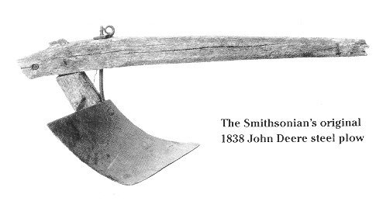
John Deere’s
Steel Plow

Slide 5
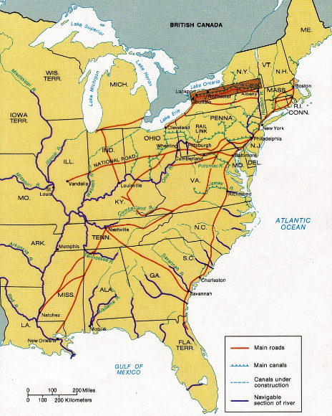
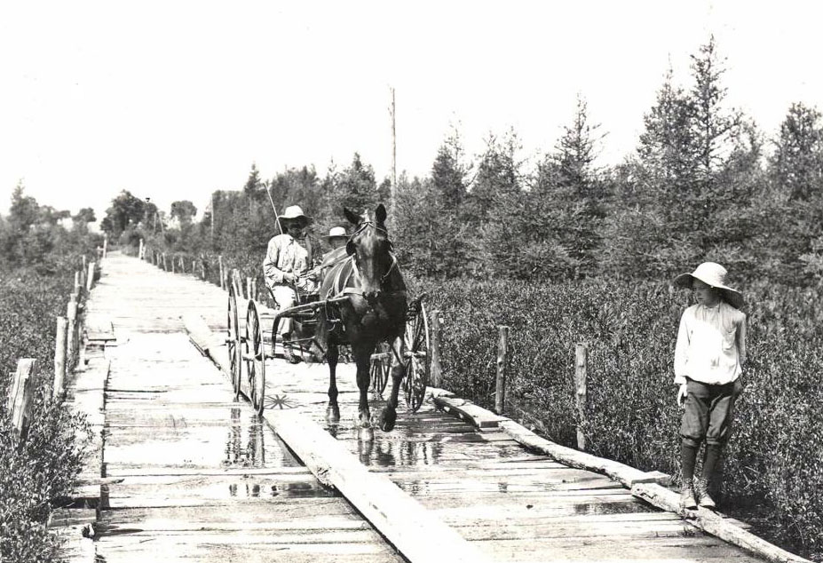

Slide 6
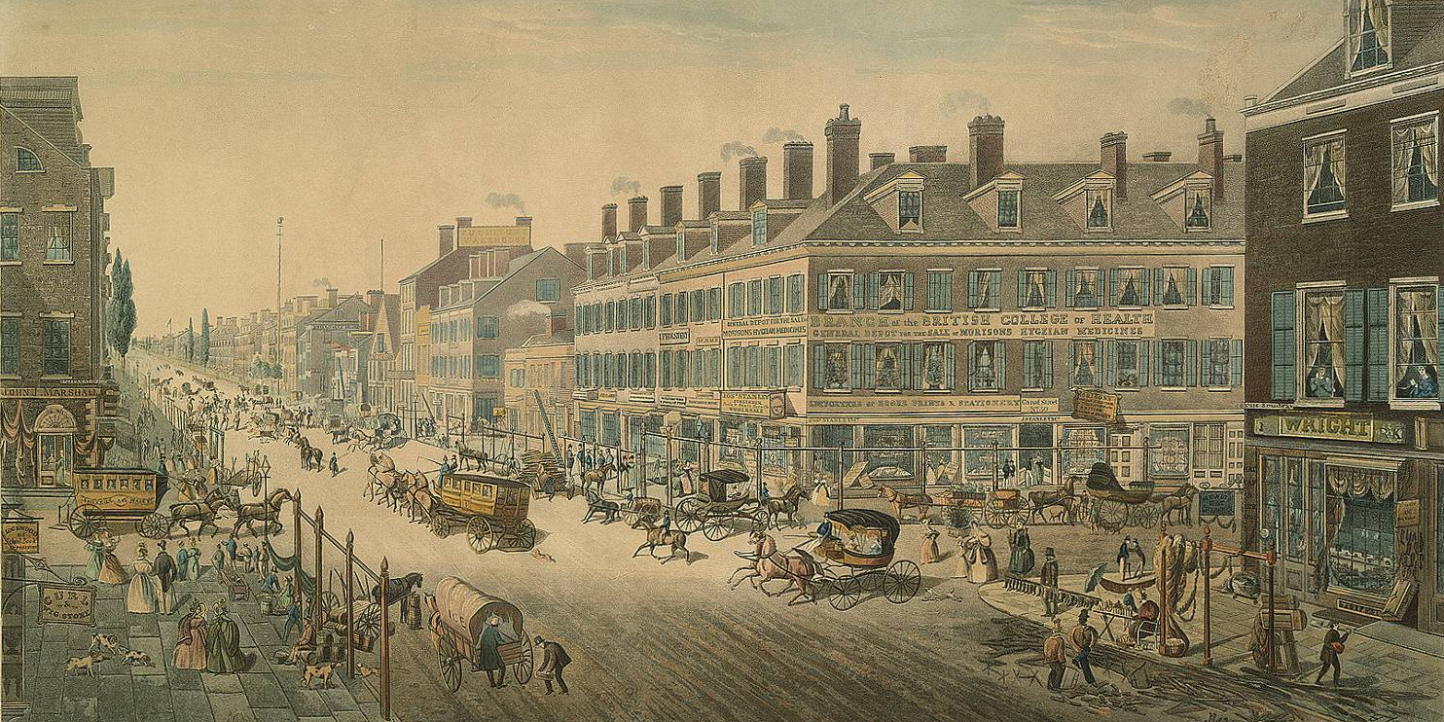

Slide 7
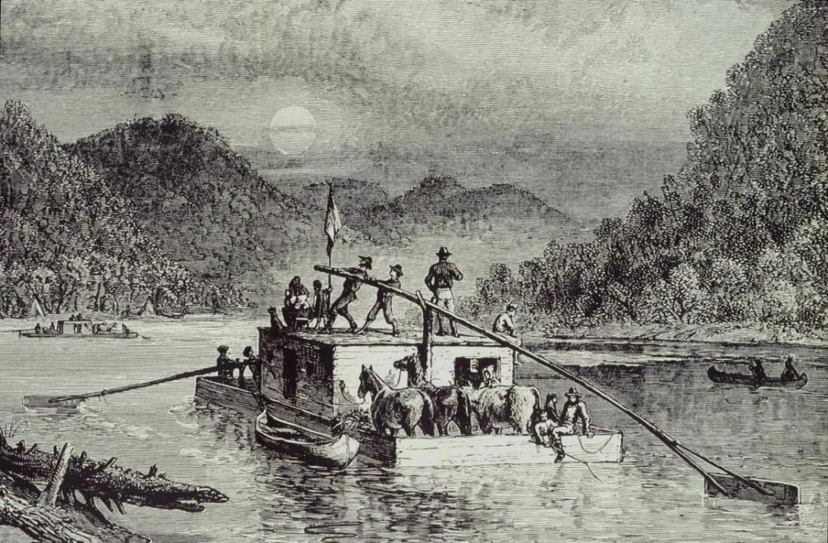

Slide 8
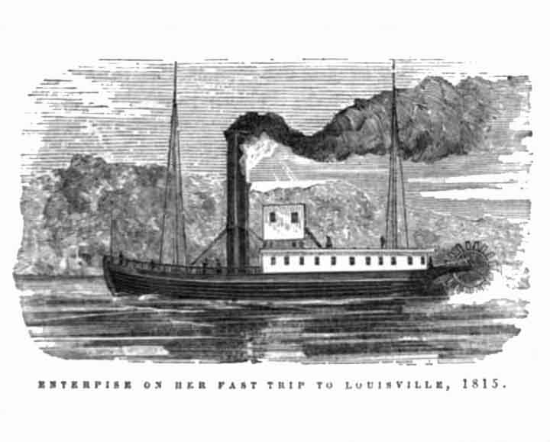

Slide 9
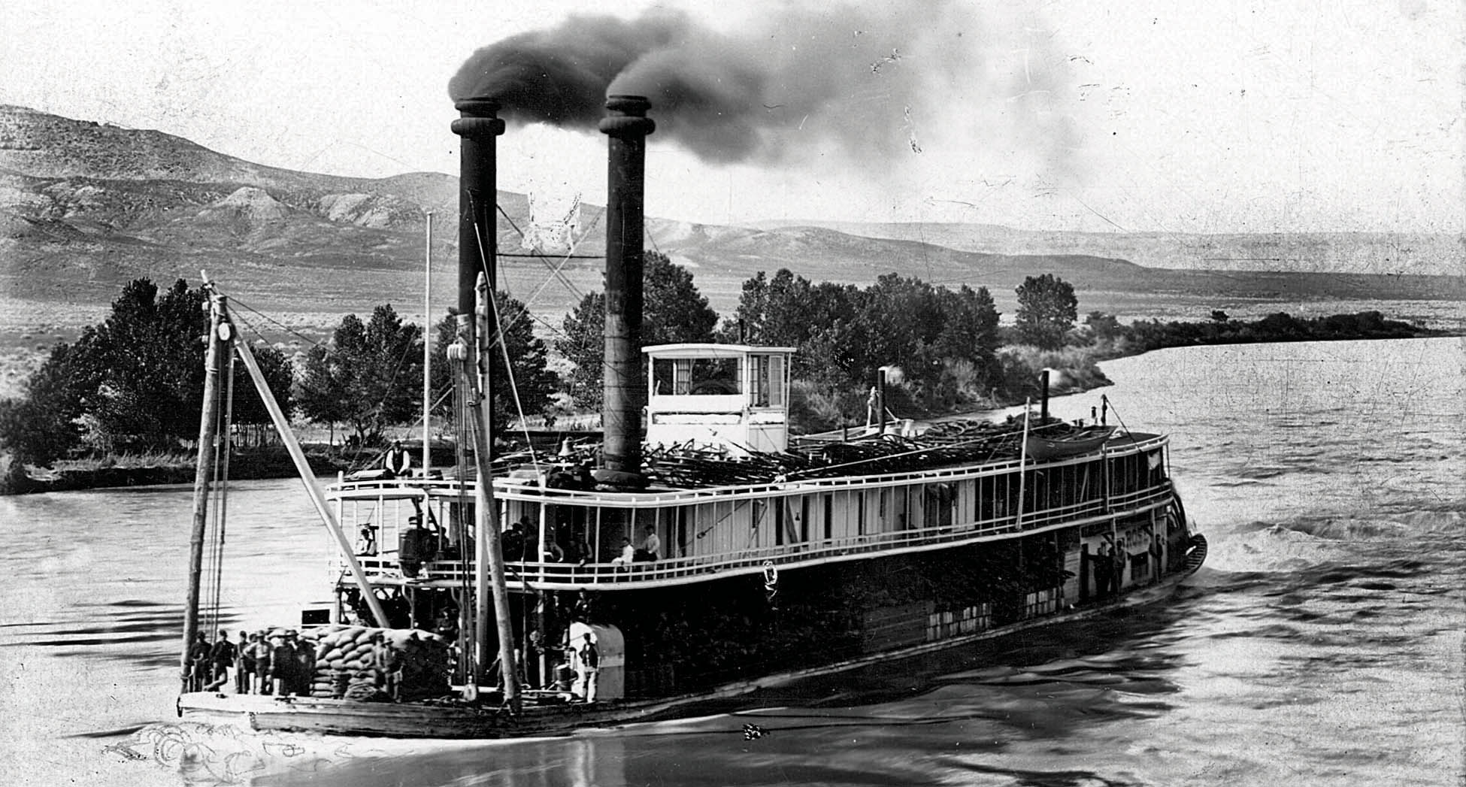

Slide 10
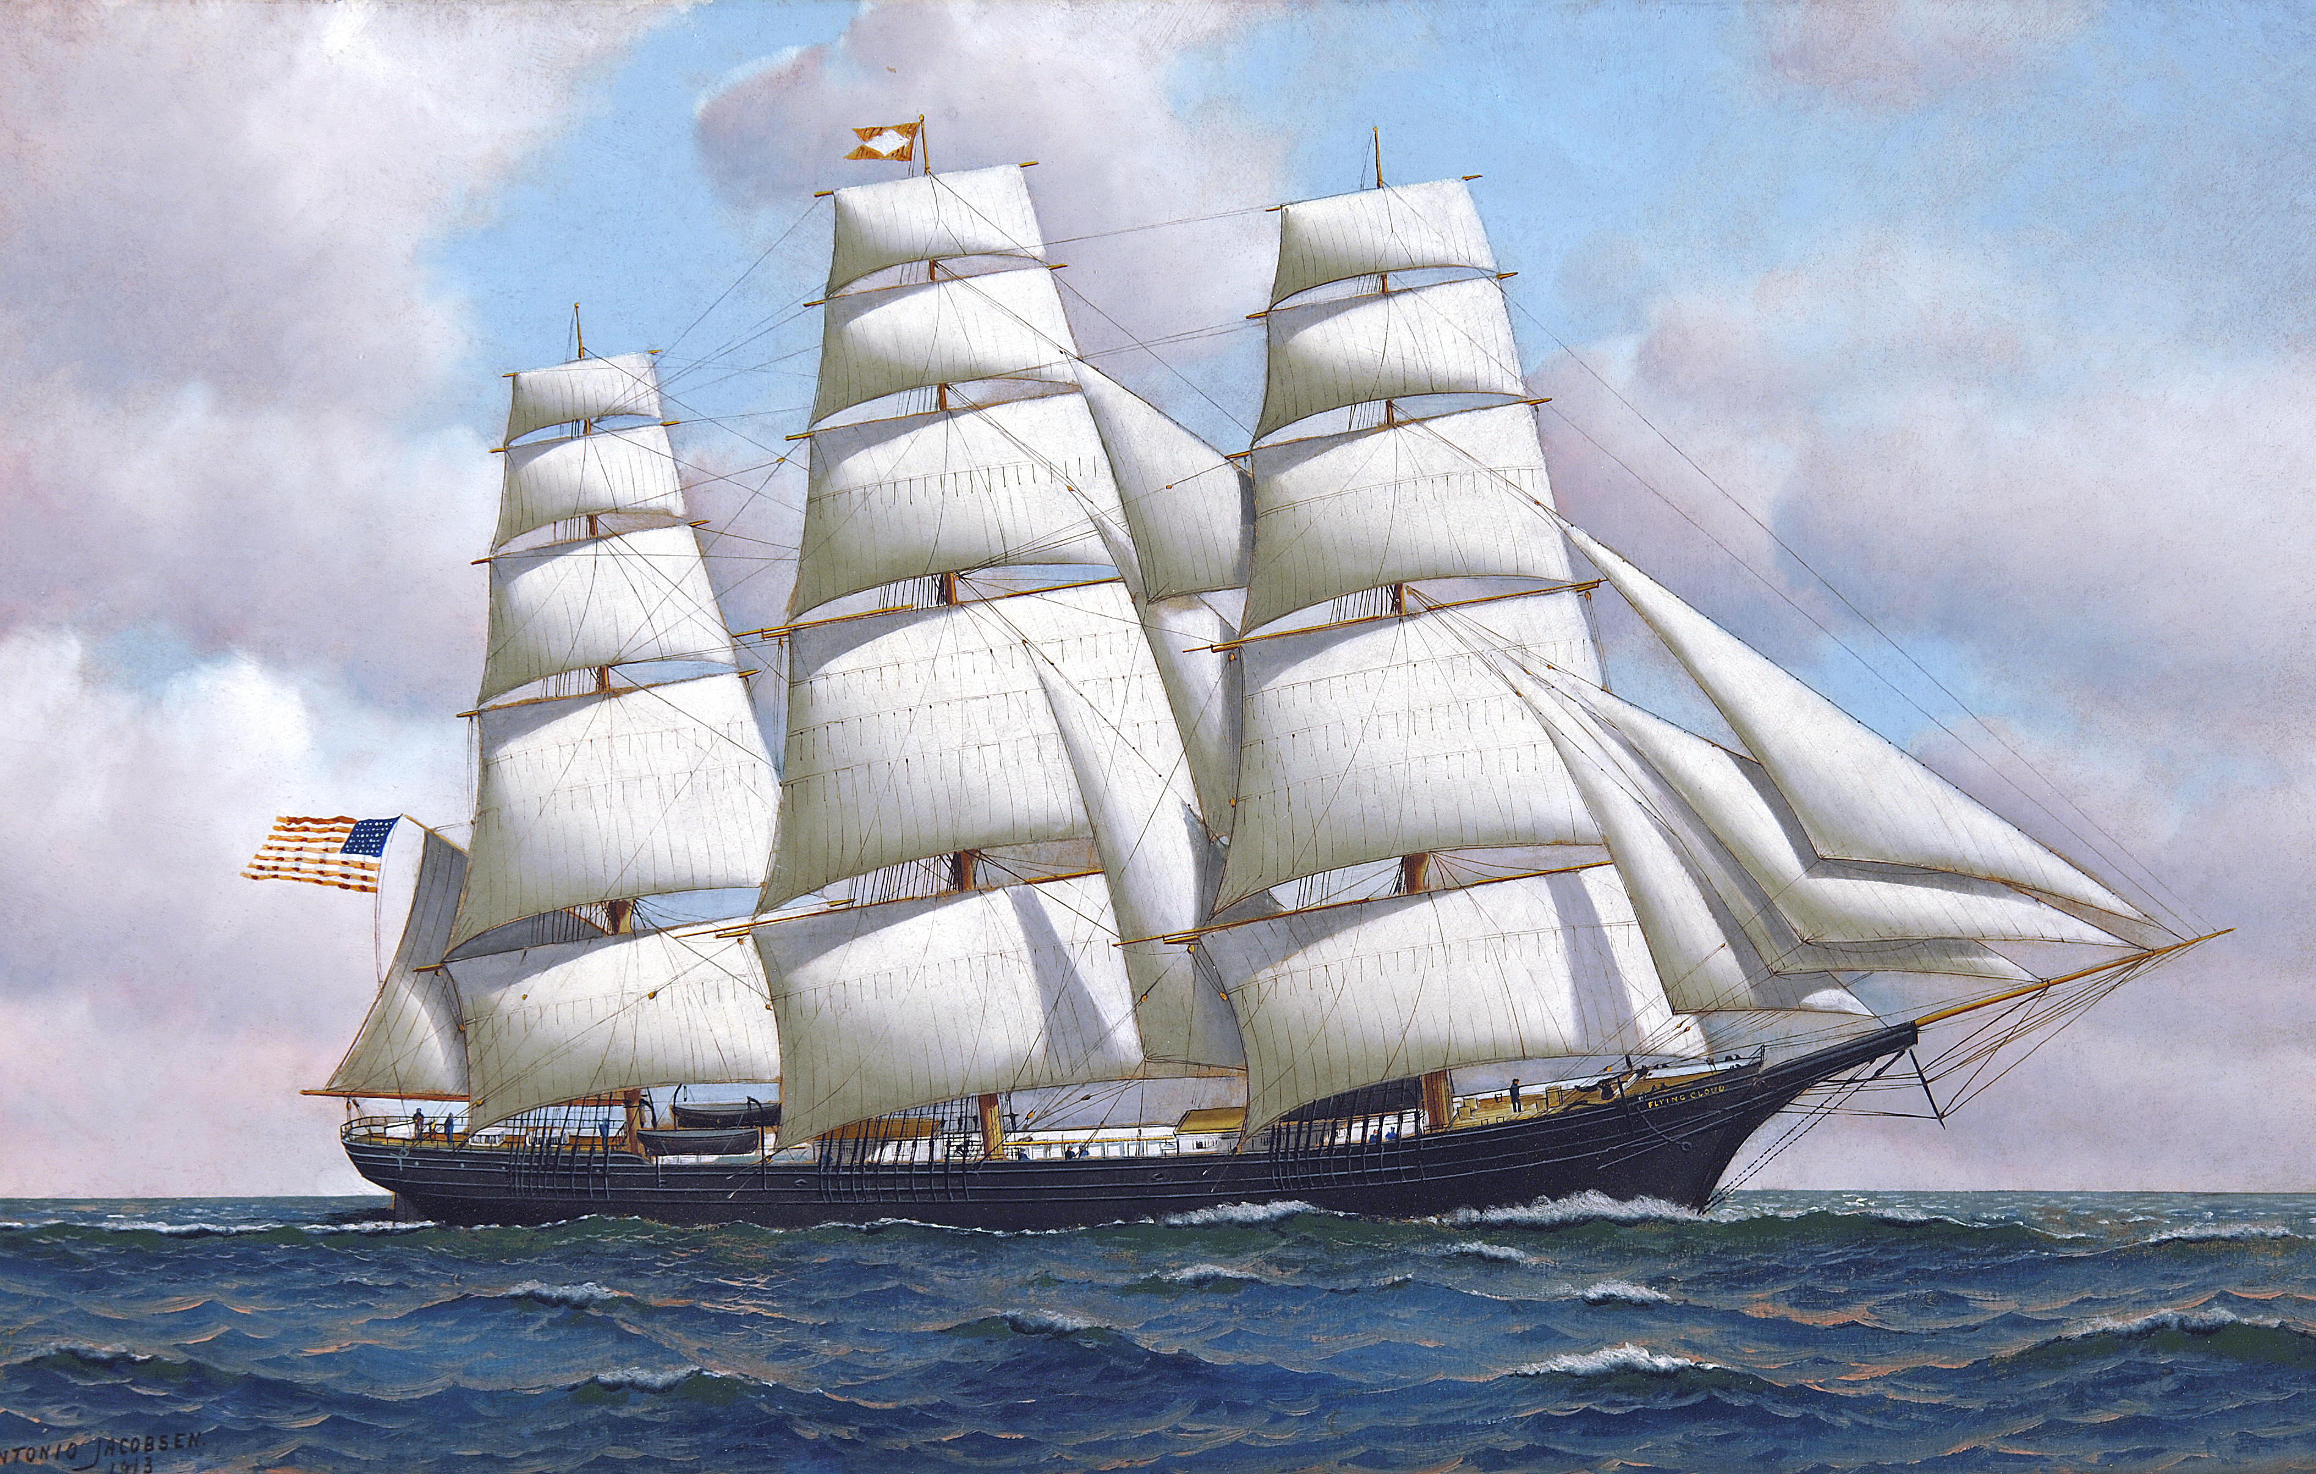

Slide 11
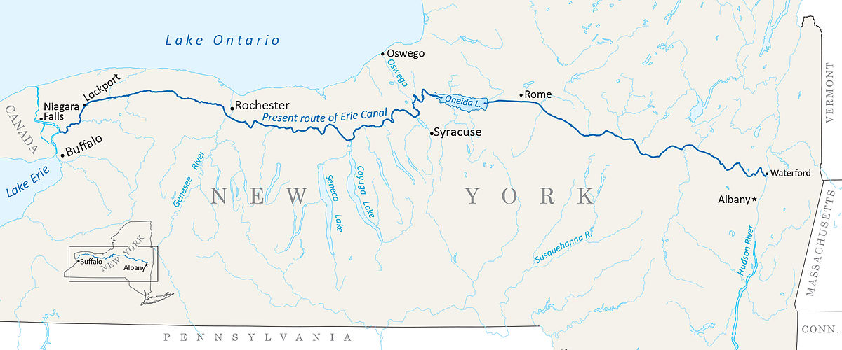
Erie Canal – Opened in 1825 - $9 million to build
363 miles – Reduced freight costs by 95%

Slide 12
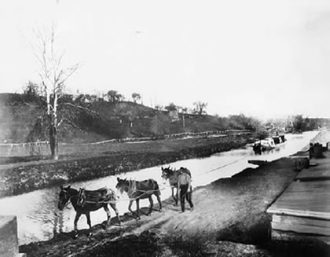
Horses pulling a packet boat on the Erie Canal

Slide 13
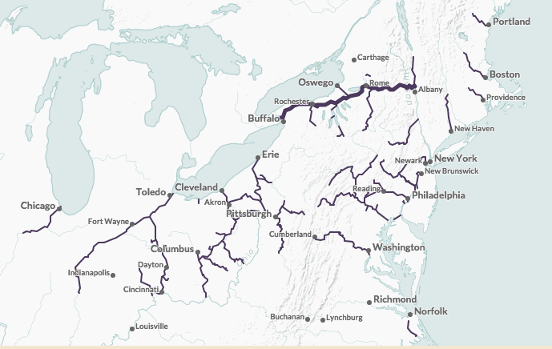
Canals, 1820-1860

Slide 14
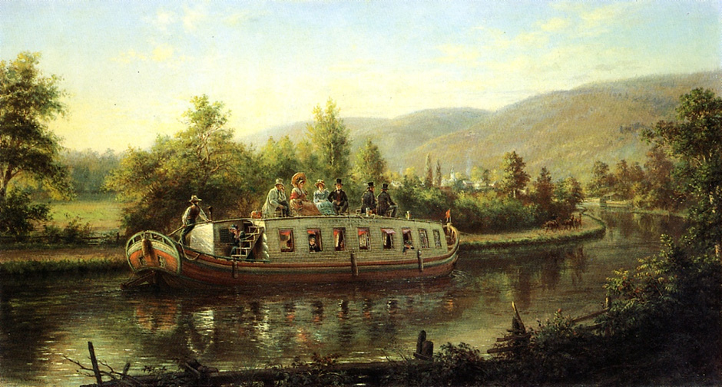

Slide 15
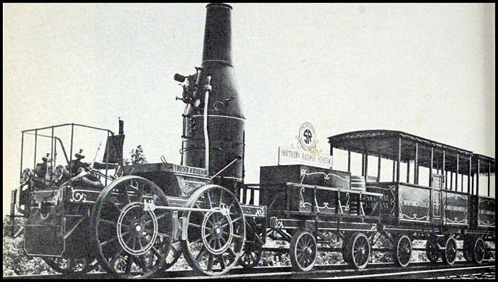
“Best Friend of Charleston”
First locomotive of the South Carolina Canal & Rail Road Company, 1831

Slide 16
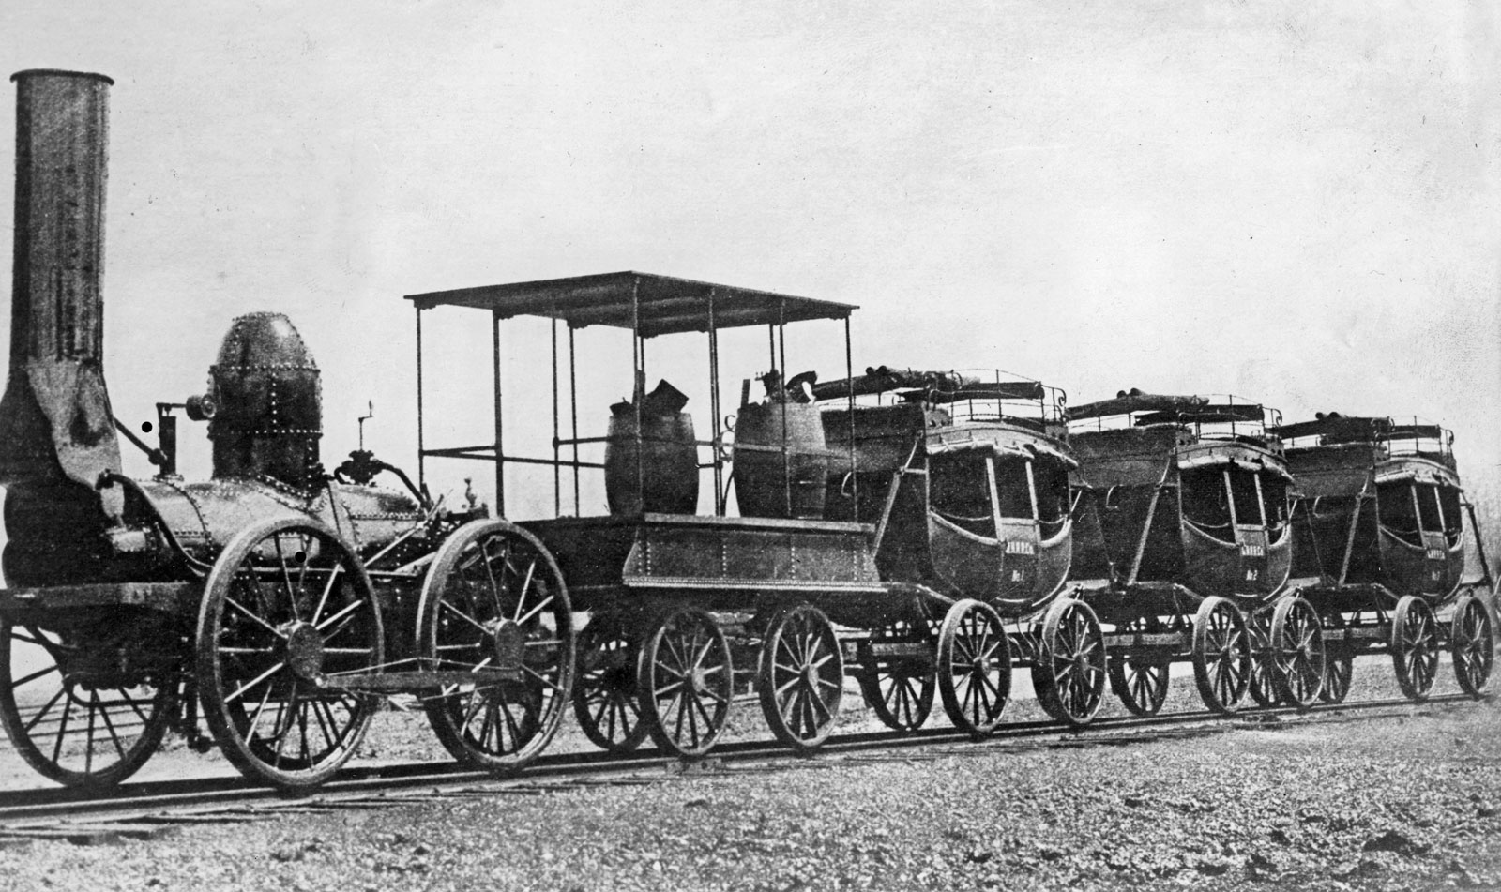
Steam locomotive De Witt Clinton
New York State, 1831

Slide 17
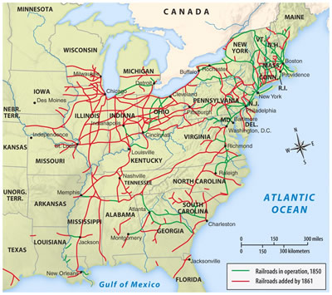
New roads, canals and railroads tended to link northern states with western states, isolating the southern states

Slide 18
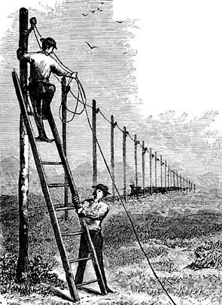
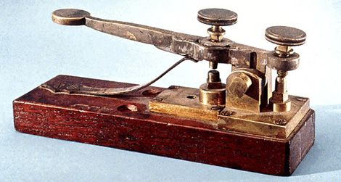
Telegraph invented by Samuel Morse, 1832

Slide 19
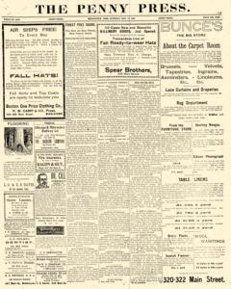
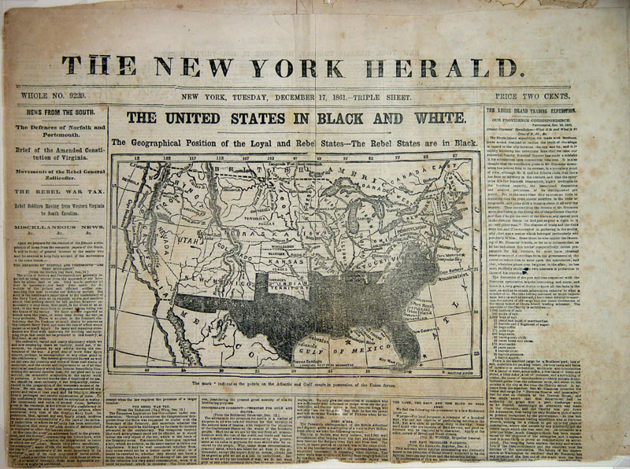
Early Newspapers – the “Penny Press”

Slide 20
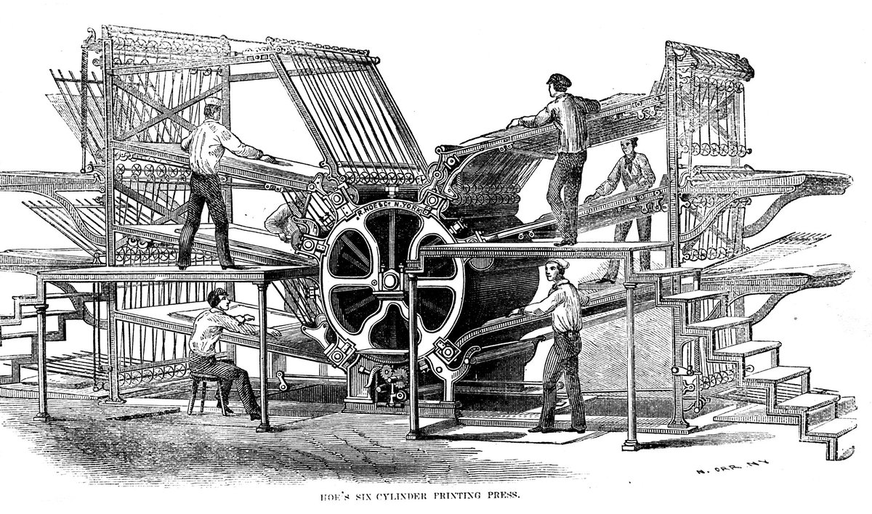

Slide 21
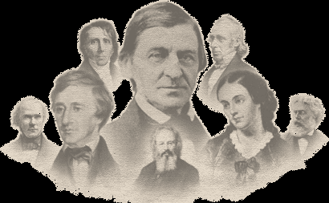
Golden Age of American Literature:
Emerson Thoreau Hawthorne Dickinson Melville Whitman Simms
Poe

Slide 22
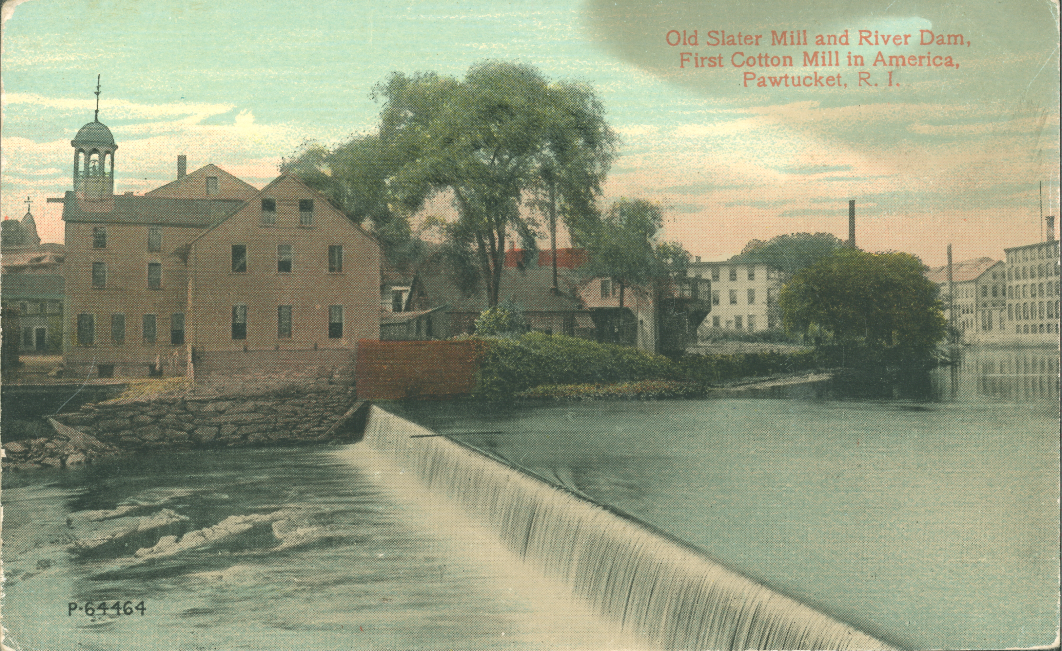

Slide 23
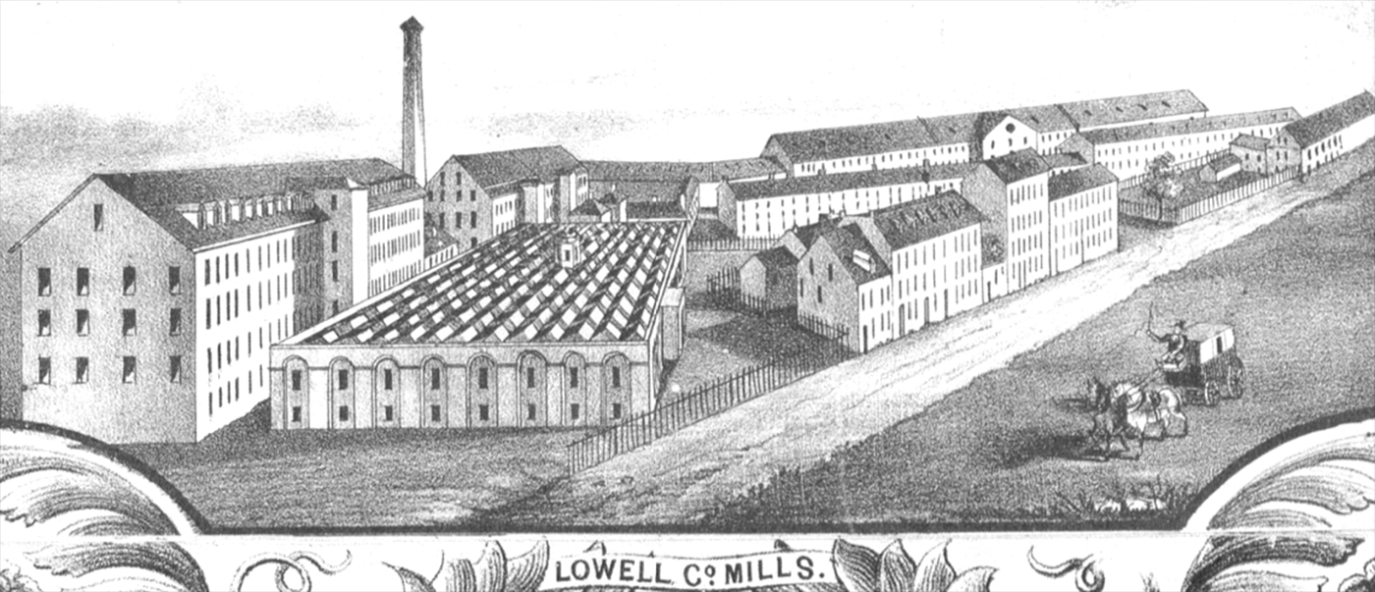

Slide 24
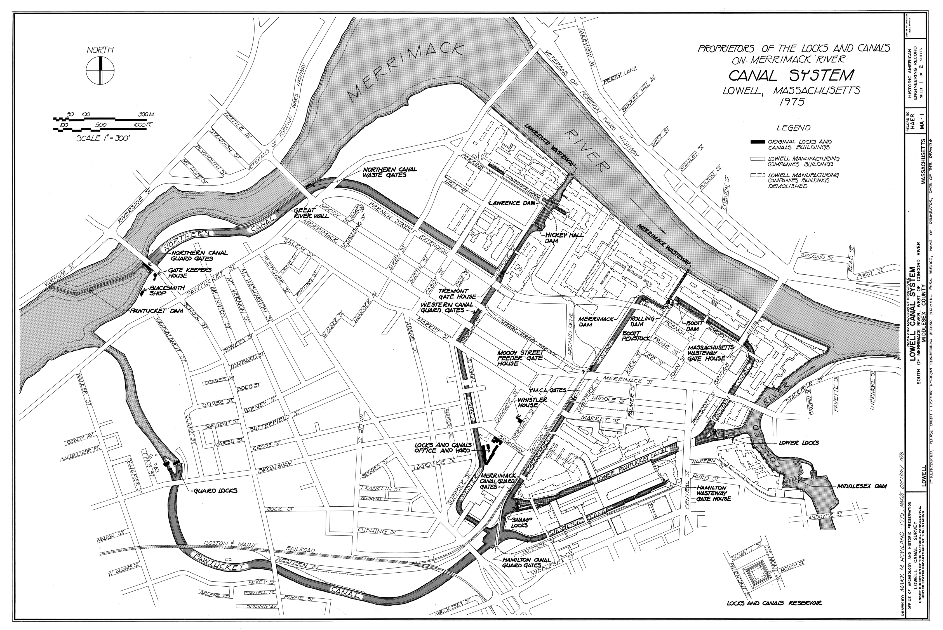

Slide 25
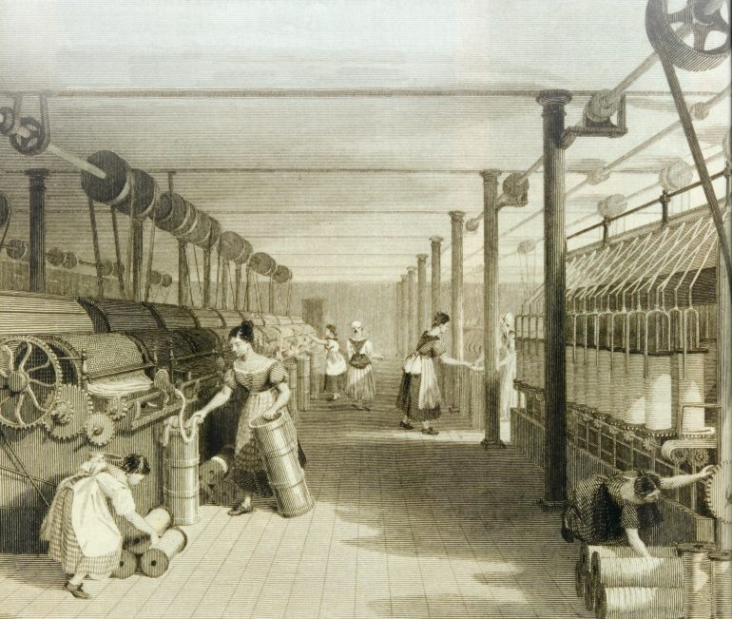
Lowell textile mills adapted technology stolen from British manufacturers. In Lowell the complete textile manufacturing process (spinning and weaving) was completed under one roof.

Slide 26
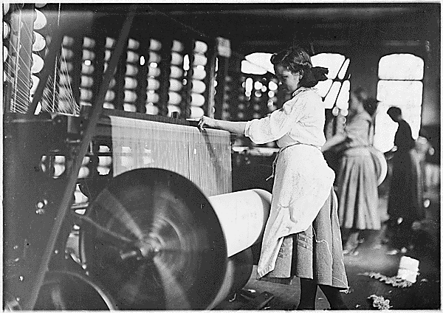

Slide 27
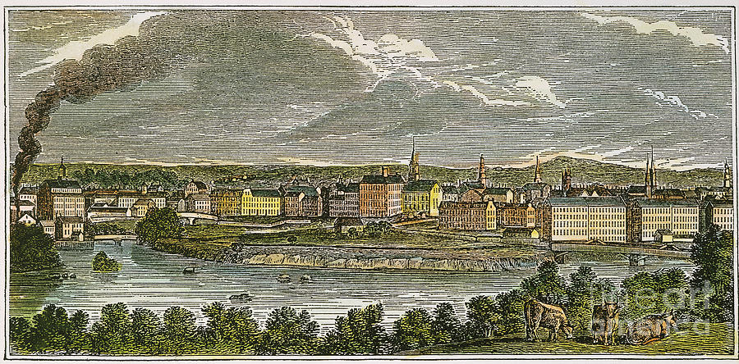
Lowell Mills, Massachusetts

Slide 28
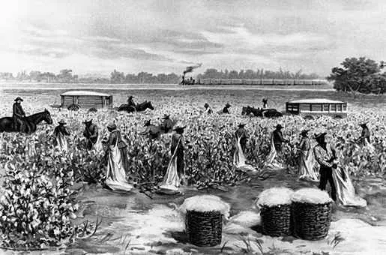

Slide 29
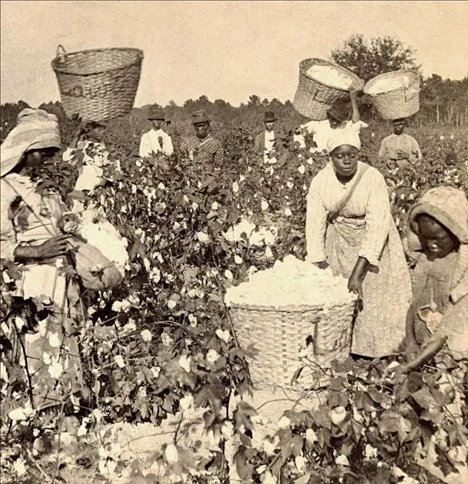
The profitability of plantation slavery reduced the motivation for Southerners to industrialize.
Northern mills and British mills used paid laborers but depended on Southern cotton grown by slaves.

Slide 30
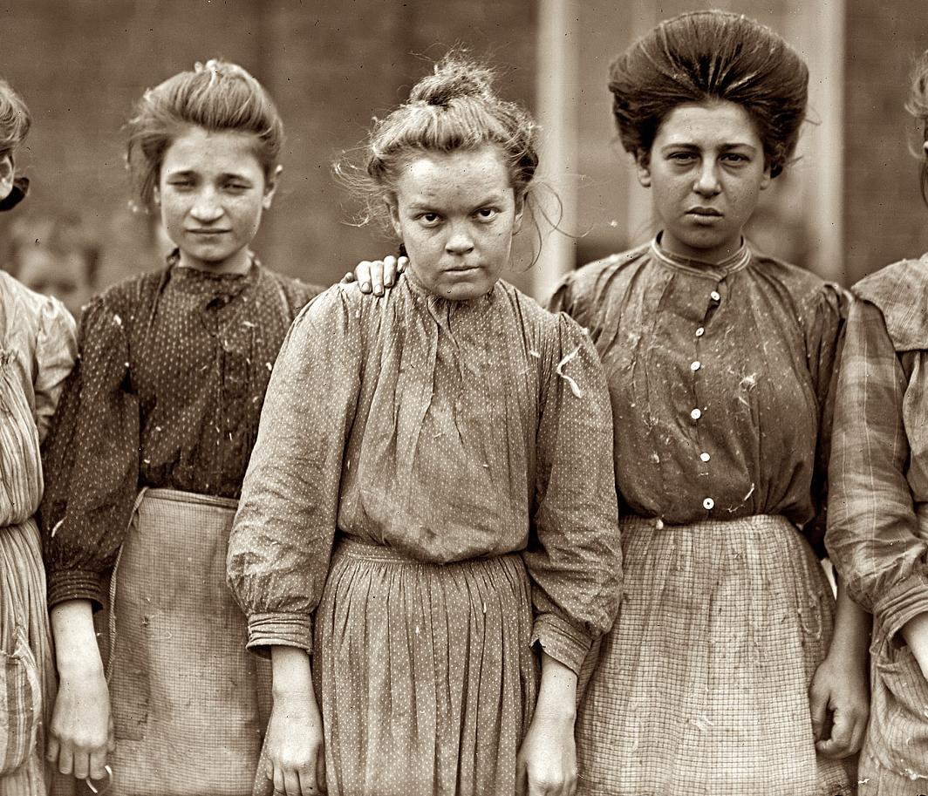
Lowell mill girls go on strike, 1833

Slide 31
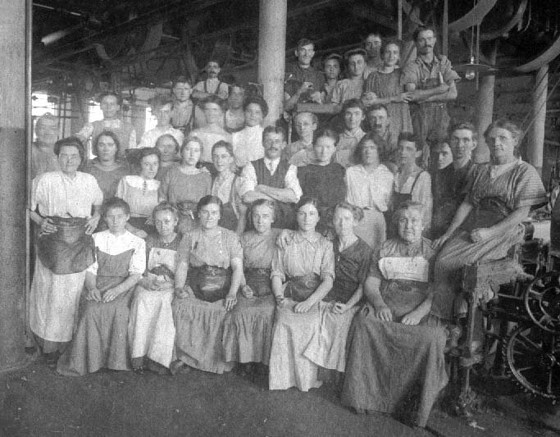
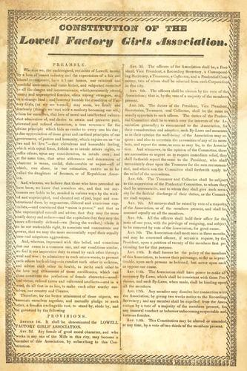
1834 - Lowell mill girls strike again

Slide 34
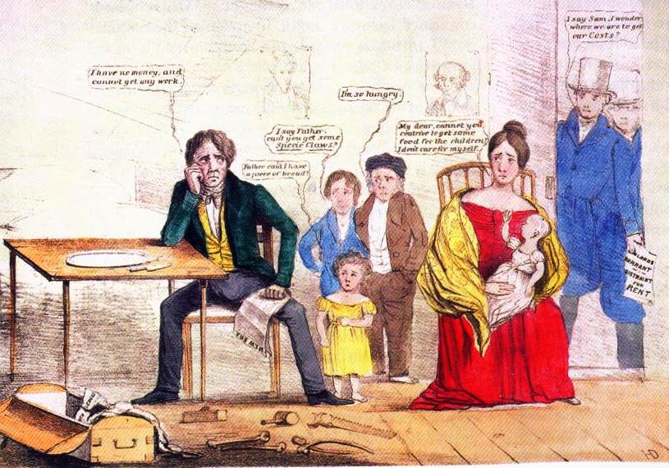
Panic of 1837
Note pictures of Andrew Jackson and Martin Van Buren on the wall.

Slide 35
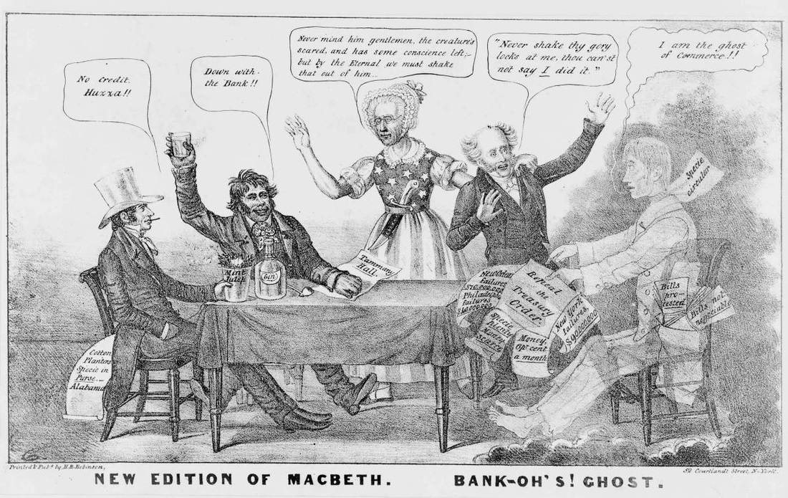
Panic of 1837 editorial cartoon blasting Jackson and Van Buren

Slide 38
Clay’s “American System” became the Whig platform in the 1830s

Slide 40
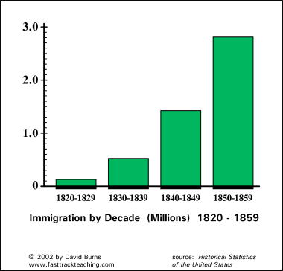

Slide 41
Rational Religion
Deism: A belief that a rational creator made a rational universe
Questioned traditional religious teachings such as miracles and divinity
Argued for science and reason in belief
Unitarianism
Belief that rejects the Trinity and argues that Jesus was a good man, but not divine
Universalism
Stressed that all people were good and could achieve salvation; attracted working poor

Slide 42
Second Great Awakening
Emphasized the availability of salvation to all who repent and believe in Christ
Preachers travelled broadly to lead revivals and rekindle religious fervor

Slide 43
Religious Revivalism
Frontier revivals
Denominational growth
Charles Finney and the burned-over district

Slide 44
Religious Revivalism, continued
Revivalism and African Americans
Camp meetings and women
Religion and reform

Slide 45
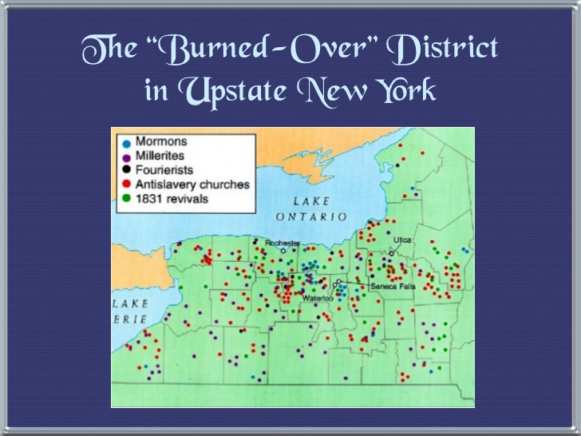

Slide 46
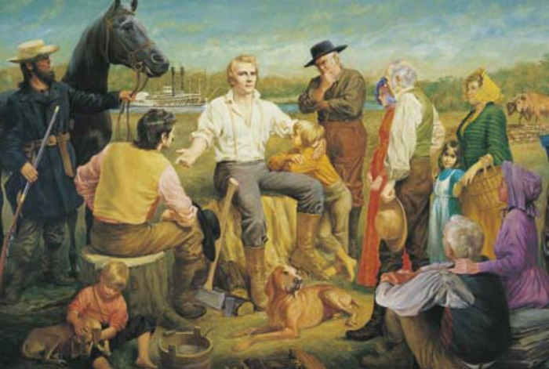
Joseph Smith, founder of the Mormon Church

Slide 47
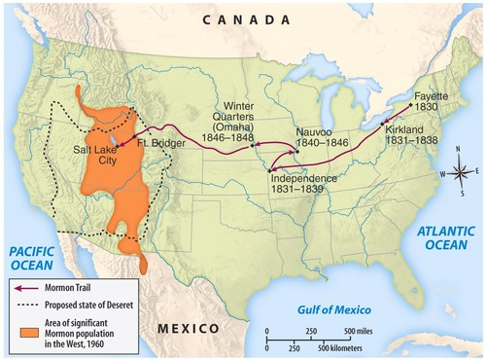

Slide 48
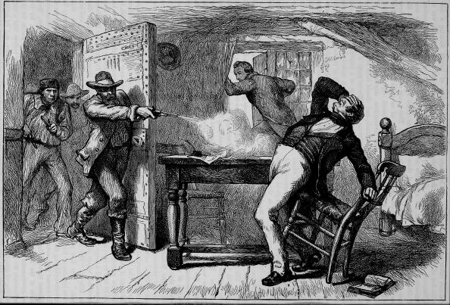
Murder of Joseph Smith, 1844

Slide 49
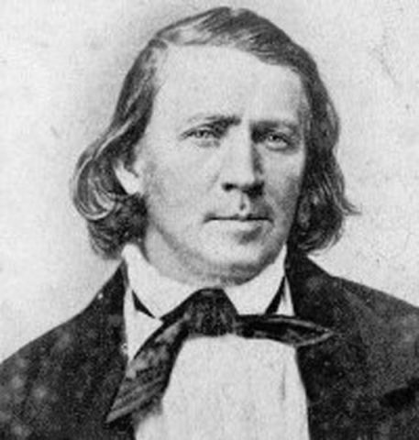
Brigham Young, succeeded Joseph Smith and led the Mormon trek to Salt Lake City, Utah
1847

Slide 50
Romanticism in America

Slide 51
Transcendentalist Movement
Ralph Waldo Emerson
Henry David Thoreau
Walden
“Civil Disobedience”
Brook Farm

Slide 52
An American Literature
Literary giants
Nathaniel Hawthorne
Emily Dickinson
Edgar Allan Poe

Slide 53
An American Literature, continued
Herman Melville
Walt Whitman

Slide 54
Politics in an Oyster House (1848)
Newspapers

Slide 56
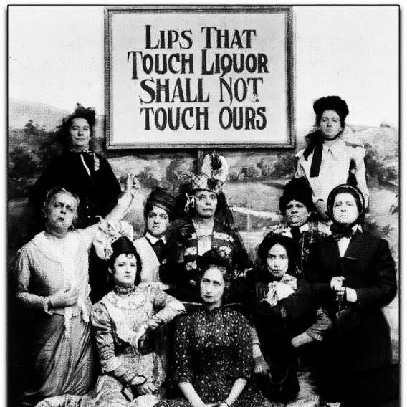
The Temperance Movement
Campaign against production and consumption of alcohol
Longest-lasting, most widespread Antebellum reform movement

Slide 57
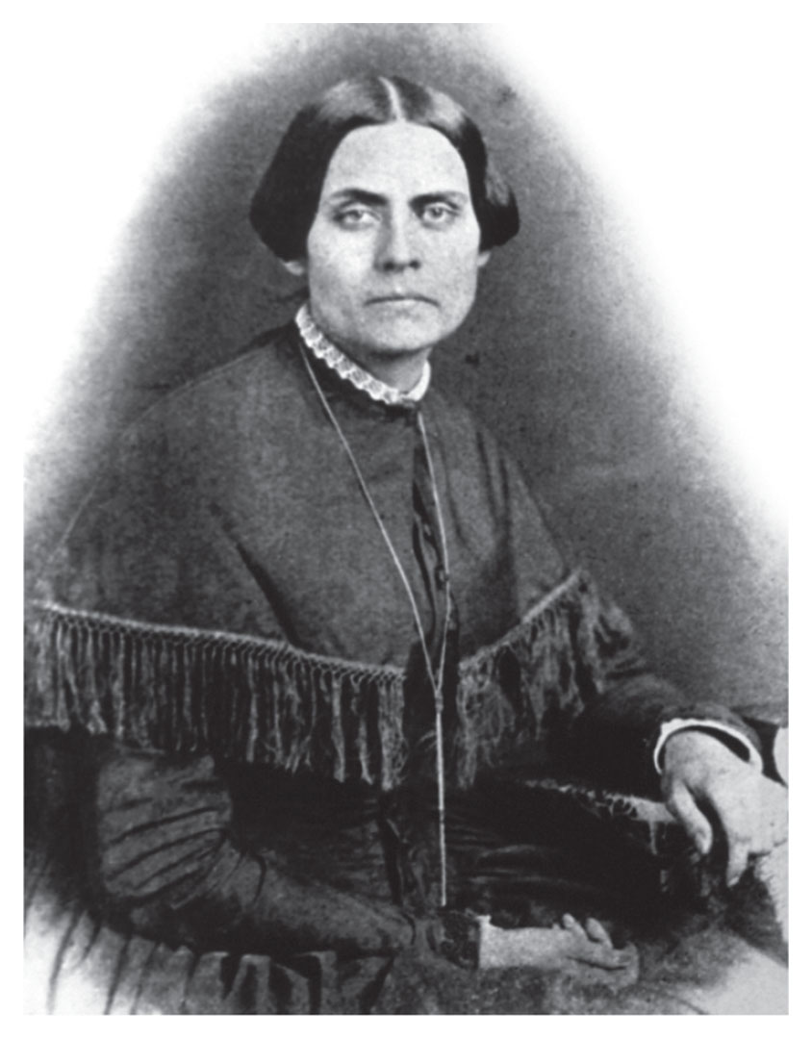
Antebellum Social Reform Movements: Women’s Rights
Catharine Beecher
Julia Ward Howe
Seneca Falls Convention

Slide 58
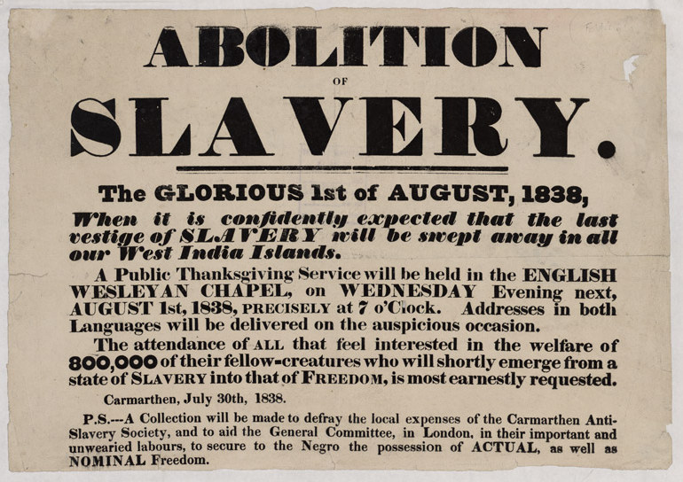

Slide 59
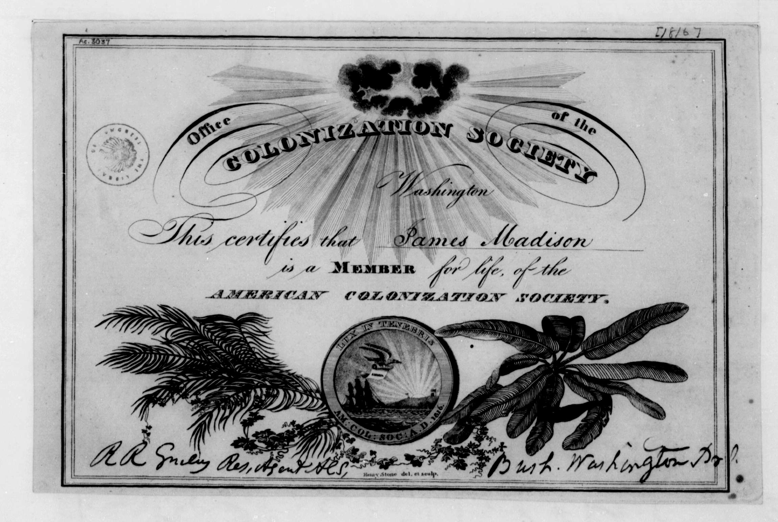

Slide 60
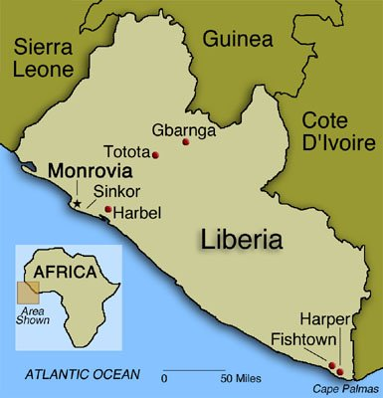
American Colonization Society proposed to send freed slaves to Africa
Purchased land in 1831
Name settlement Liberia
Plan opposed by African-American leaders
Only 15,000 blacks sent to Liberia by 1860

Slide 61
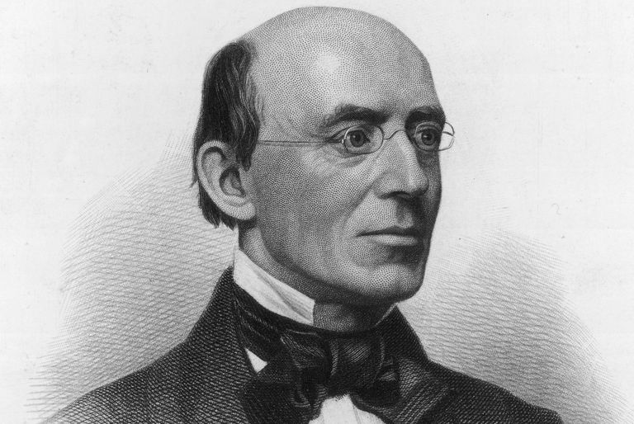
William Lloyd Garrison
Publisher of The Liberator
Supported Women’s Rights
Pacifist
Blamed by Southerners for Nat Turner’s revolt

Slide 62
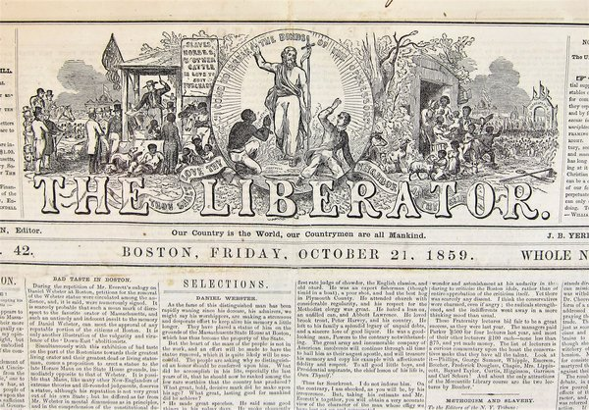

Slide 63
Abolitionism and the Role of Women
Splits in the movement
Sarah and Angelina Grimké
The Liberty Party

Slide 64
Political advertisement for James G. Birney, candidate for the new anti-slavery Liberty Party
1840 presidential election

Slide 65
Black Anti-Slavery Activity
William Wells Brown
Frederick Douglass
Sojourner Truth
The Underground Railroad

Slide 66
Frederick Douglass

Slide 71
Uncle Tom’s Cabin
Anti-slavery novel written by Harriet Beecher Stowe, daughter of a preacher and resident of Maine who had never been to the South.

Slide 72
“Wage slavery”
Exploitation of factory workers by northern industrialists

Slide 73
In 1860,
one-third
of white southern families
(or fewer)
owned slaves.

Slide 76
The majority of slaves lived and worked on large plantations

Slide 77
Slaves accounted for one-third of the total southern population from 1790 to 1860

Slide 82
Americans flow into Mexico.
Some brought slaves.
Many called for self-rule rather than obey laws passed by Mexican Congress.

Slide 83
General Antonio Lopez de Santa Anna,

Slide 84
Battle of the Alamo, Feb. 23 to March 6, 1836

Slide 85
Texas declares independence, March 2, 1836

Slide 89
John Tyler
Became president when Harrison died
Former Democrat
Blocked Whig agenda
Cabinet resigned (except Webster)
Expelled from Whig party, 1841
“President without a party”

Slide 90
Oregon Trail – Independence, Missouri to Oregon City

Slide 92
James Polk
Democrat, elected President in 1844
Expansionist
Wanted to annex Texas immediately
Wanted to seize Oregon territory

Slide 93
“Manifest Destiny”

Slide 94
1846 Orgeon Treaty settled Oregon boundary dispute by establishing border at 49th parallel

