Slide 1
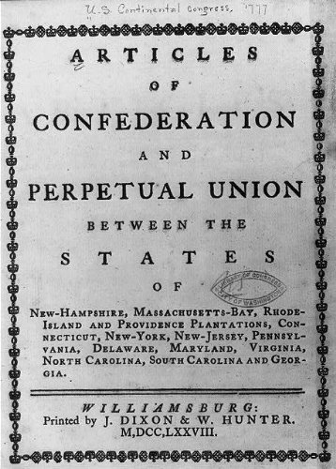
Articles of Confederation
Served as first constitution of the United States
Created a government in which states were strong and the central government was weak
Proposed in 1777
Ratification delayed until 1781

Slide 3
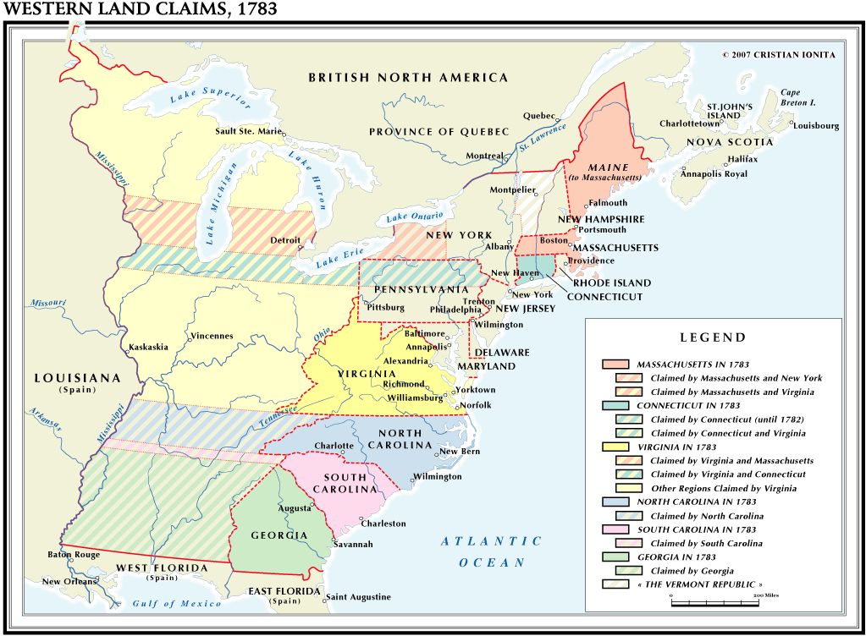

Slide 4
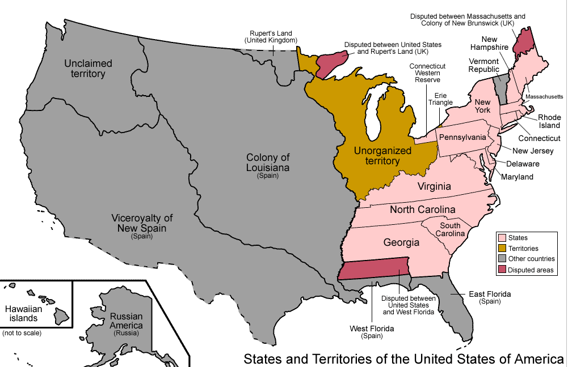

Slide 6
Northwest Ordinance of 1787
Passed by the Confederation Congress in July, 1787
Created the Northwest Territory
Outlined conditions under which territories could apply for statehood
Prohibited slavery in any states created north of the Ohio River, i.e., in the Northwest Territory

Slide 7
Post-War Economic Crisis
National and state war debts
Trade restrictions
Shortage of cash

Slide 8
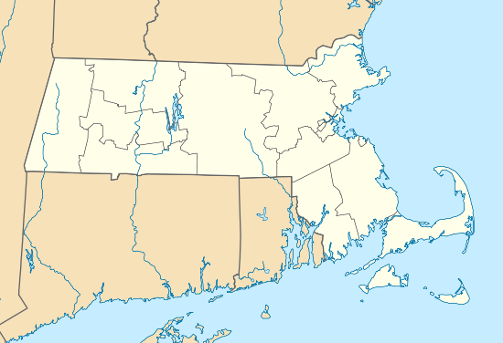

Slide 9
Western Massachusetts Farmers’ Grievances
FIRST: The present system of taxation unfairly taxes the poor.
SECOND: The tax rates have been set too high.
THIRD: There is a shortage of cash money, and farm goods are not accepted as payment for debts and taxes.
FOURTH: Court and lawyer fees are set too high.
FIFTH: State government officials are being paid fattened salaries.
SIXTH: The state capital at Boston should be moved inland

Slide 10
“I've labored hard all my days and fared hard. I have been greatly abused, have been obliged to do more than my part in the war, been loaded with class rates, town rates, province rates, Continental rates and all rates ... been pulled and hauled by sheriffs, constables and collectors, and had my cattle sold for less than they were worth ... The great men are going to get all we have and I think it is time for us to rise and put a stop to it, and have no more courts, nor sheriffs, nor collectors nor lawyers.”
Massachusetts Farmer “Plough Jogger,” 1786

Slide 11
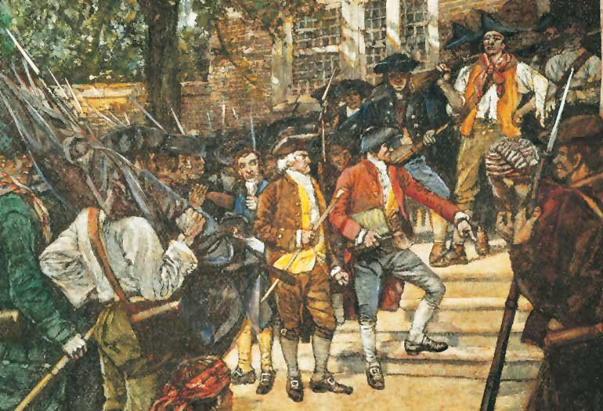

Slide 13
“[There are] … 12 or 15,000 desperate and unprincipled men … we shall have a formidable rebellion … This dreadful situation has alarmed every man of principle and property in New England … something must be done or we shall be involved in all the horror of faction and civil war without a prospect of its termination.”
Henry Knox to George Washington, October 23, 1786

Slide 14
“The aid of the federal government is necessary to stop the Progress of the insurgents … unless speedy and effectual measures shall be taken … they will possess themselves of the Arsenal at Springfield, subvert the constitutional government, and not only reduce that Commonwealth [of Massachusetts] to a State of Anarchy and Confusion, but probably involve the United States in the Calamities of a civil war.”
Declaration of the Confederation Congress, 1786

Slide 15
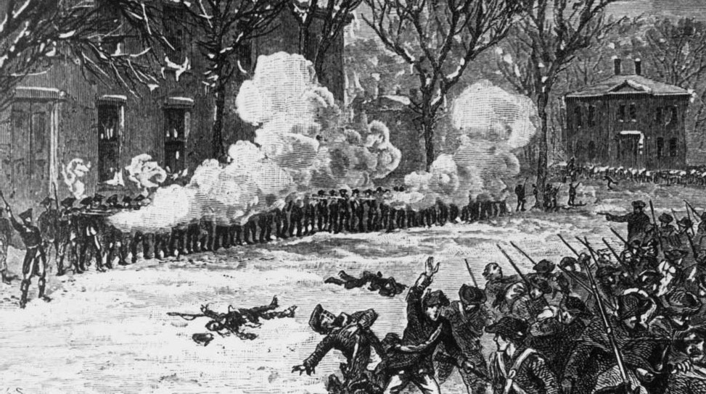
Shays’ Rebellion – Western Massachusetts – 1786-1787

Slide 17
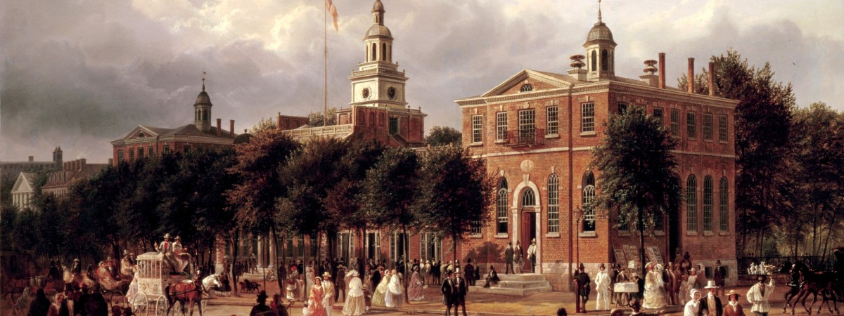
The Constitutional Convention, Pennsylvania State House, Philadelphia
May 27 – September 17, 1787

Slide 18
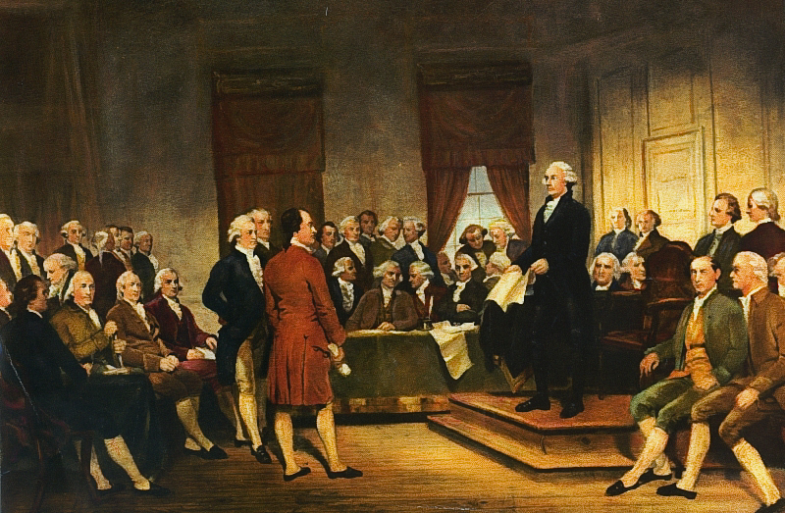

Slide 19
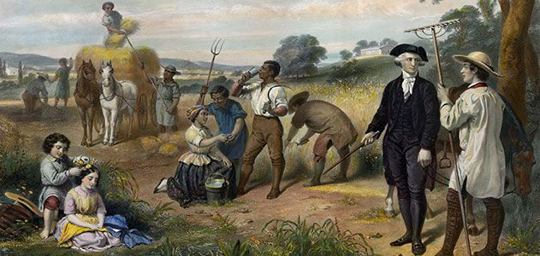
Of the 55 delegates to the Constitutional Convention, about 25 owned slaves.

Slide 20
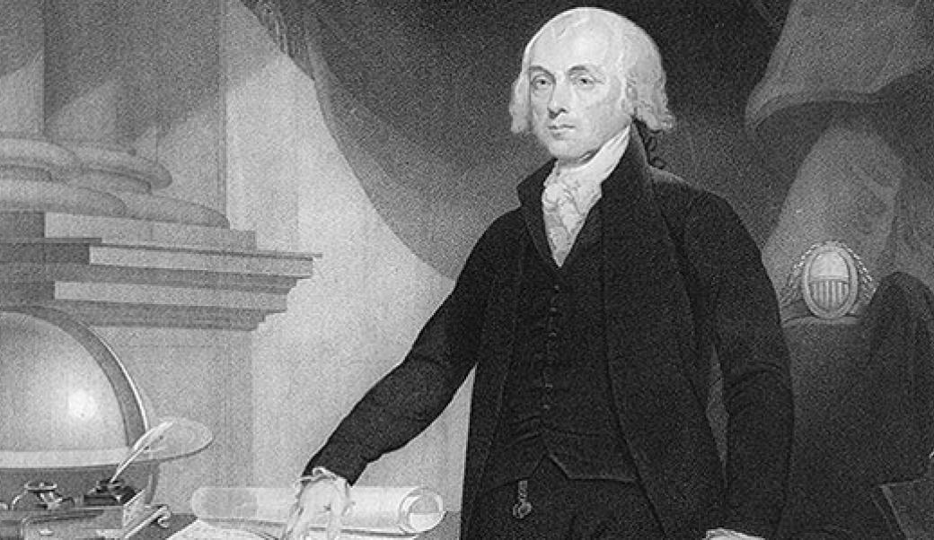
James Madison

Slide 21
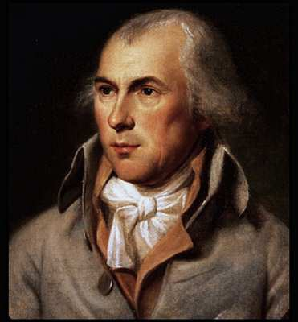
Virginia plan
Favors large states
Bicameral legislature (i.e., two houses)
Representation in both
houses to be determined
by population
Lower house elected by
people
Upper house elected by
lower house
James Madison of Virginia

Slide 22
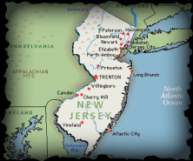
New Jersey Plan
Favors small states
Continental Congress would continue
States would have equal number of votes
Give government power to levy taxes
Congressional laws take precedence over state laws

Slide 23
Connecticut Compromise
(also known as the “Great Compromise”)
- Presented by Roger Sherman of Connecticut
- Blended Virginia (large state) and New Jersey (small state) proposals
- Created bicameral legislature
- Representation in the Lower house to be based on population
- States would have the same number of representatives in the upper house, i.e., the Senate

Slide 24
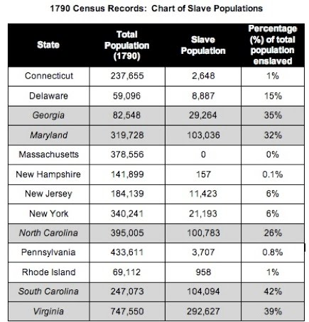

Slide 25
The Three-Fifths Compromise
When determining a state’s population, five slaves to be counted as three freemen

Slide 27
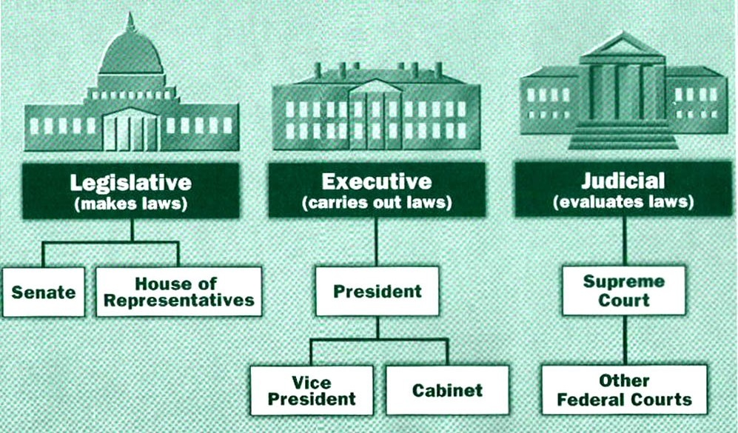

Slide 30
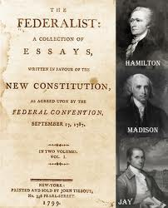
The Federalist Papers
Series of 85 essays in support of the proposed Constitution
Written by Alexander Hamilton, James Madison, and John Jay
Published between 1787 and 1788
Authorship kept secret until Hamilton’s death in 1804

Slide 32
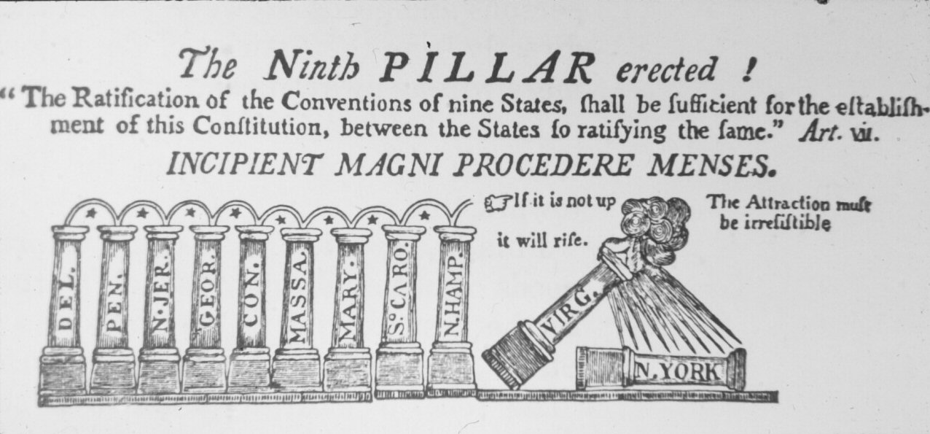

Slide 34
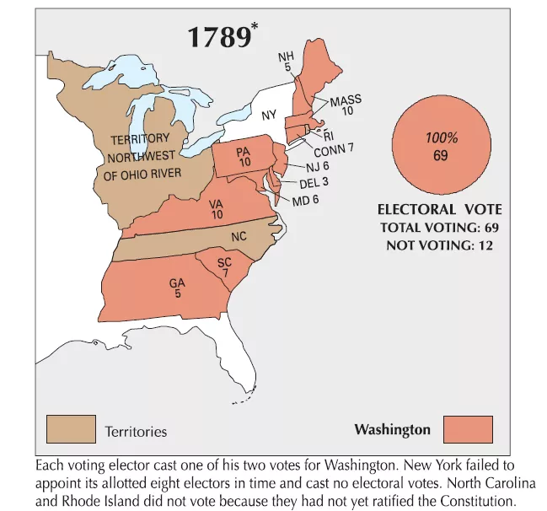

Slide 37
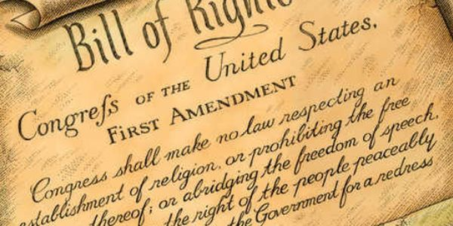

Slide 38
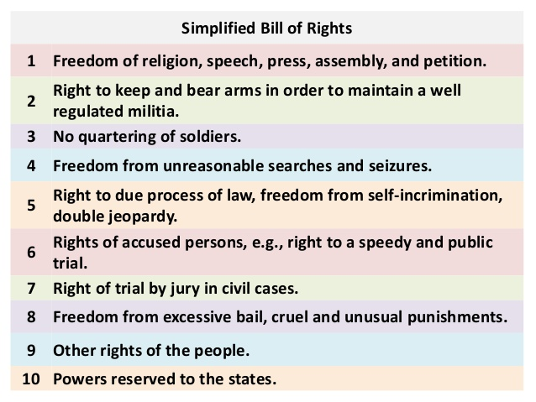

Slide 39
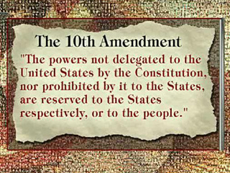

Slide 40
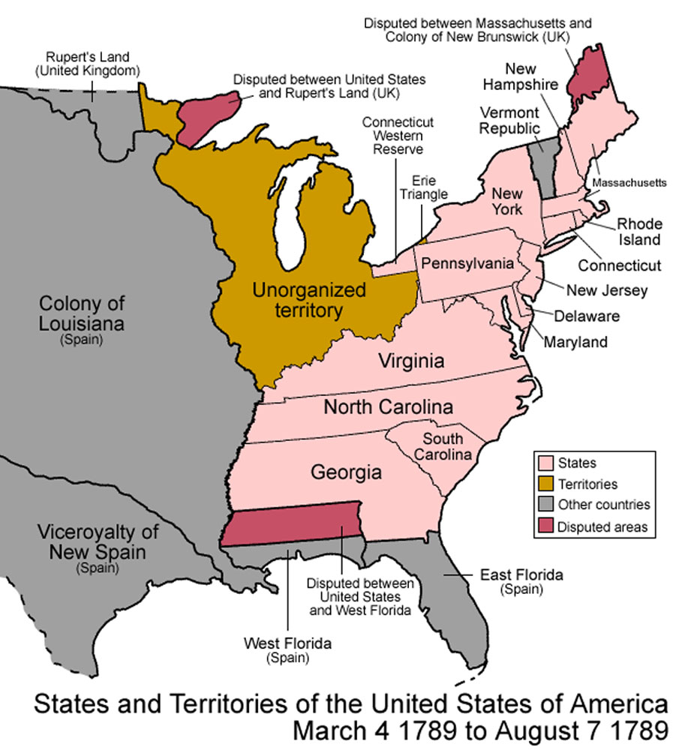
What were the goals and priorities of the new nation?

Slide 41
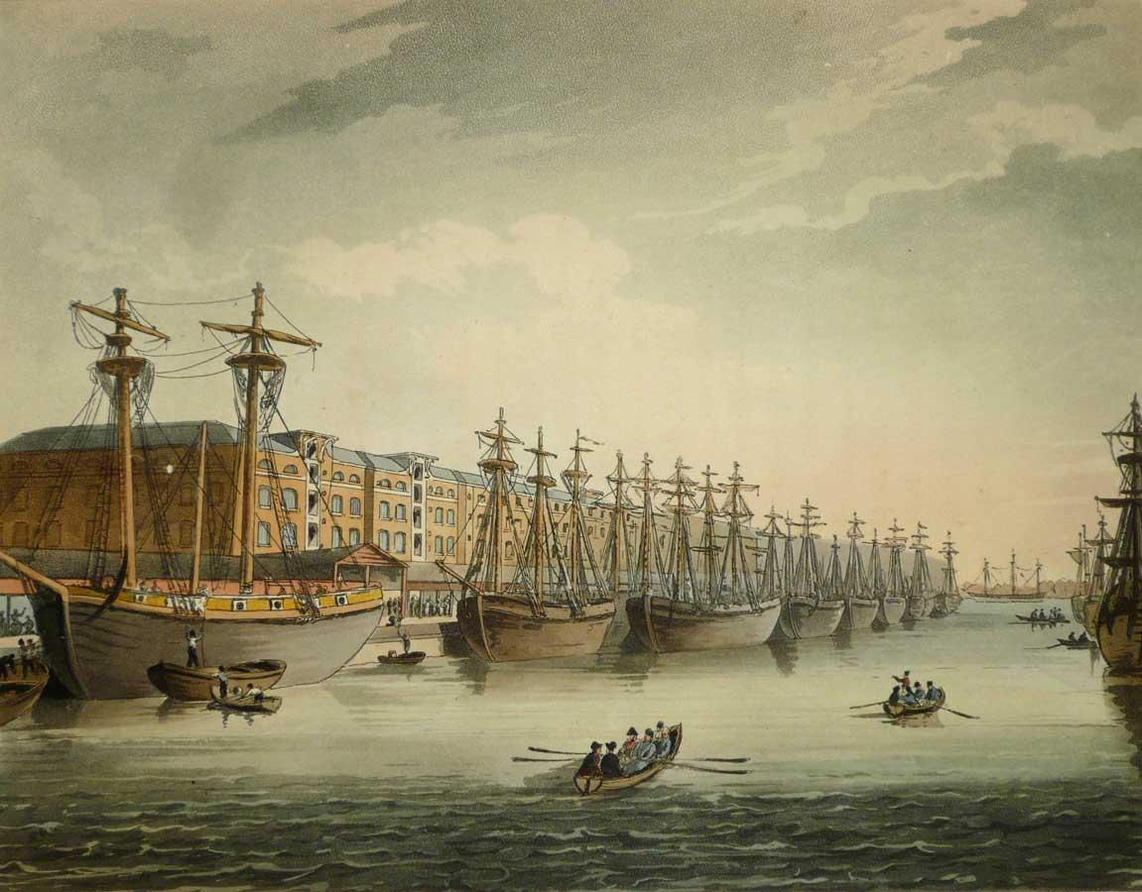
Hamilton’s vision
Make the United States a major commercial and manufacturing power like England, with thriving cities that manufacture goods for export

Slide 42
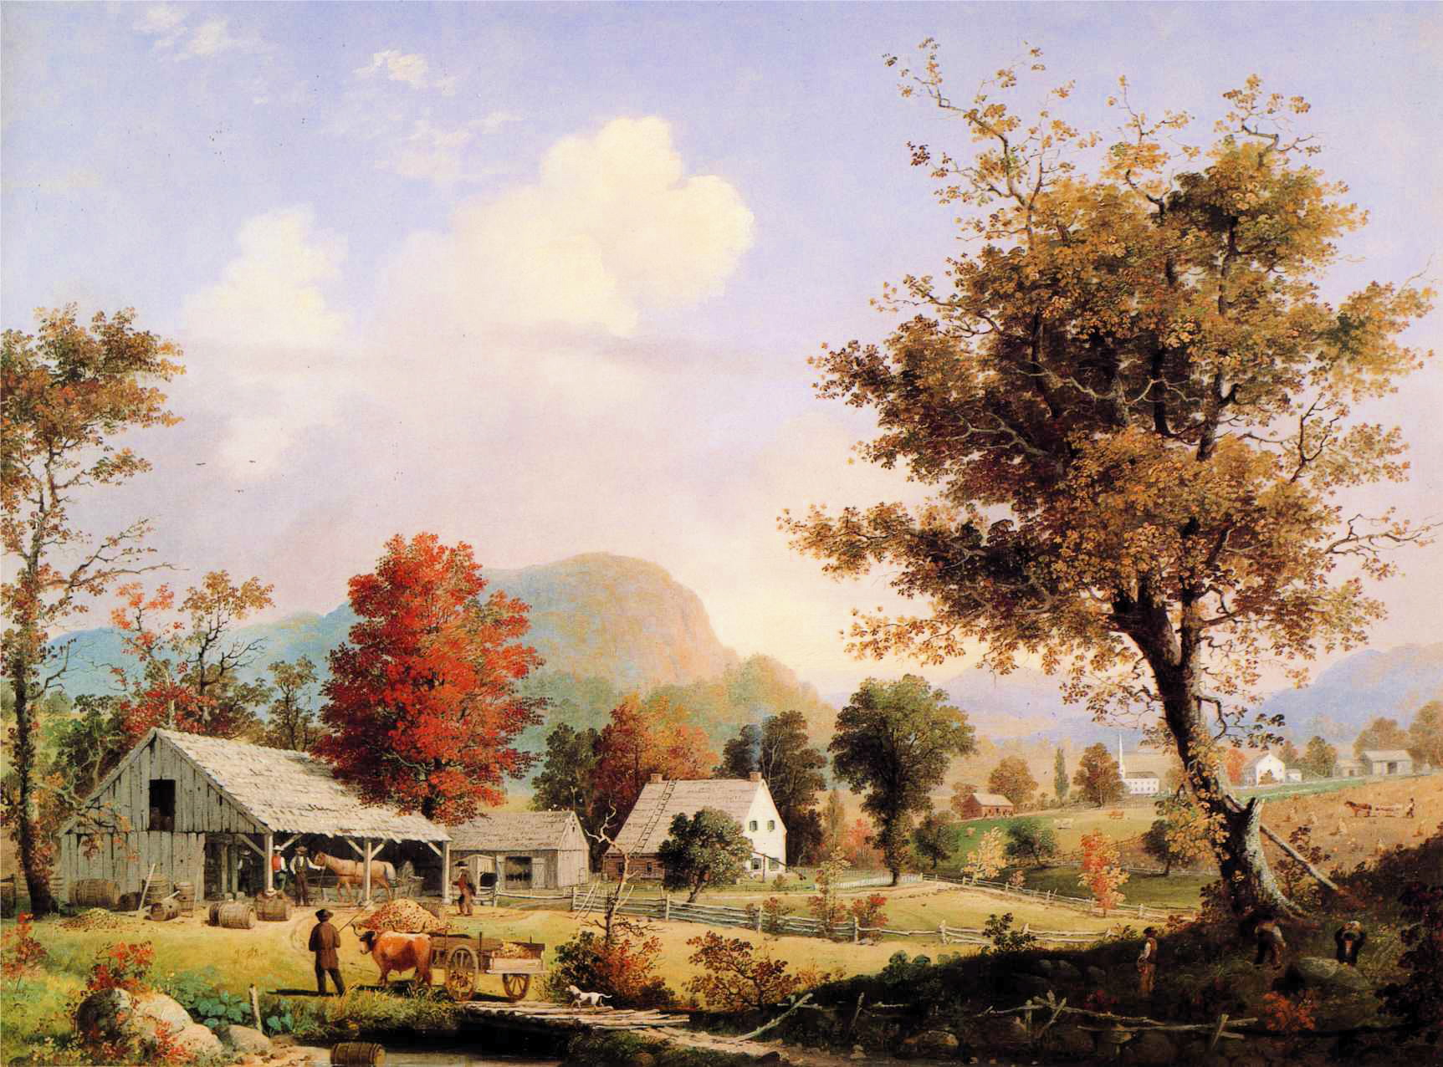
Jefferson’s vision
Make the United States a nation of self-sufficient farm families with only enough manufacturing to supply America’s needs

Slide 50
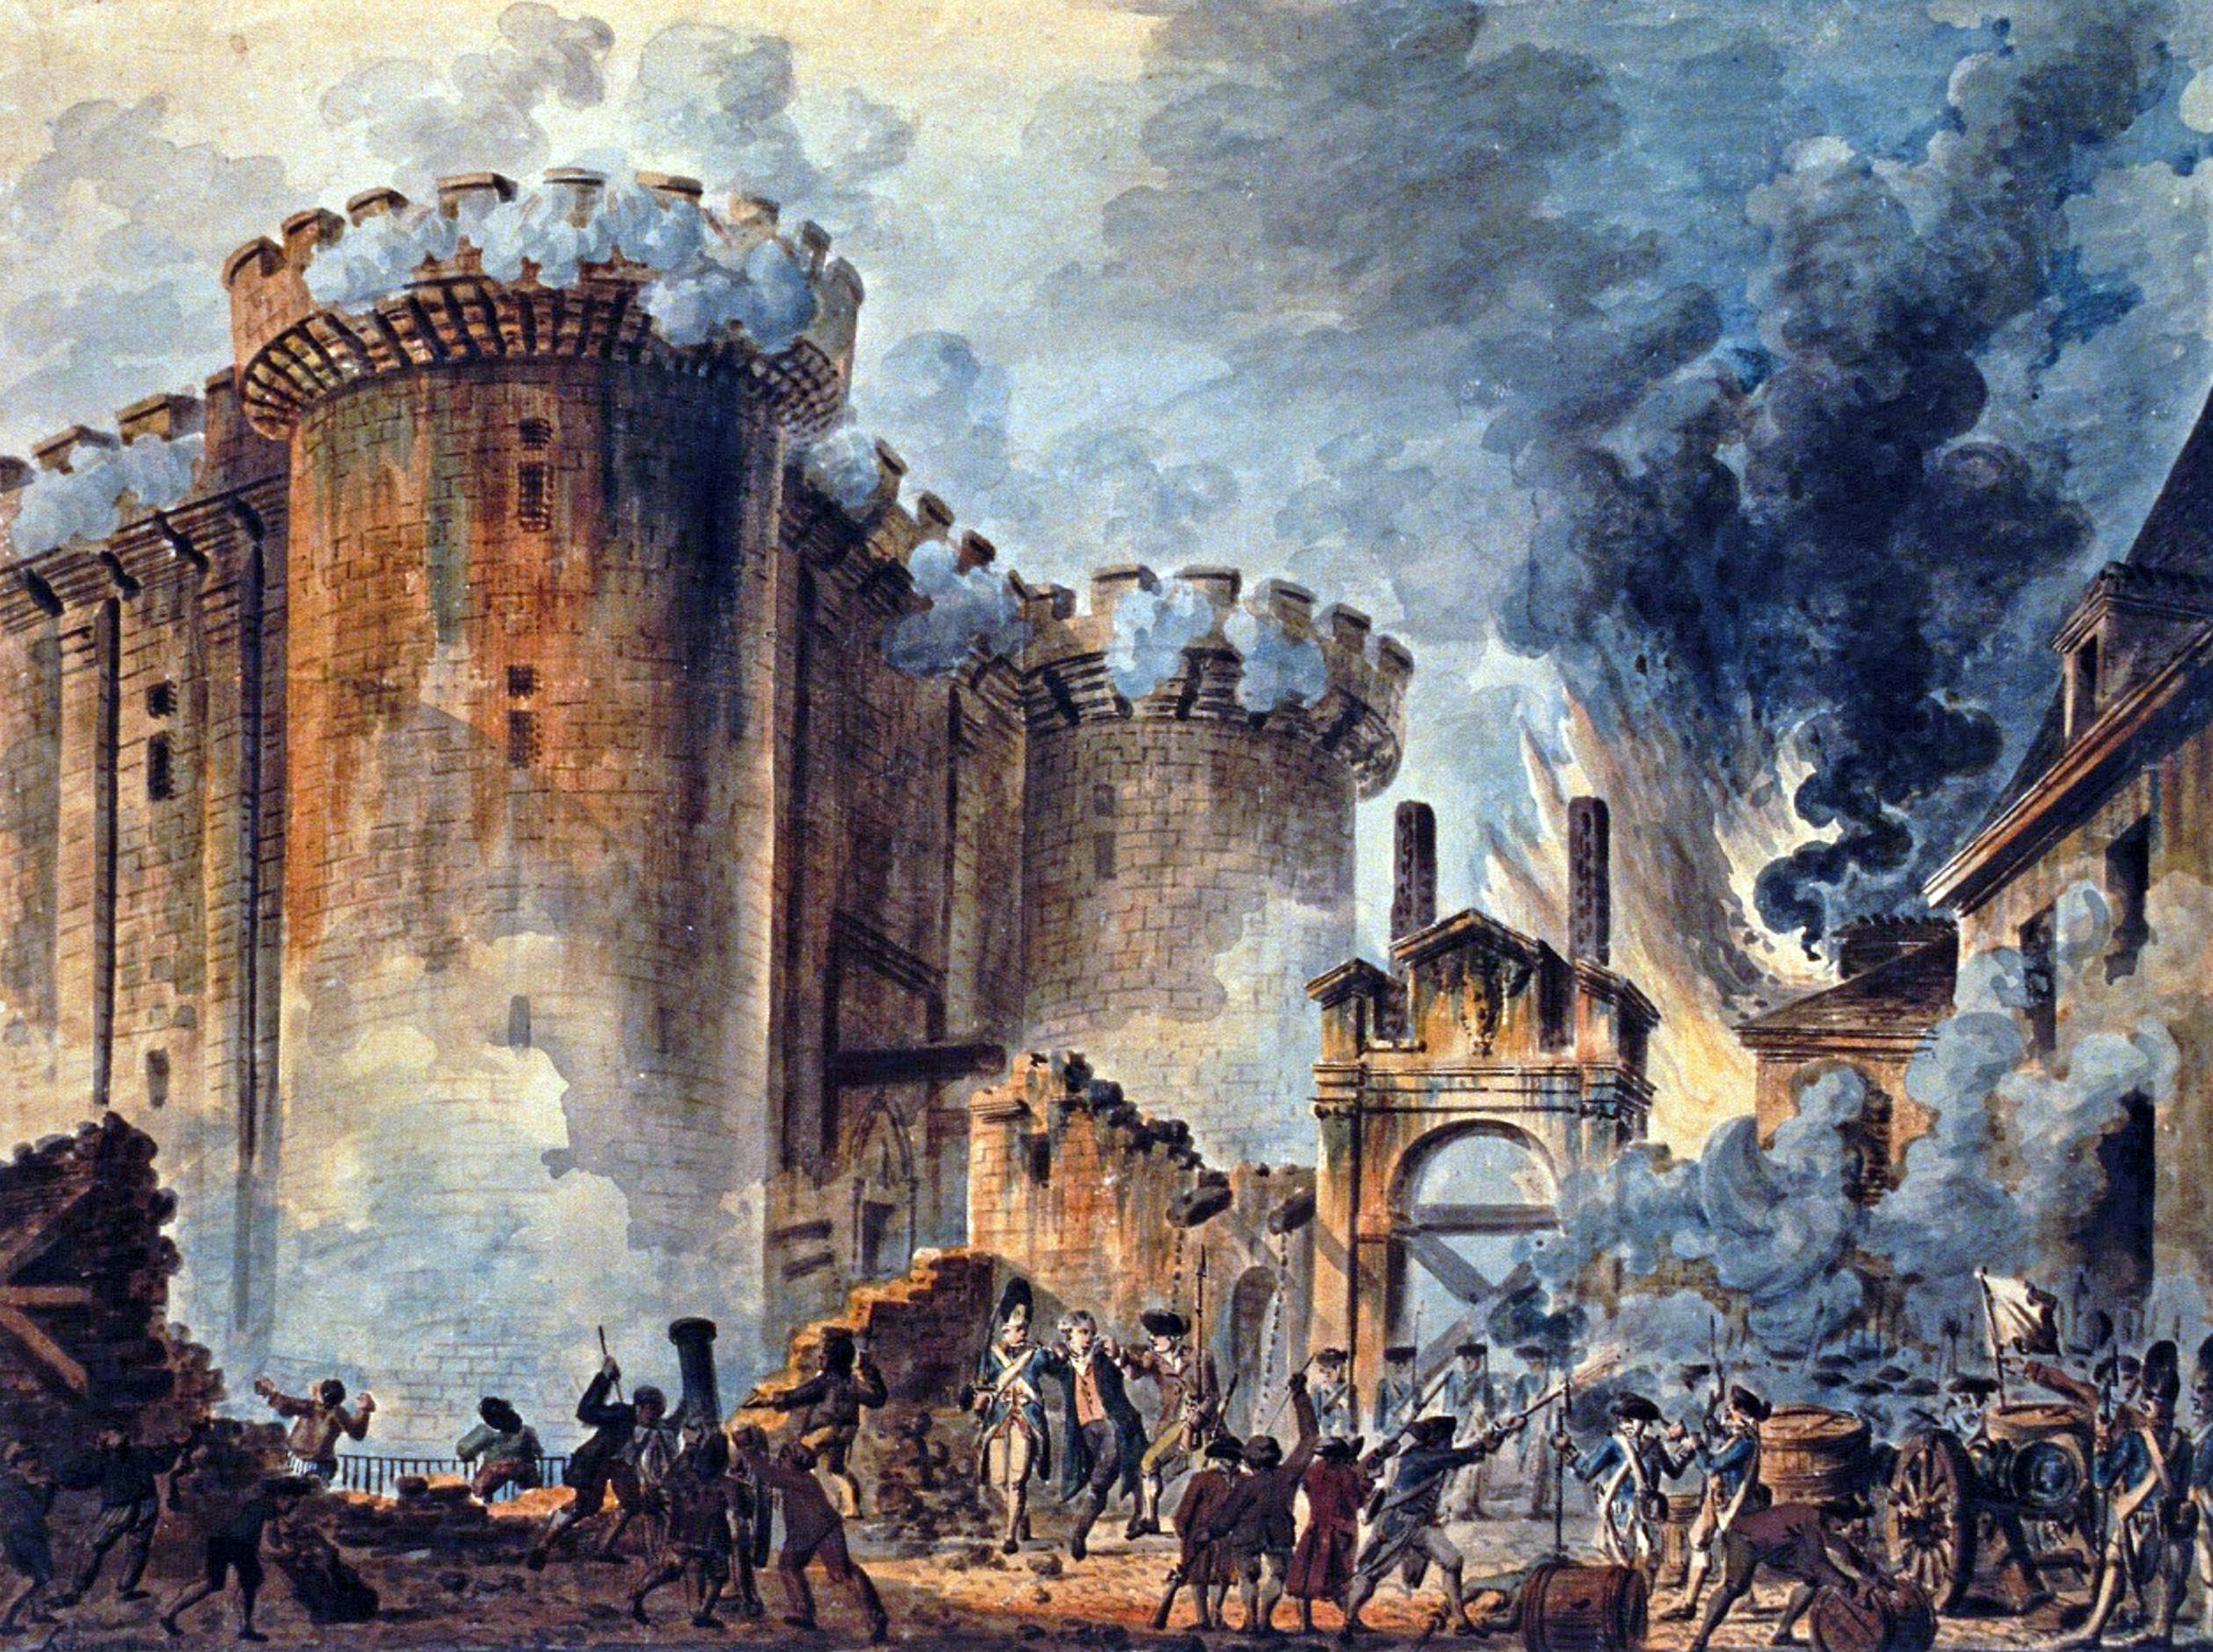
The storming of the Bastille in Paris begins the French Revolution, July 1789

Slide 51
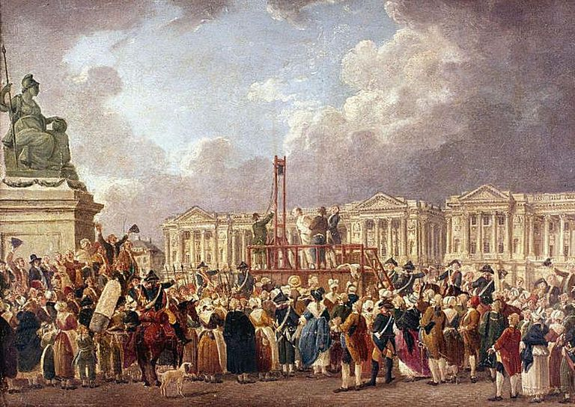
After King Louis XVI and Marie Antoinette are beheaded, 17,000 more people are executed in the “Reign of Terror” in France.
France and England declare war on each other in February, 1793

Slide 54
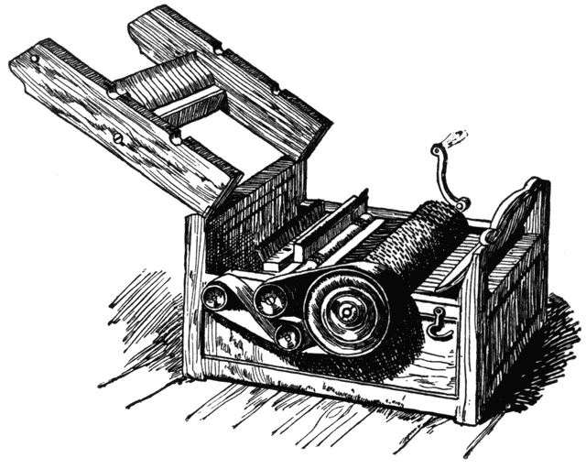
Eli Whitney’s Cotton Gin, invented in 1793

Slide 55
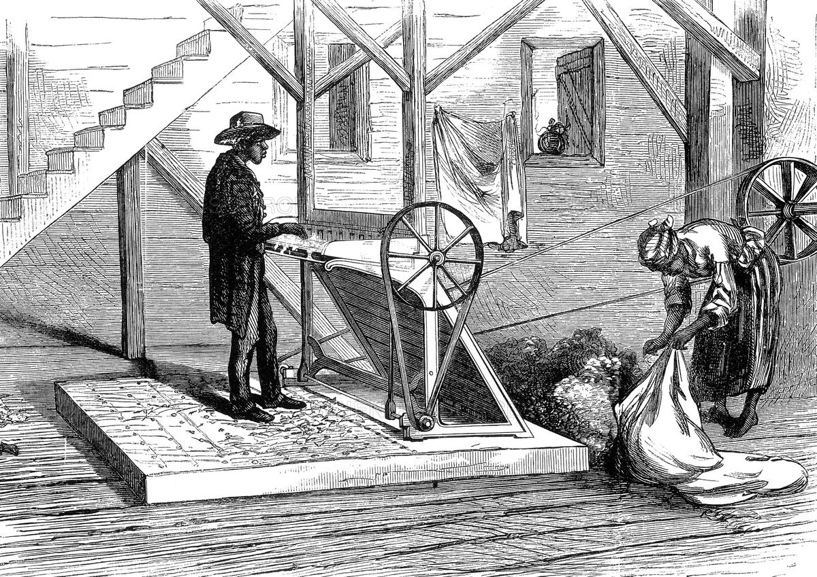

Slide 56
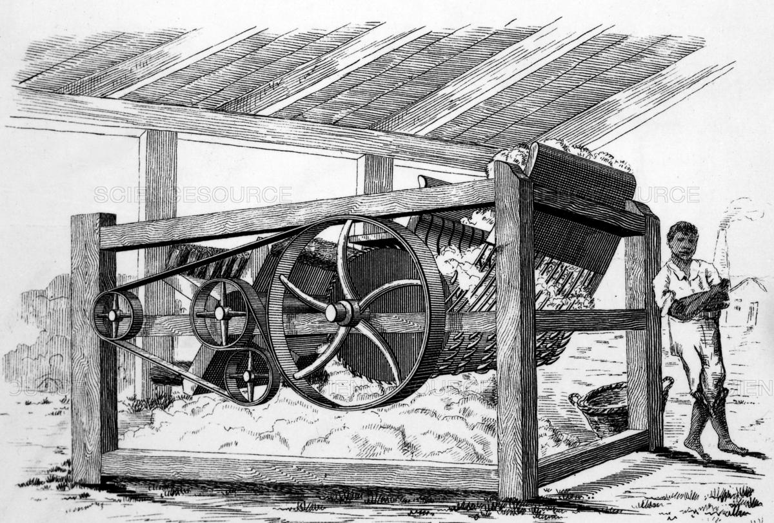

Slide 57
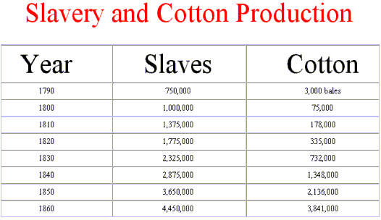

Slide 58
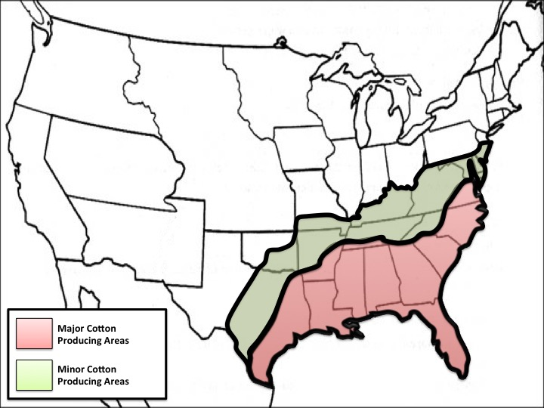

Slide 59
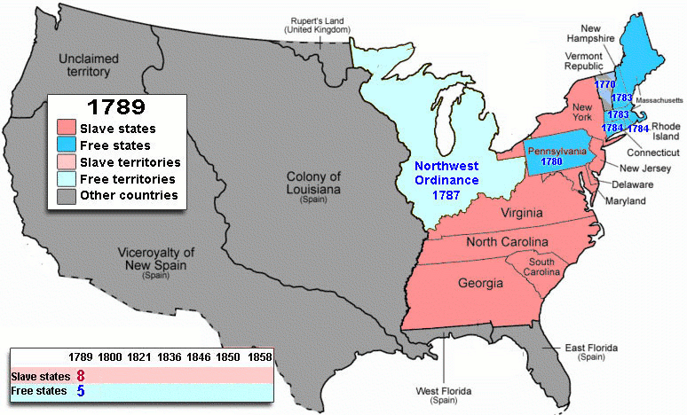

Slide 60
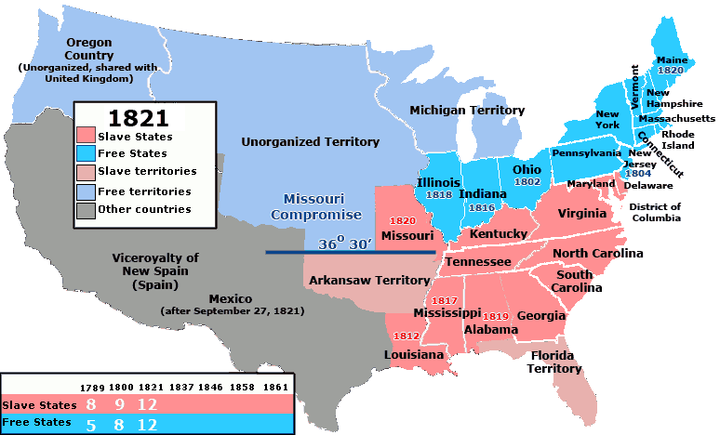

Slide 61
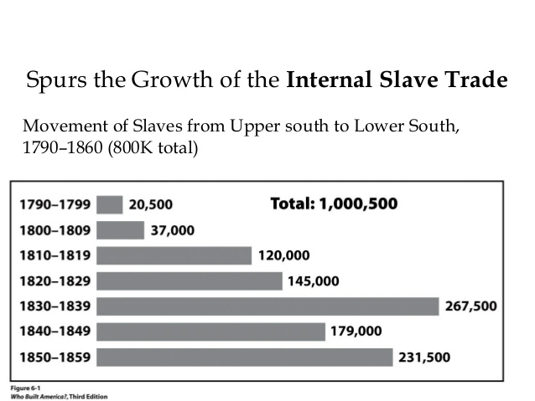

Slide 64
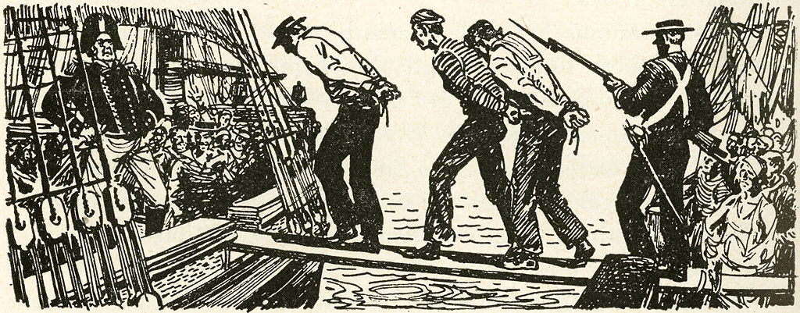
British warship impressing American sailors on the high seas

Slide 66
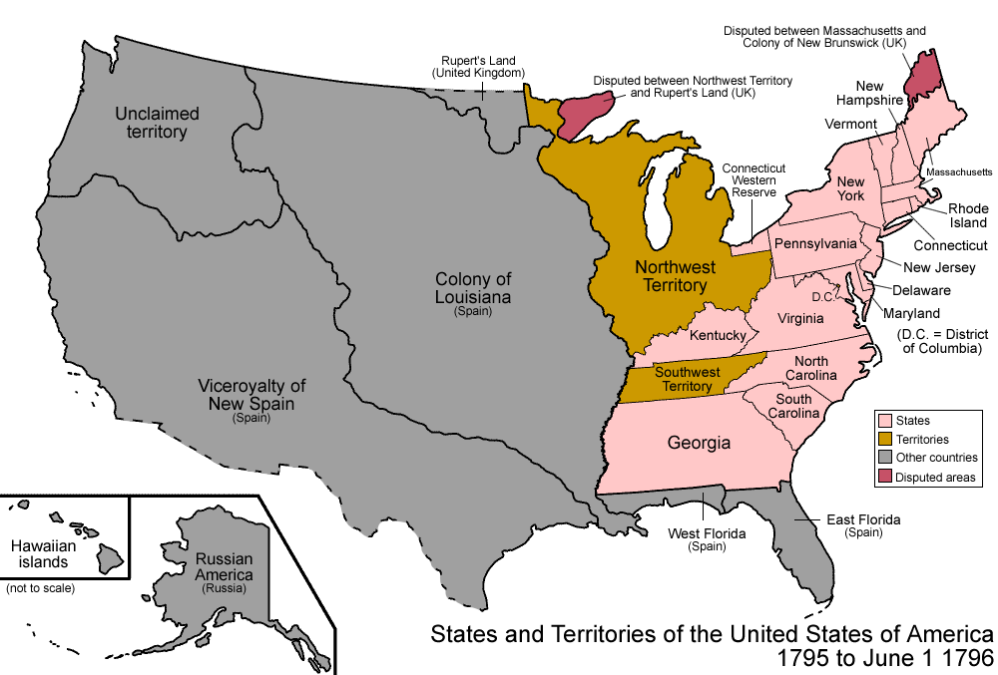

Slide 67
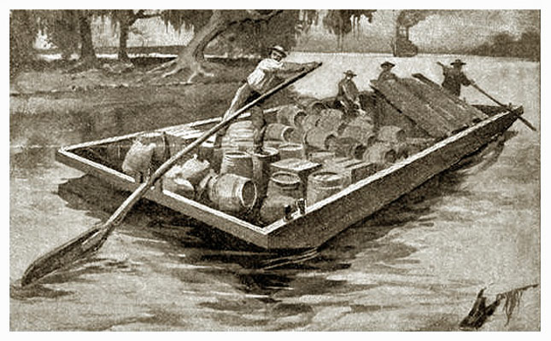

Slide 68
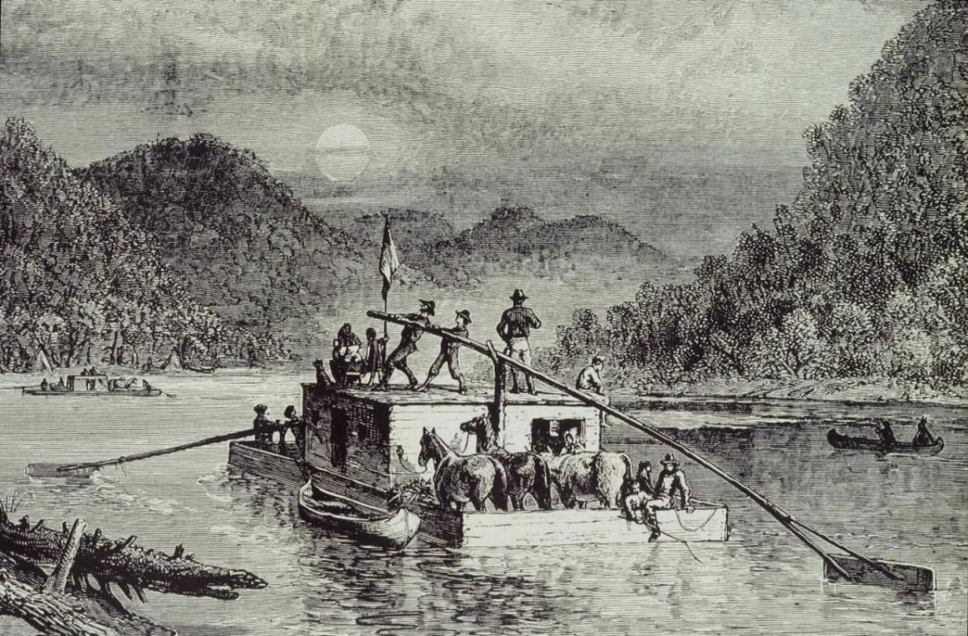

Slide 69
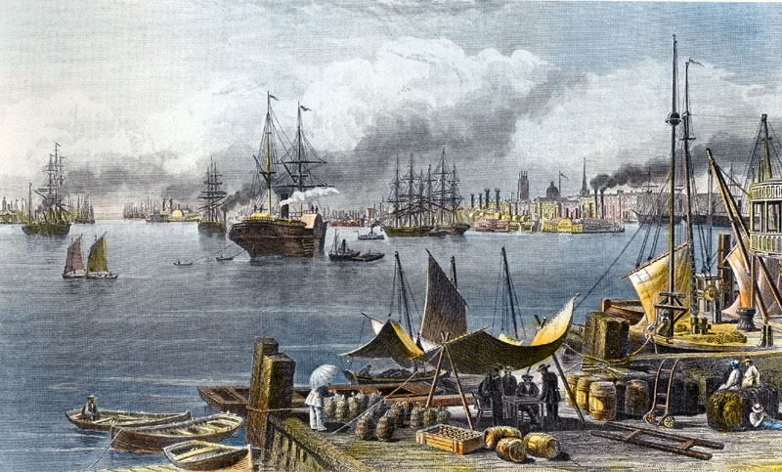

Slide 73
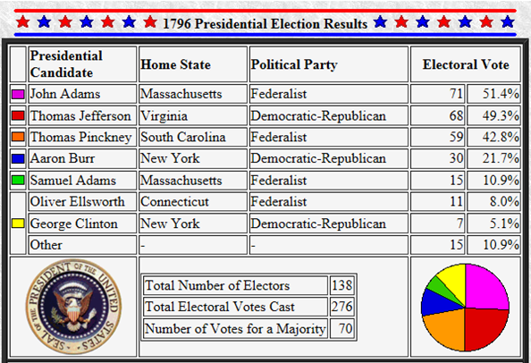

Slide 76
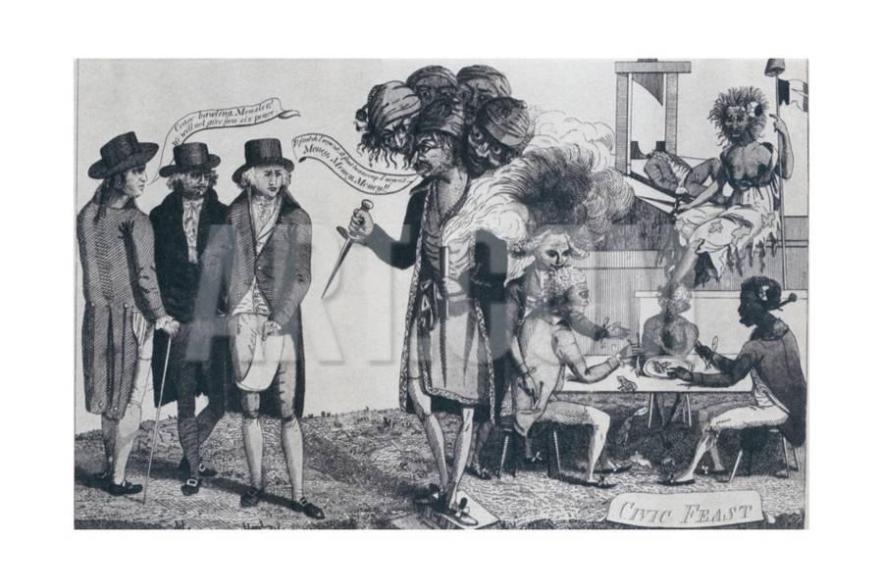
Anti-French political cartoon regarding XYZ affair.
The affair caused Americans to clamor for war against France.

Slide 77
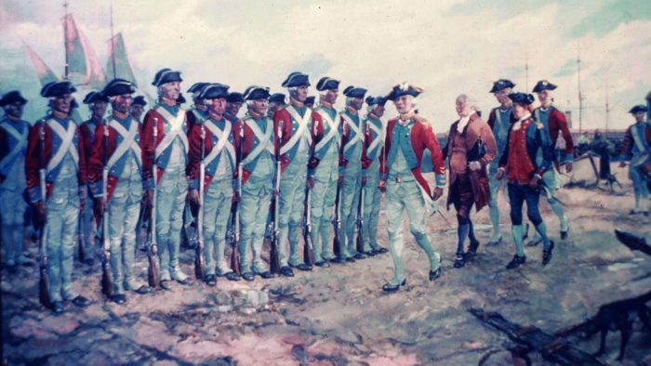
Adams’ cabinet calls for 20,000 man army and construction of a U.S. Navy to fight the French

Slide 78
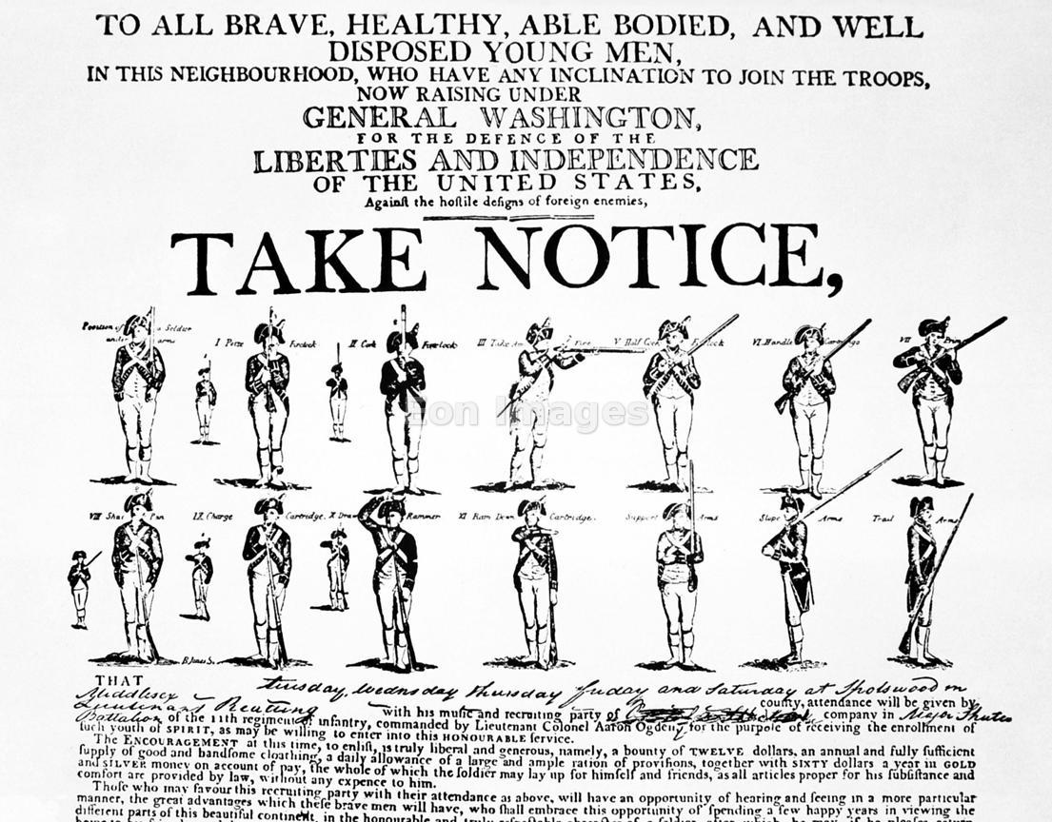

Slide 79
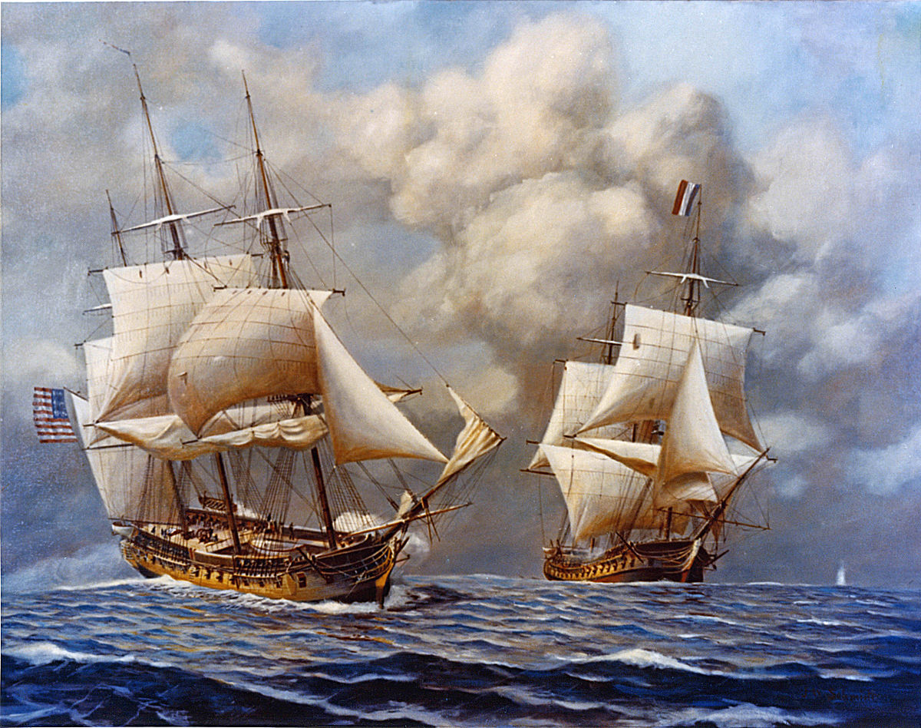
Quasi-War with France
The frigate USS Constellation
unleashes a broadside upon the French frigate L'Insurgentein the open sea, February, 1799

Slide 82
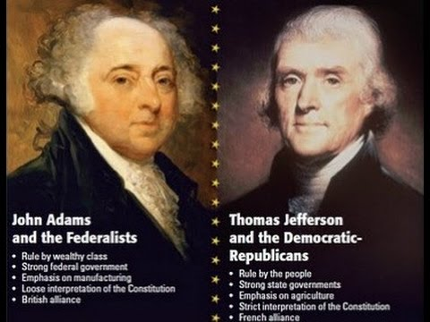

Slide 84
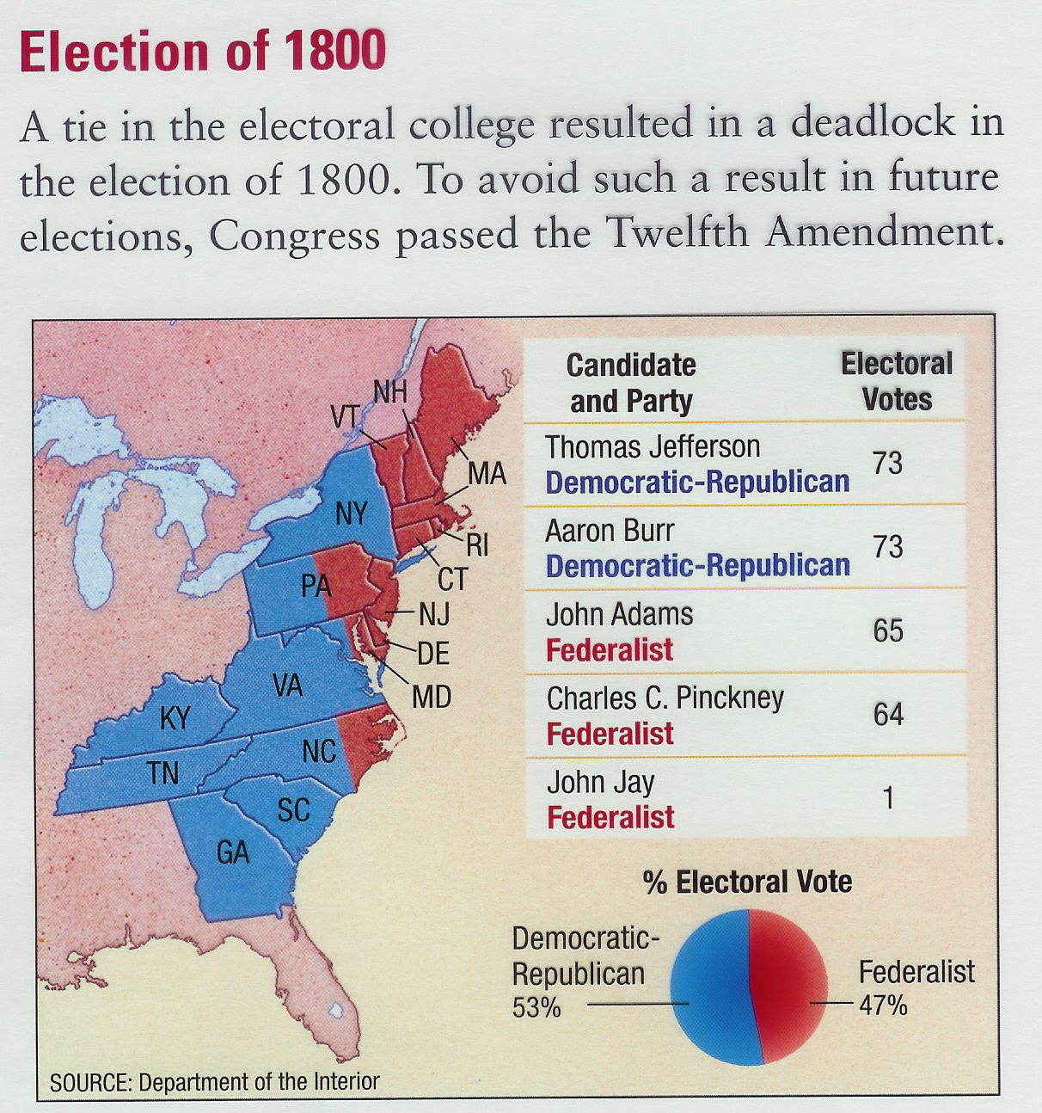

Slide 85
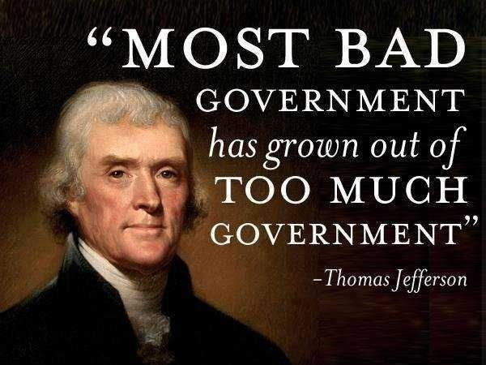

Slide 86
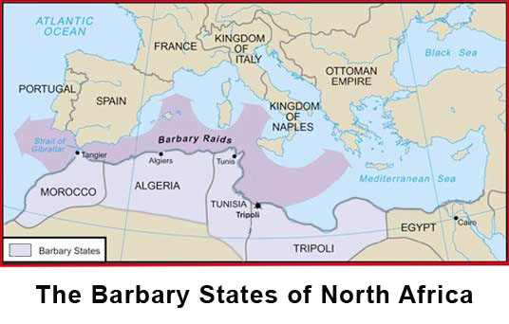

Slide 87
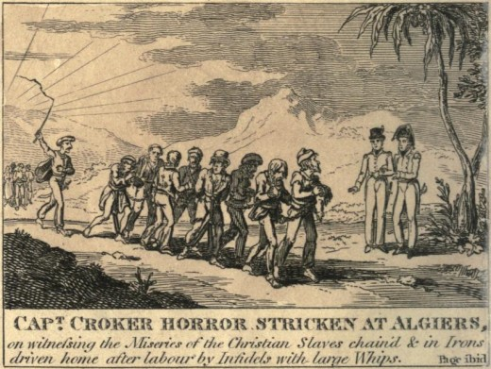

Slide 88
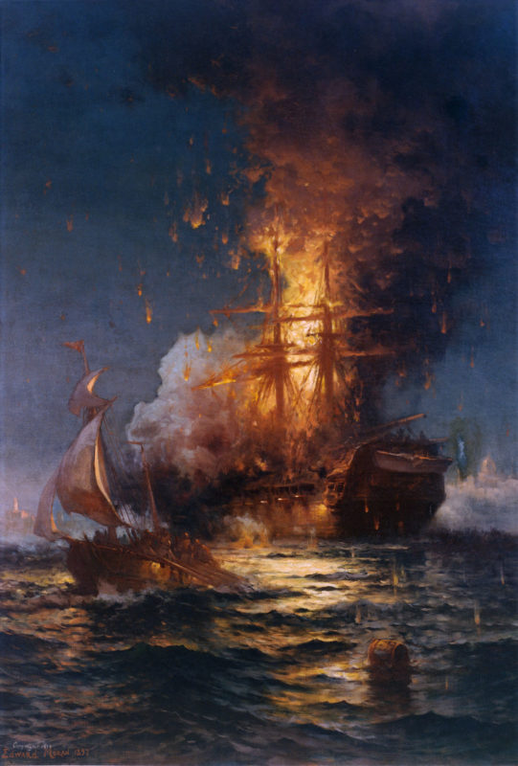
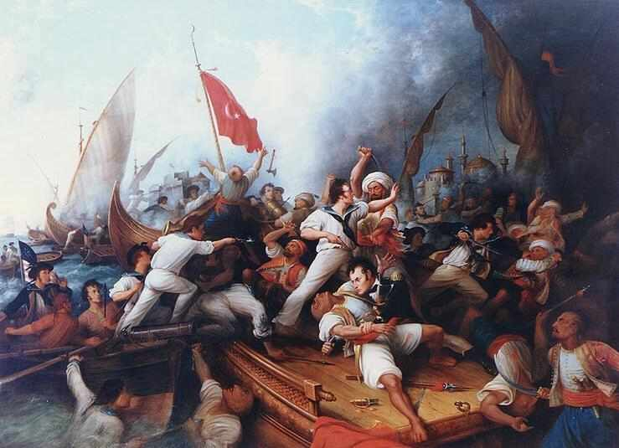
First Barbary War, 1801-1805

Slide 89
Saint Dominique (now Haiti)

Slide 91
Toussaint L’Ouverture
Jean-Jacques Dessalines

Slide 92
1791 – Toussaint L’Ouverture leads successful slave revolt in St. Dominique (now Haiti)

Slide 95
French troops led by General Leclerc battle Haitian rebels led by Jean-Jacques Dessaline, March, 1802

Slide 96
Under Dessalines’ leadership, Haitian rebels killed
3,000-5,000 whites in the 1804 “Haiti Massacre”

Slide 105
Vice President Aaron Burr kills Alexander Hamilton in illegal duel in New Jersey, 1804

Slide 111
James Madison, Democratic-Republican, elected 1808, reelected 1812

Slide 118
British troops burn the White House, August 1814

Slide 123
James Monroe, Democratic-Republican, elected 1816, reelected 1820

Slide 125
First Bank of the United States, chartered in 1791, expired 1811
Second Bank of the United States, chartered in 1816 for 20 years

Slide 136
Election of 1820
James Monroe, Democratic Republican, reelected without opposition
“Era of Good Feelings”

Slide 140
Election of 1824

Slide 143
Election of 1828 – Andrew Jackson versus John Quincy Adams

Slide 145
Spoils System
The appointment of a victorious candidate’s supporters to political office

Slide 147
Vote for and against the 1828 “Tariff of Abominations” in the House of Representatives

Slide 148
1830 Indian Removal Act
Authorized removal of Native Americans to lands west of the Mississippi in exchange for their homelands in the east

Slide 152
John C. Calhoun
Vice President and author of The South Carolina Exposition and Protest
1828

Slide 158
Whig Party promotions, 1840 election

Slide 159
Political advertisement for James G. Birney, candidate for the new anti-slavery Liberty Party
1840 presidential election

Slide 163
John Tyler
Became president when Harrison died
Former Democrat
Blocked Whig agenda
Cabinet resigned (except Webster)
Expelled from Whig party, 1841
“President without a party”

