Slide 1
Hist 201: U.S. History Discovery to Reconstruction
Prof. John Navin
CCU Dept. of History

Slide 2
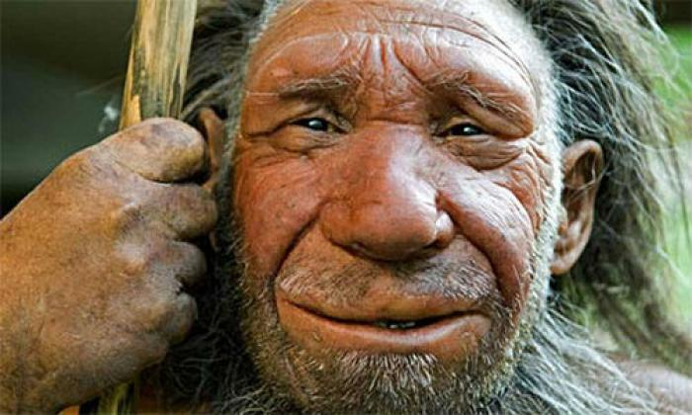

Slide 3
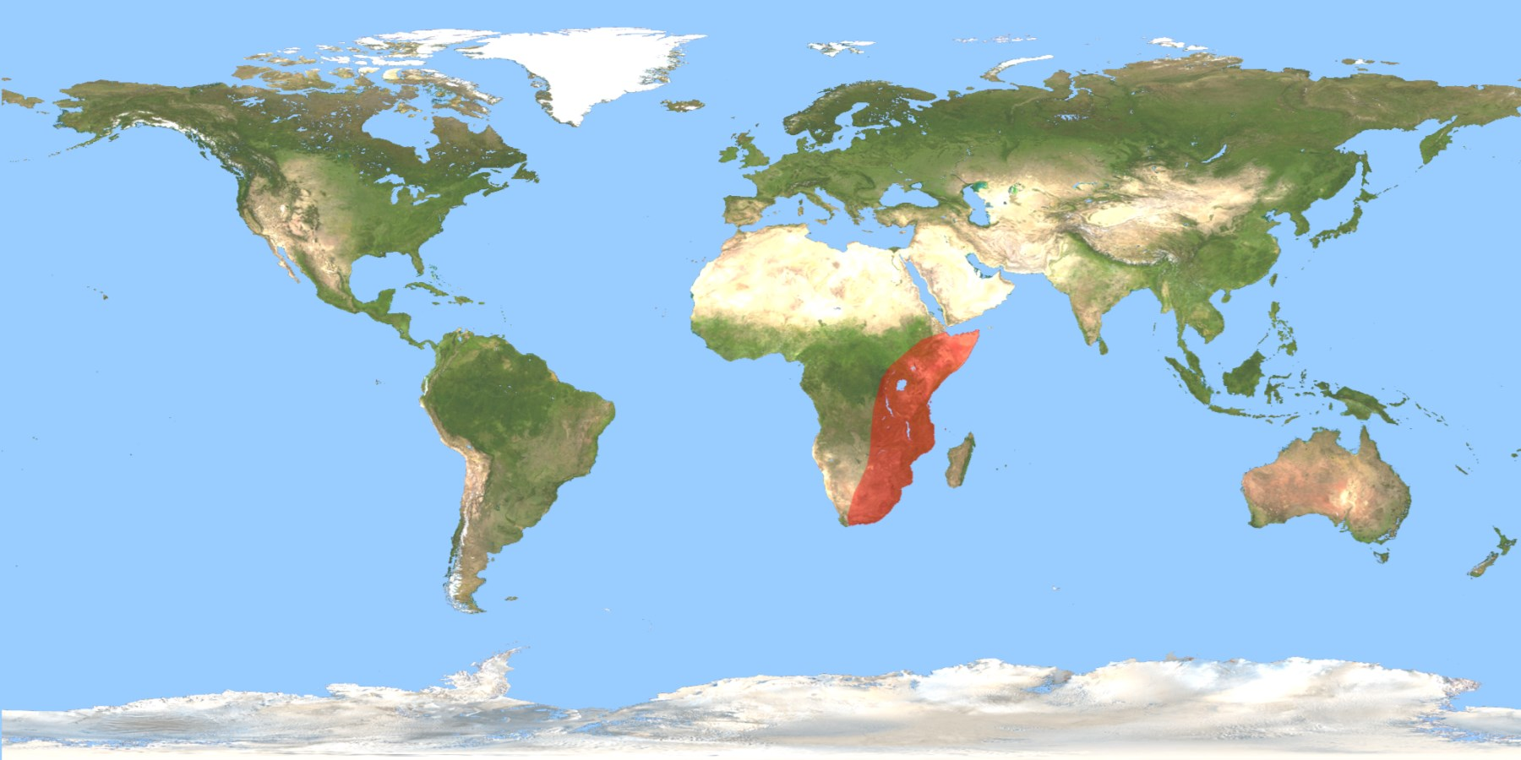
Homo Habilis range, sub-Saharan Africa, 2.1-1.5 million years ago

Slide 4
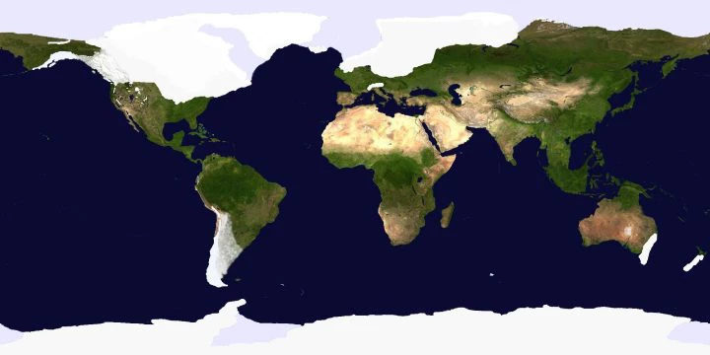
Full Ice Age Earth Condition

Slide 5
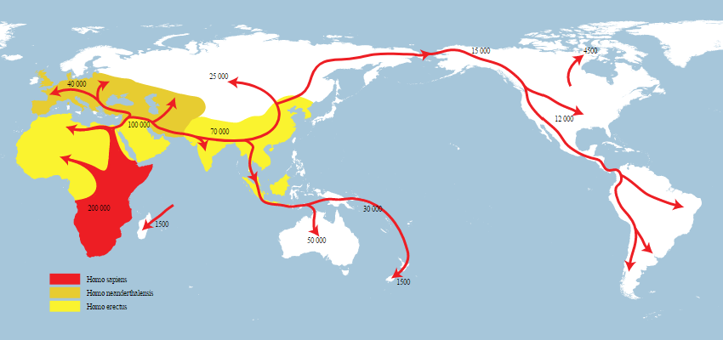
Migration Routes

Slide 6
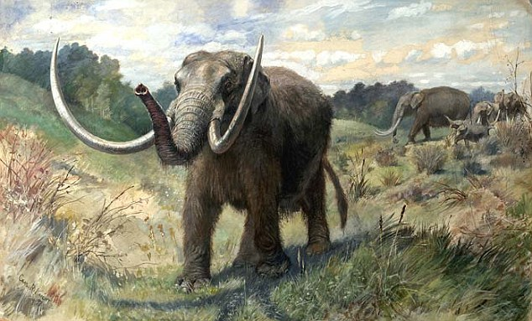

Slide 7
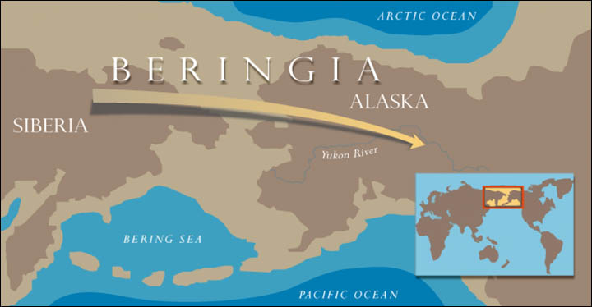

Slide 8
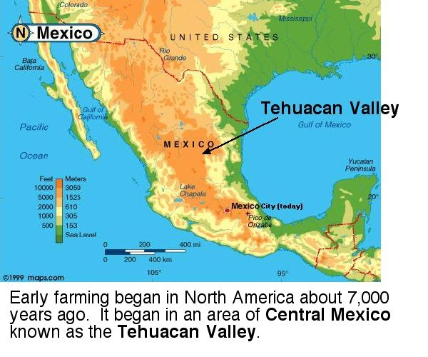

Slide 9
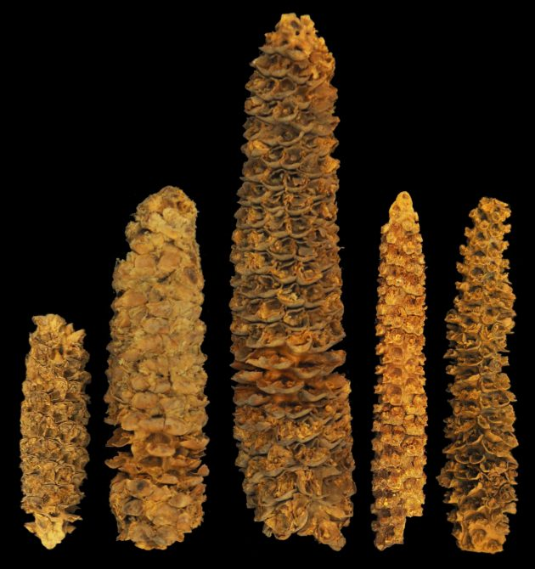
“Study dates corn as staple crop in Central America beginning 4,300 years ago”
Science & Nature, 2017
A selection of preserved maize cobs from
El Gigante rock shelter, Honduras

Slide 10
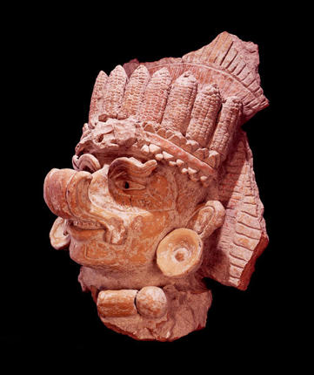
Mayan corn god, Oaxaca, c. 500 A.D.

Slide 11
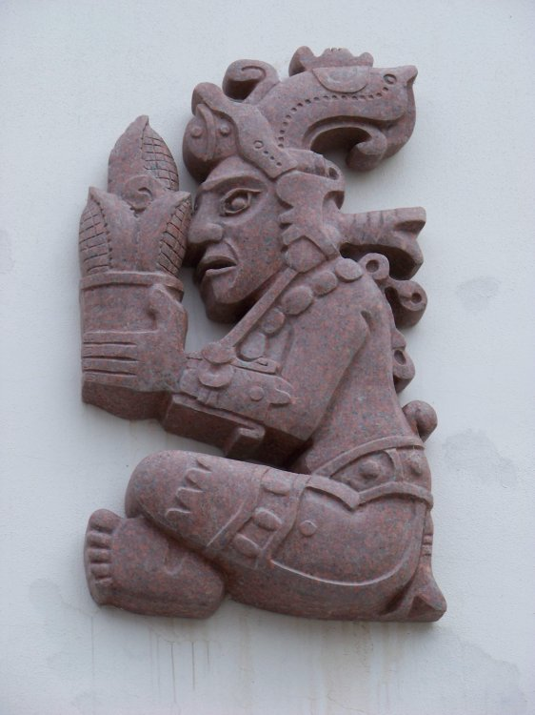
Mayan Maize God, Hun Hunahpu, who was killed by the Lords of Xibalba, brought back to life by his sons, the Hero Twins, and emerged from the underworld as corn.

Slide 12
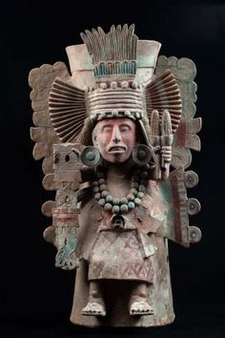
Xilonen Goddess of Maize Aztec, circa 1500 A.D.

Slide 13
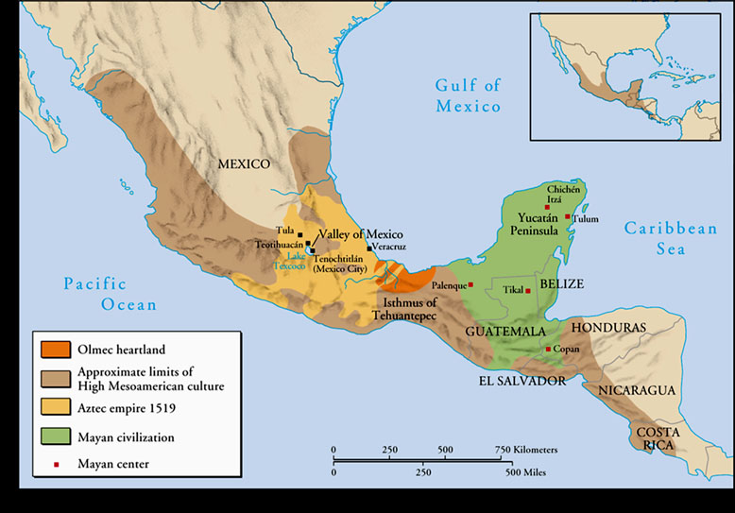

Slide 14
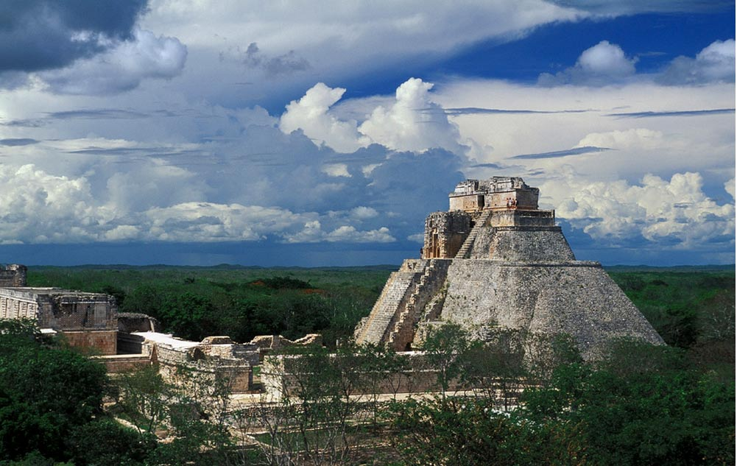
Mayan
ruins

Slide 15
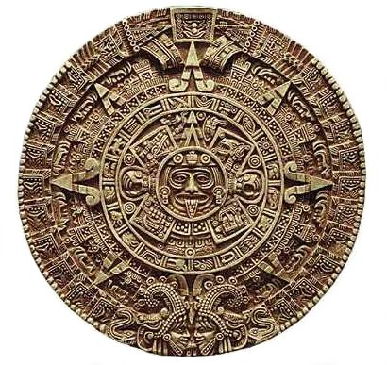
Mayan Calendar

Slide 16
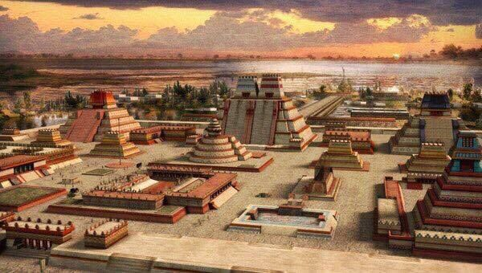
Artist’s depiction of Aztec city of Tenochtitlan circa 1500

Slide 17
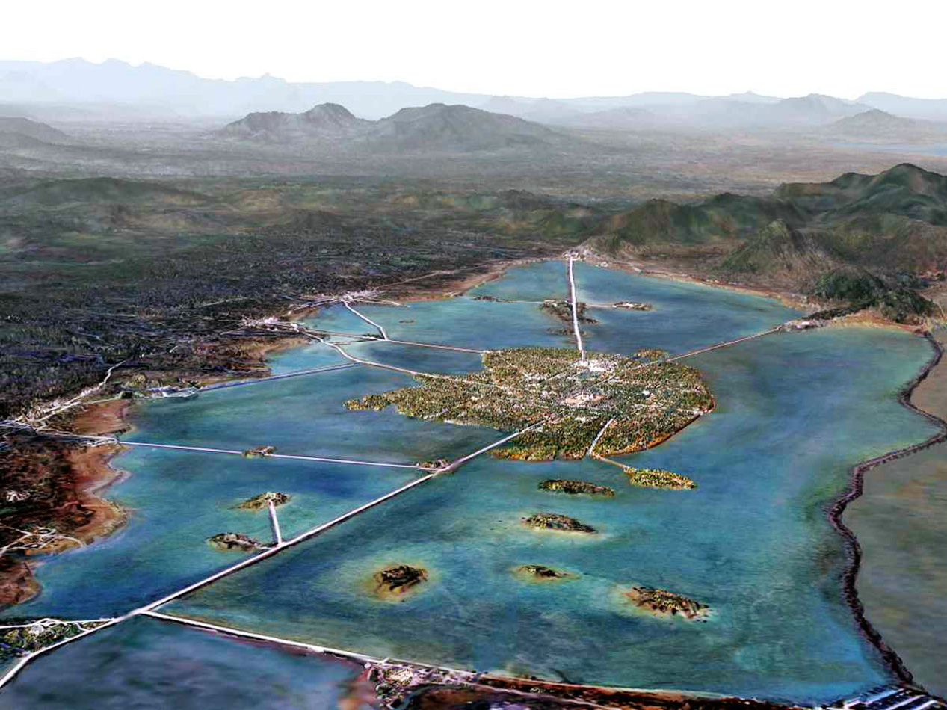

Slide 18
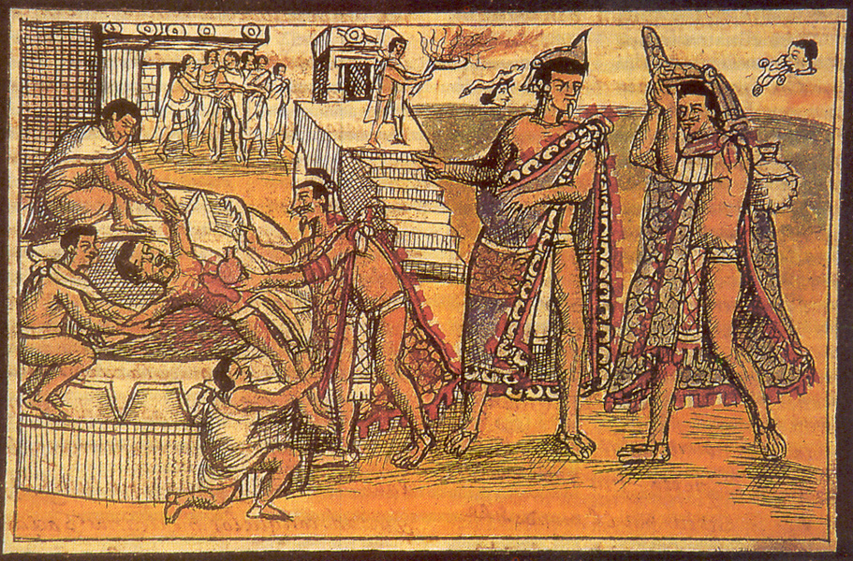

Slide 19
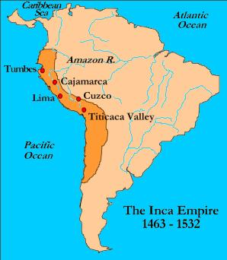

Slide 20
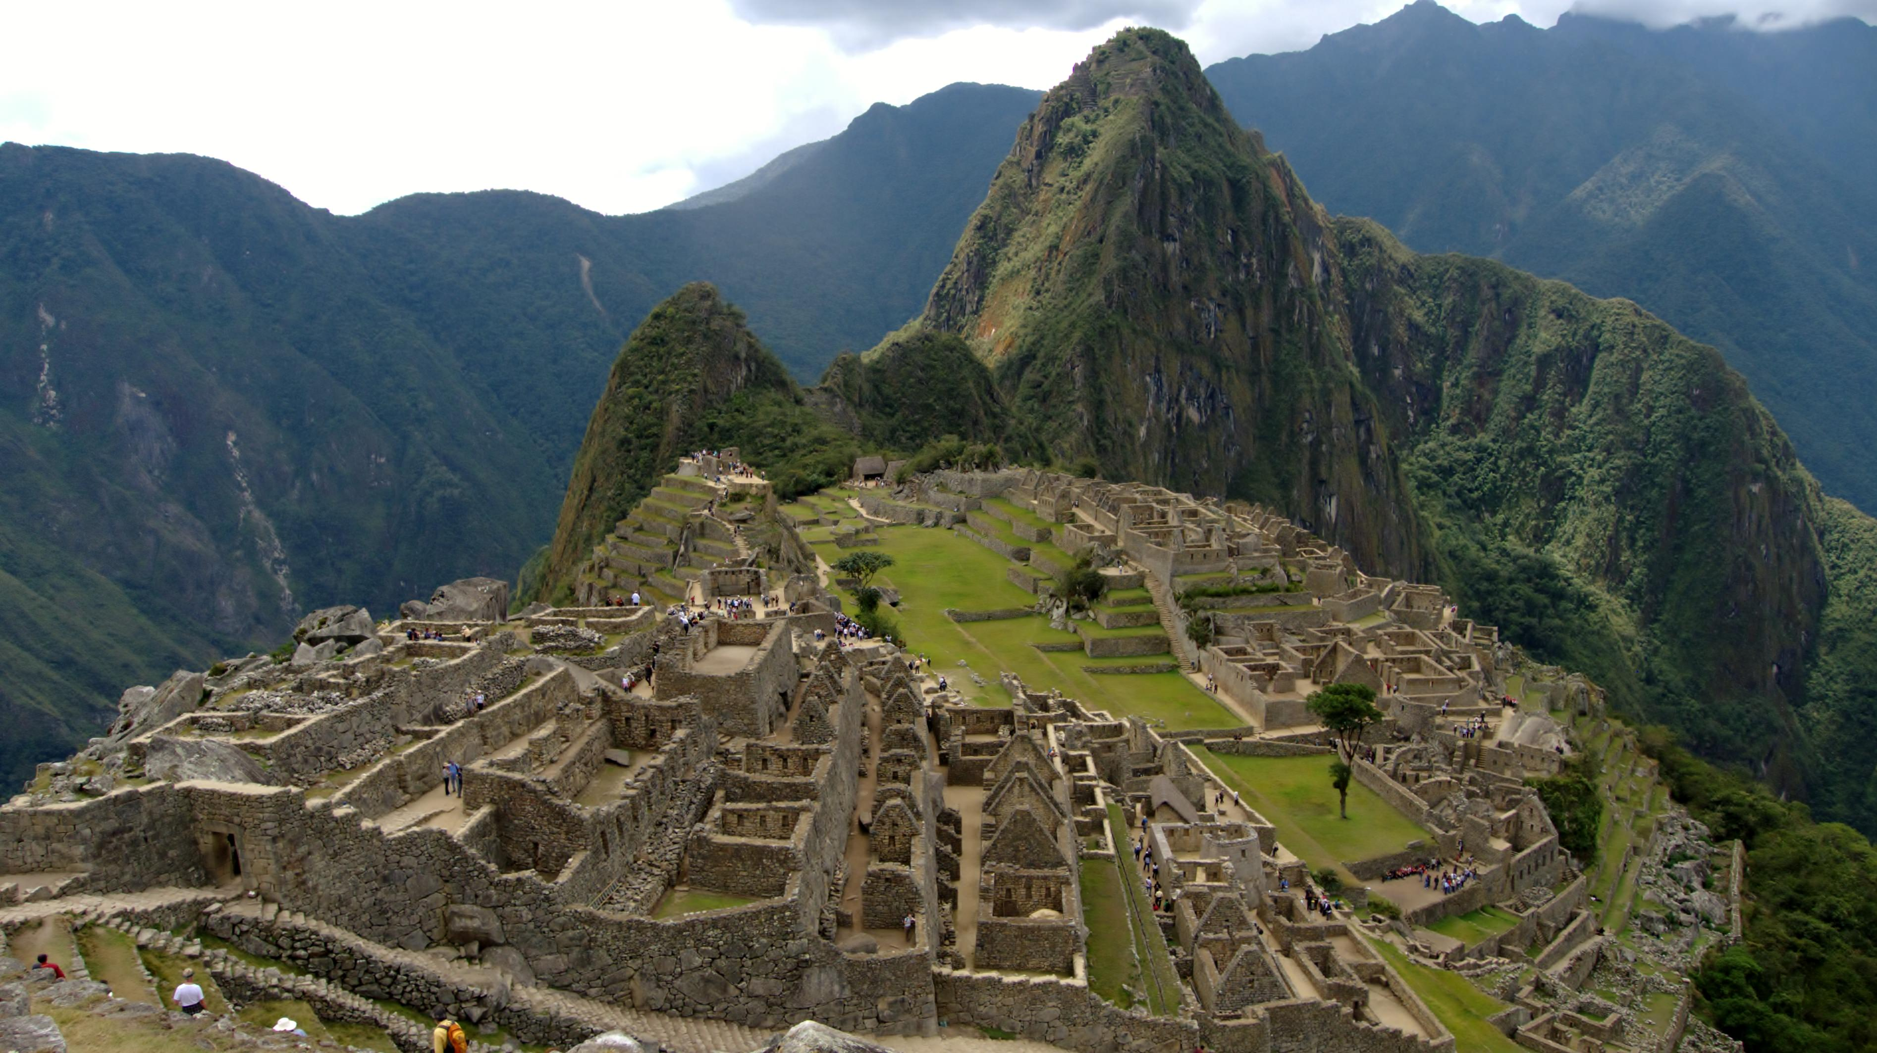

Slide 21
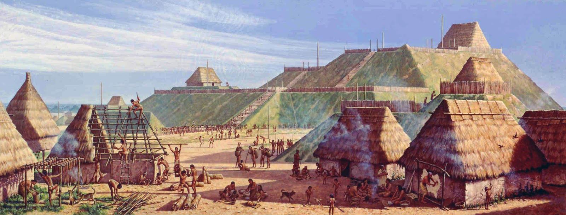
Cahokia (Illinois) circa 1150 A.D.

Slide 22
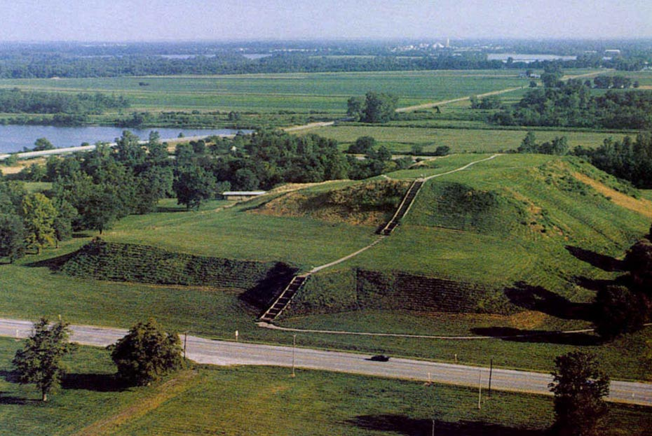
Monks mound, Cahokia

Slide 23
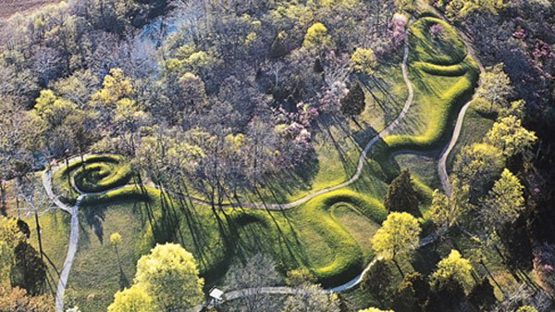
Great Serpent Mound of Ohio, Adena, circa 1070 A.D.

Slide 24
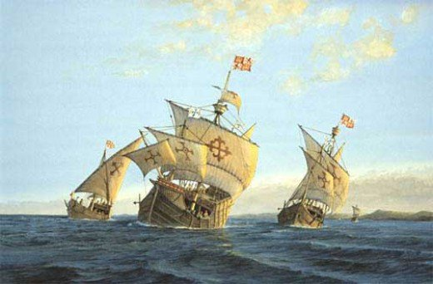

Slide 25
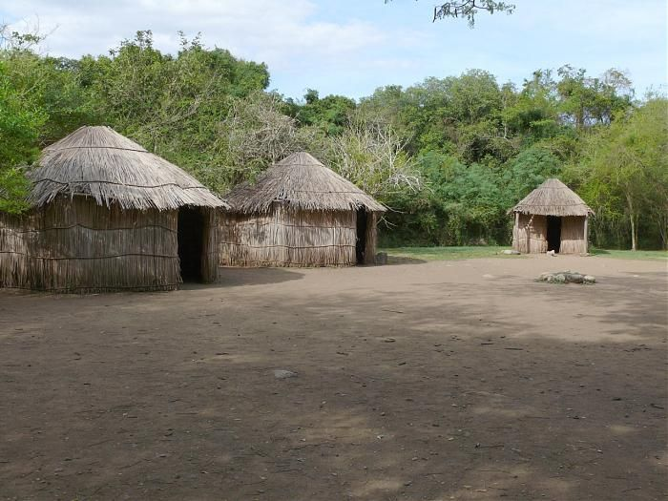
Taino
Bohios

Slide 26
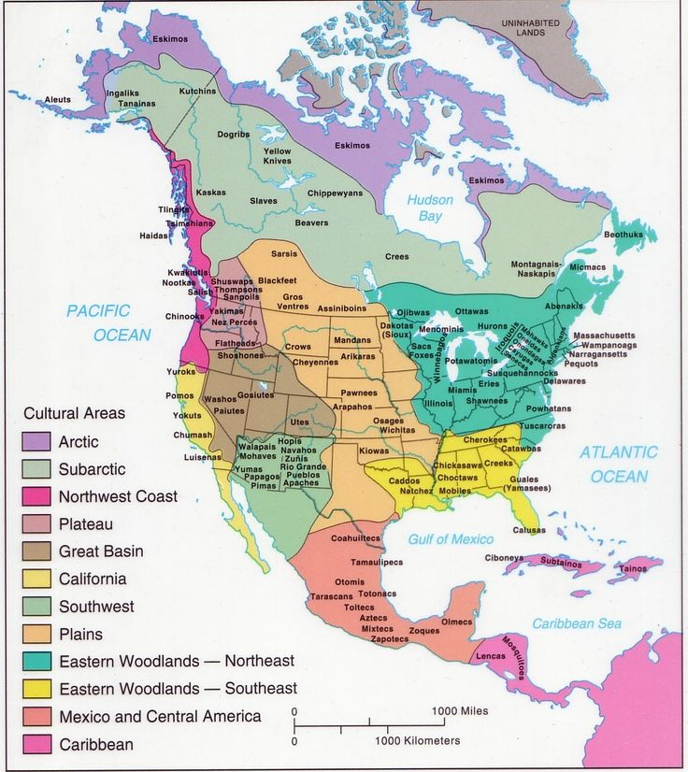

Slide 27
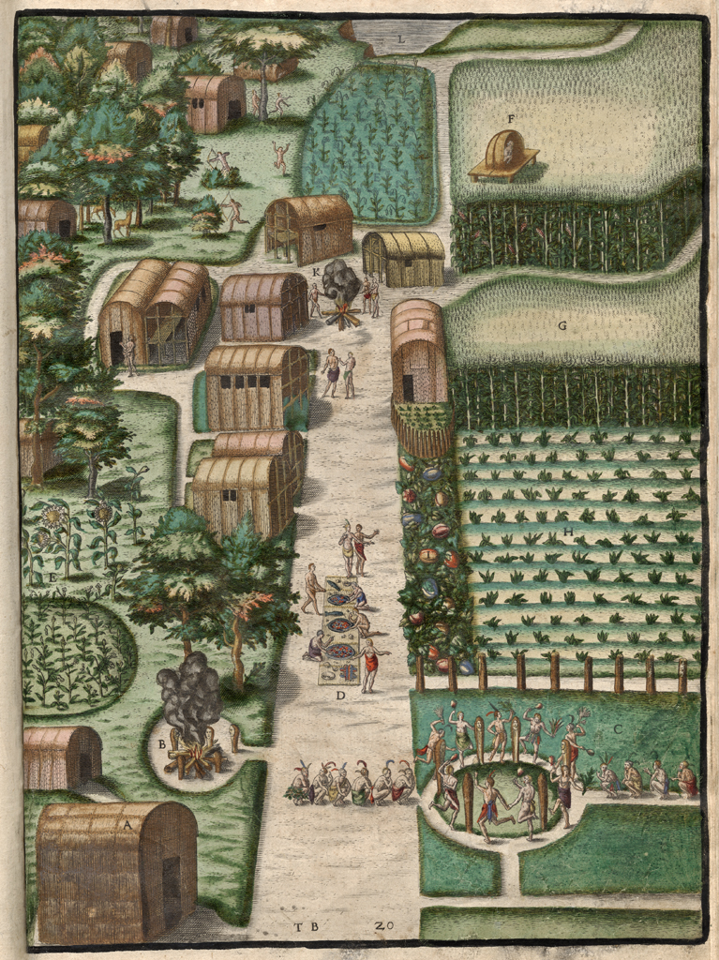
“The Towne of Secota” by Theodor de Bry, 1588, based on painting by John White

Slide 28
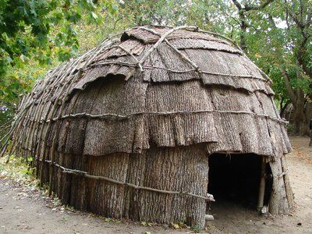
Iroquois Longhouse

Slide 29
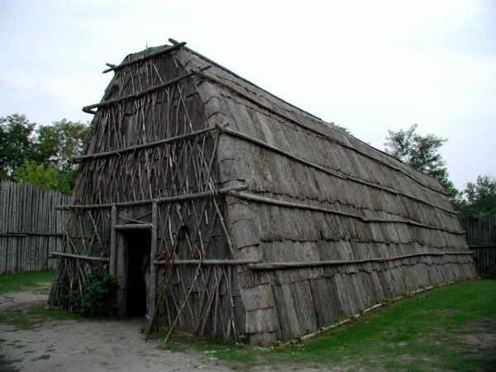
Algonquian Longhouse

Slide 30
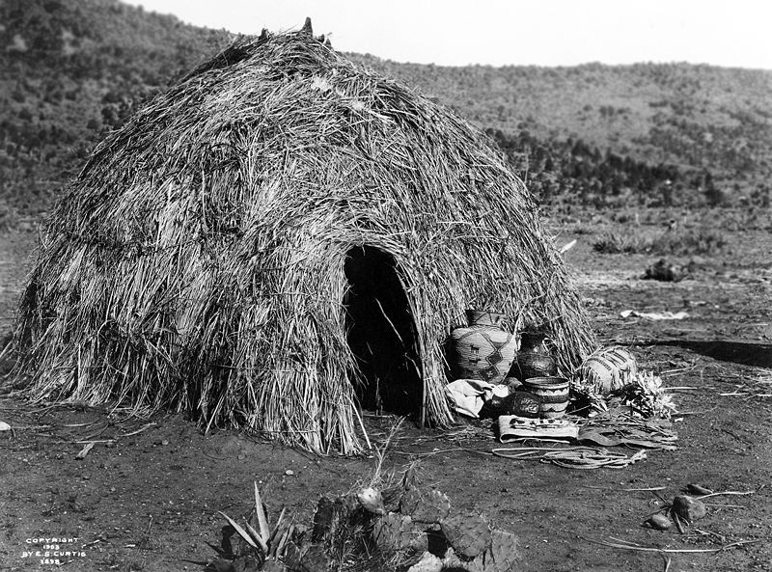
Apache Wickiup

Slide 31
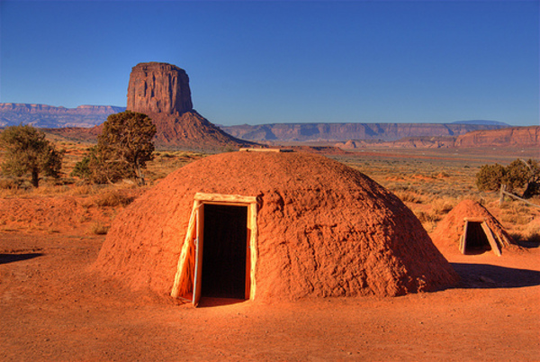
Navajo Hogan, Utah/
Arizona border

Slide 32
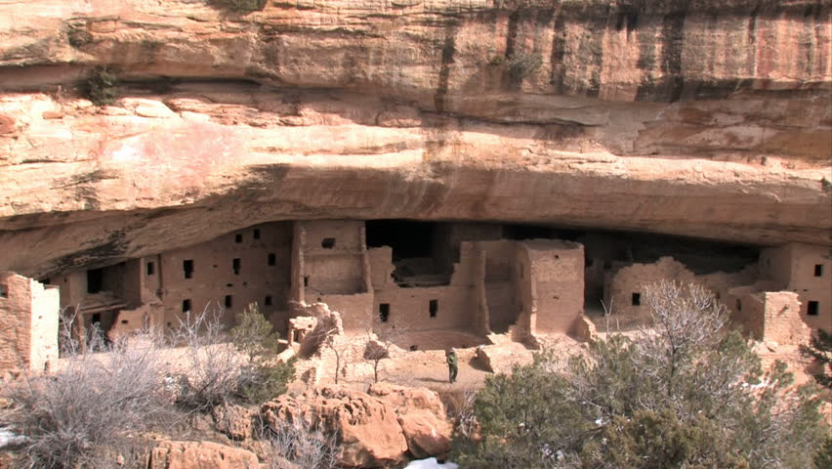
Pueblo
Cliff
Dwelling, Colorado

Slide 33
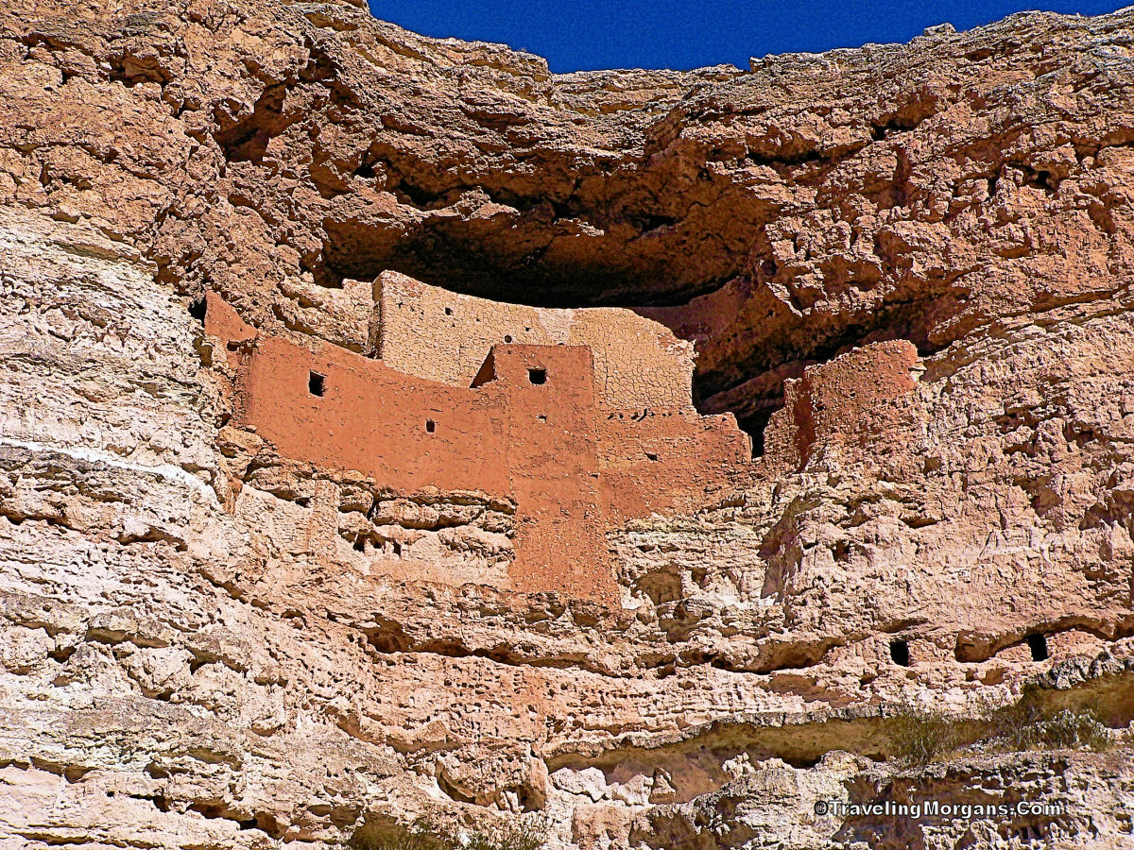
Gila Cliff Dwelling, New Mexico

Slide 34
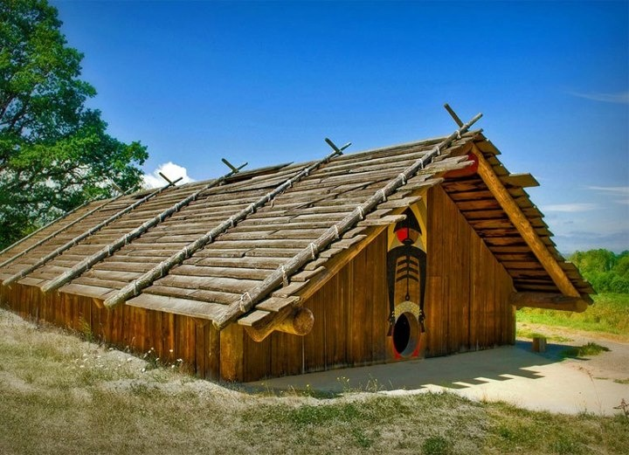
Chinook Long House or Plank House

Slide 35
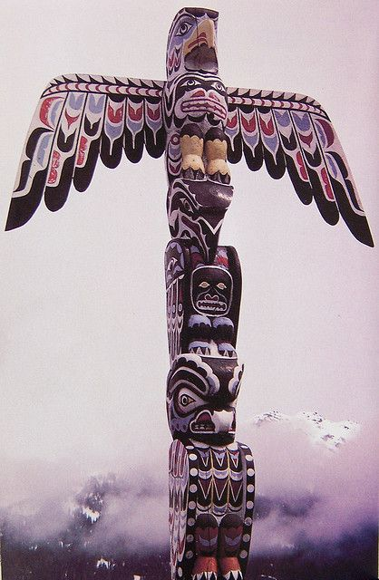

Slide 36
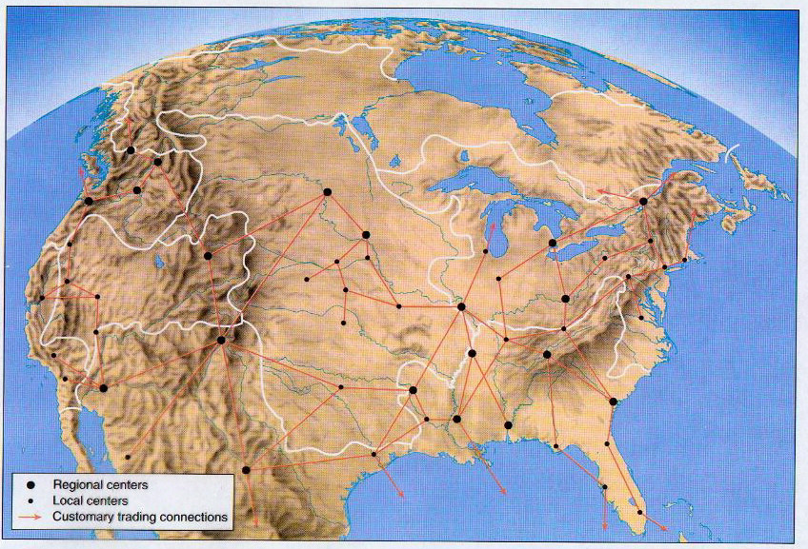
Pre-contact Native American trade routes

Slide 37
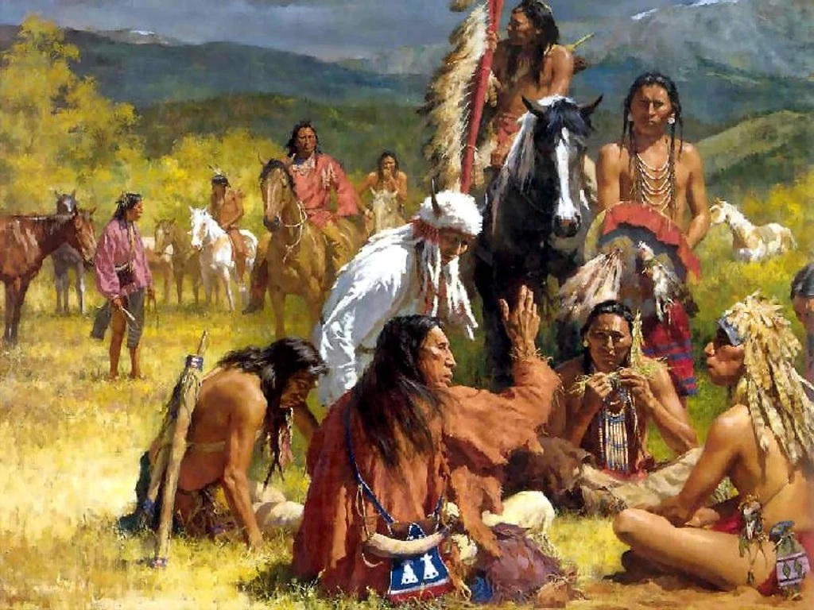

Slide 38
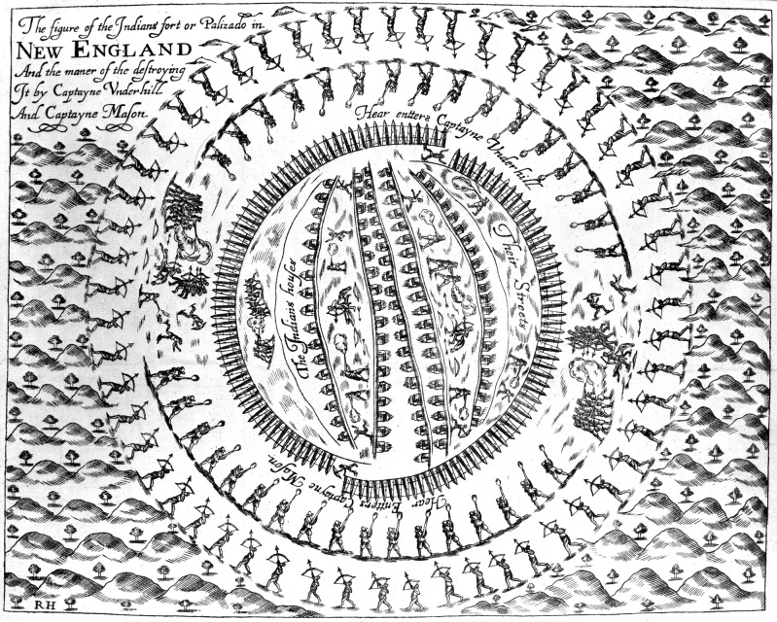
English and Narragansett assault on Pequot village, 1637

Slide 39
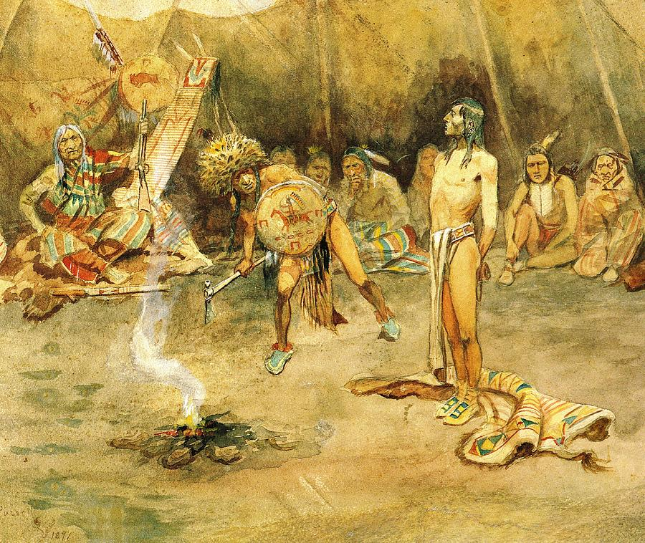
Sioux torturing a Blackfoot Brave
Charles Russell, 1864-1926

Slide 40
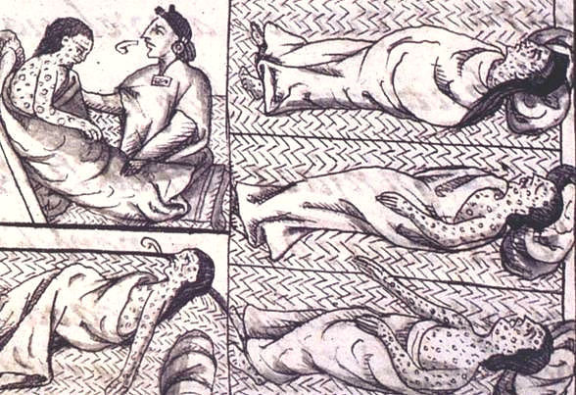
Aztec smallpox victims

Slide 41
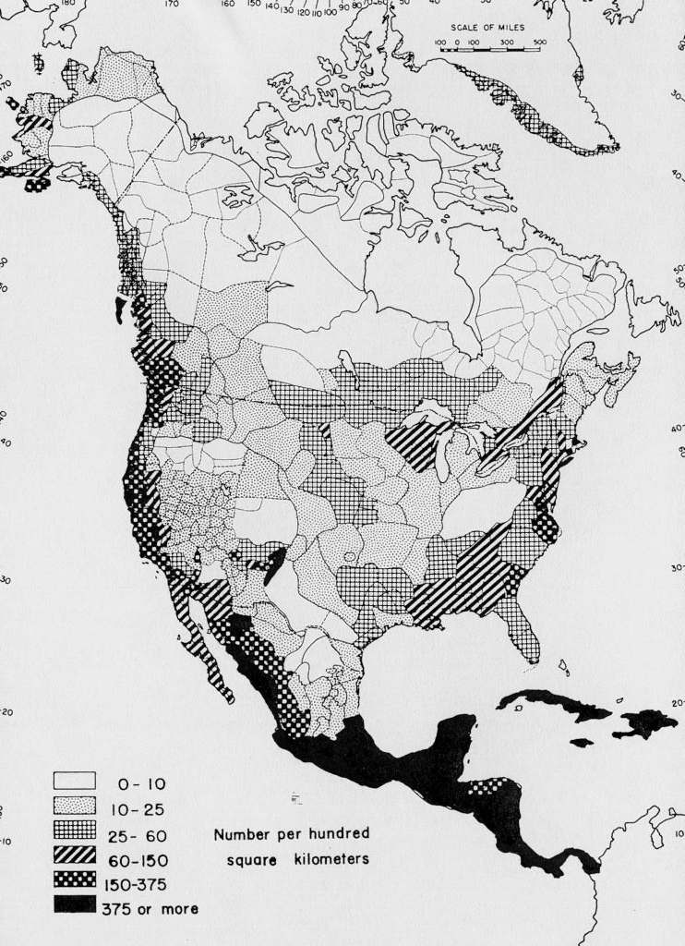

Slide 42
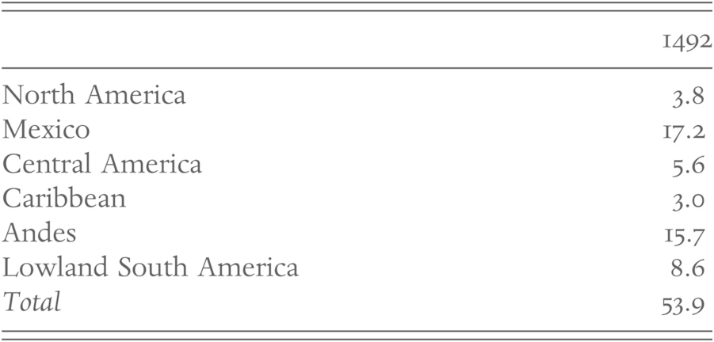
Regional Population in Millions in 1492
Source: The Cambridge World History – Cambridge University Press, 2015

Slide 43
TEXTBOOK ESTIMATES OF I492 INDIAN POPULATION
IN MILLIONS
John Garraty 1990 1-2 United States
Richard Current 1987 2+ North America
Alan Brinkley 1991 4 United States
Mary Beth Norton 1990 4-6 North America
James Martin 1989 5-8 North America
Irwin Unger 1989 Up to 9 United States
James Davidson 1990 10 North America
Thomas Bailey 1991 10 United States
John Blum 1989 10+ United States
George Tindall 1988 10-12 United States

Slide 44
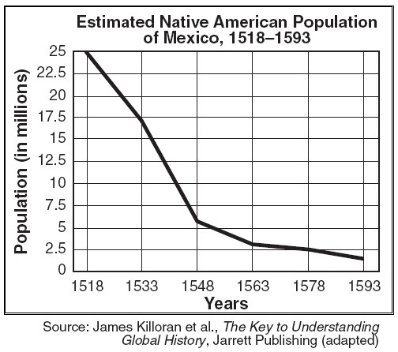
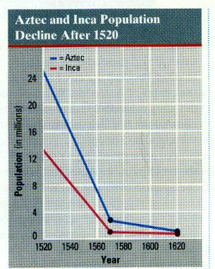

Slide 45
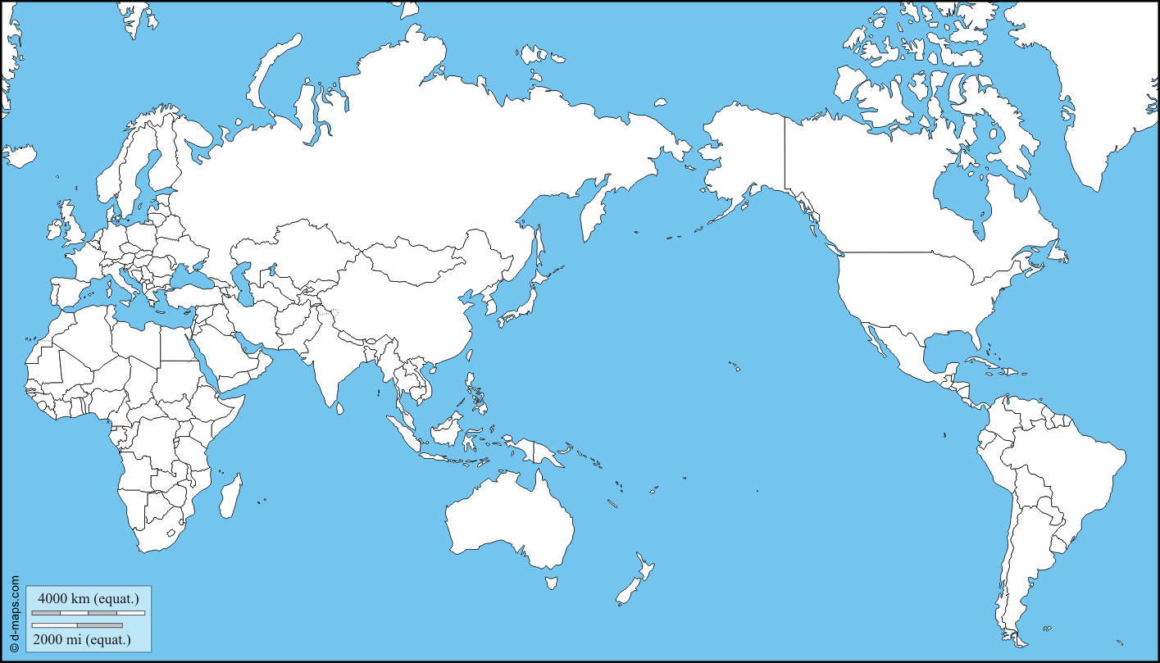

Slide 46
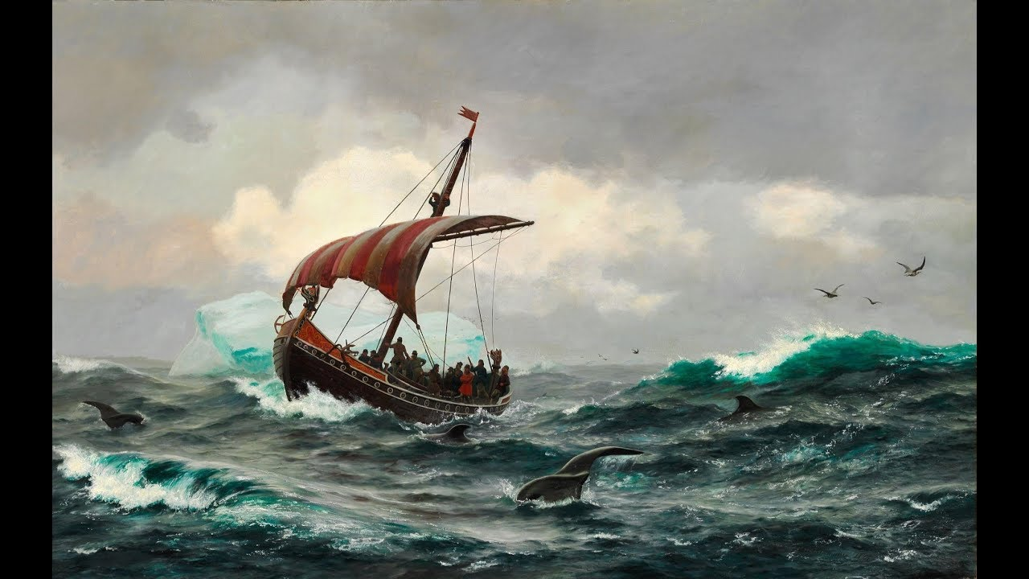

Slide 47
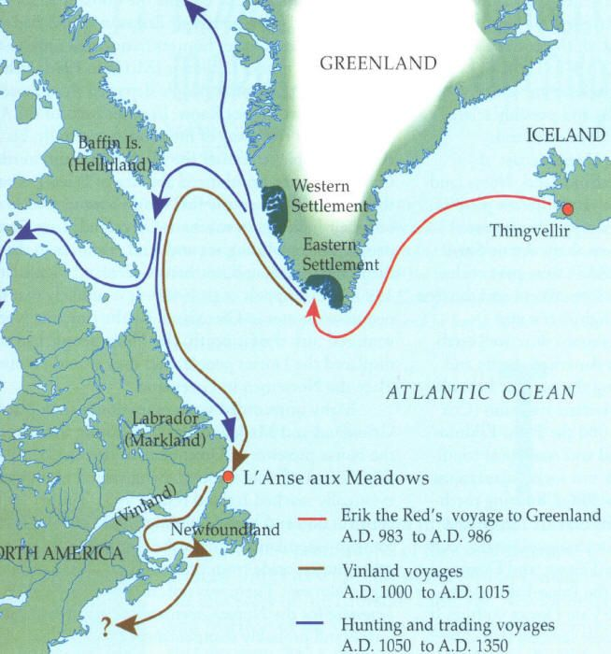
Viking settlements in North America

Slide 48
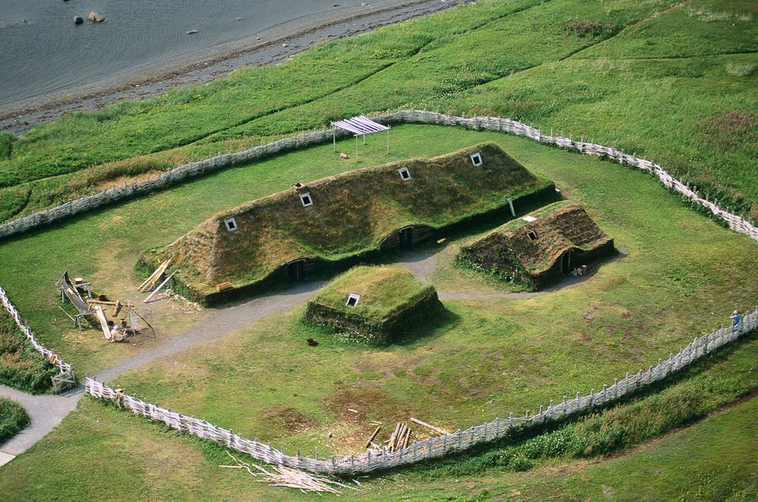

Slide 49
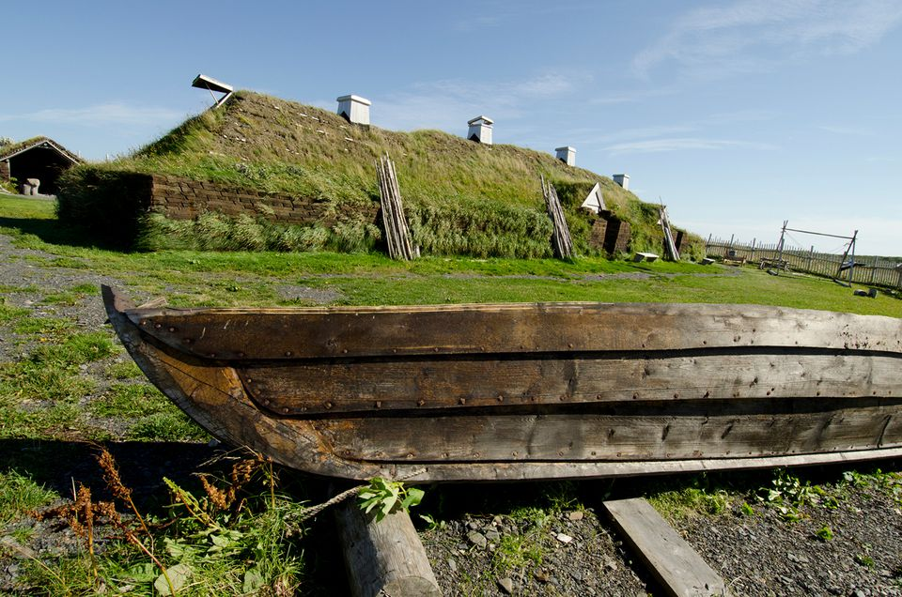

Slide 50
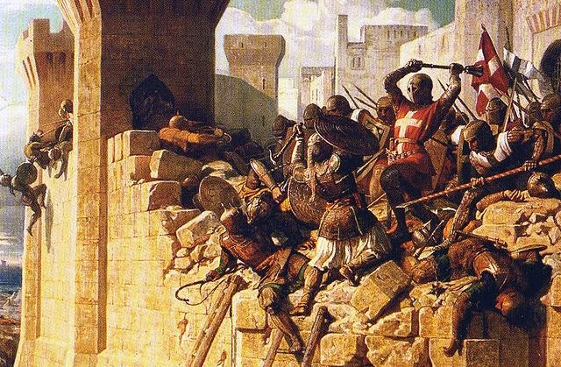
Siege of Acre, Third Crusade, 1189-1191 A.D.

Slide 51
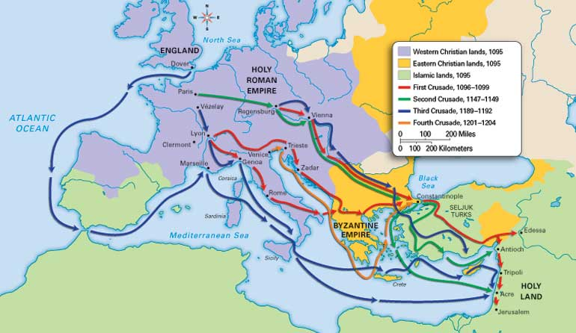

Slide 53
Fra Mauro world map (1459)

Slide 55
Martellus World Map, circa 1489

Slide 60
Demarcation lines created by
Papal Bull, 1493
and
Treaty of Tordesillas, 1494

Slide 61
Amerigo Vespucci’s four claimed voyages for Spain

Slide 63
Ferdinand Magellan’s route, 1519-1522

Slide 64
Map of Juan de la Cosa, c. 1500

Slide 66
World Map by Portuguese cartographer, 1502

Slide 73
Spanish explorers of the North American mainland
Francisco Vazquez de Coronado, Hernando de Soto, and Ponce de Leon

Slide 74
Diego Gutierrez
map,
1562

Slide 79
Pueblo Revolt at Hopi, 1680

