Slide 1
Lincoln, Secession, and the
Concept of Nation
Prof. John Navin
Coastal Carolina University
Department of History

Slide 2
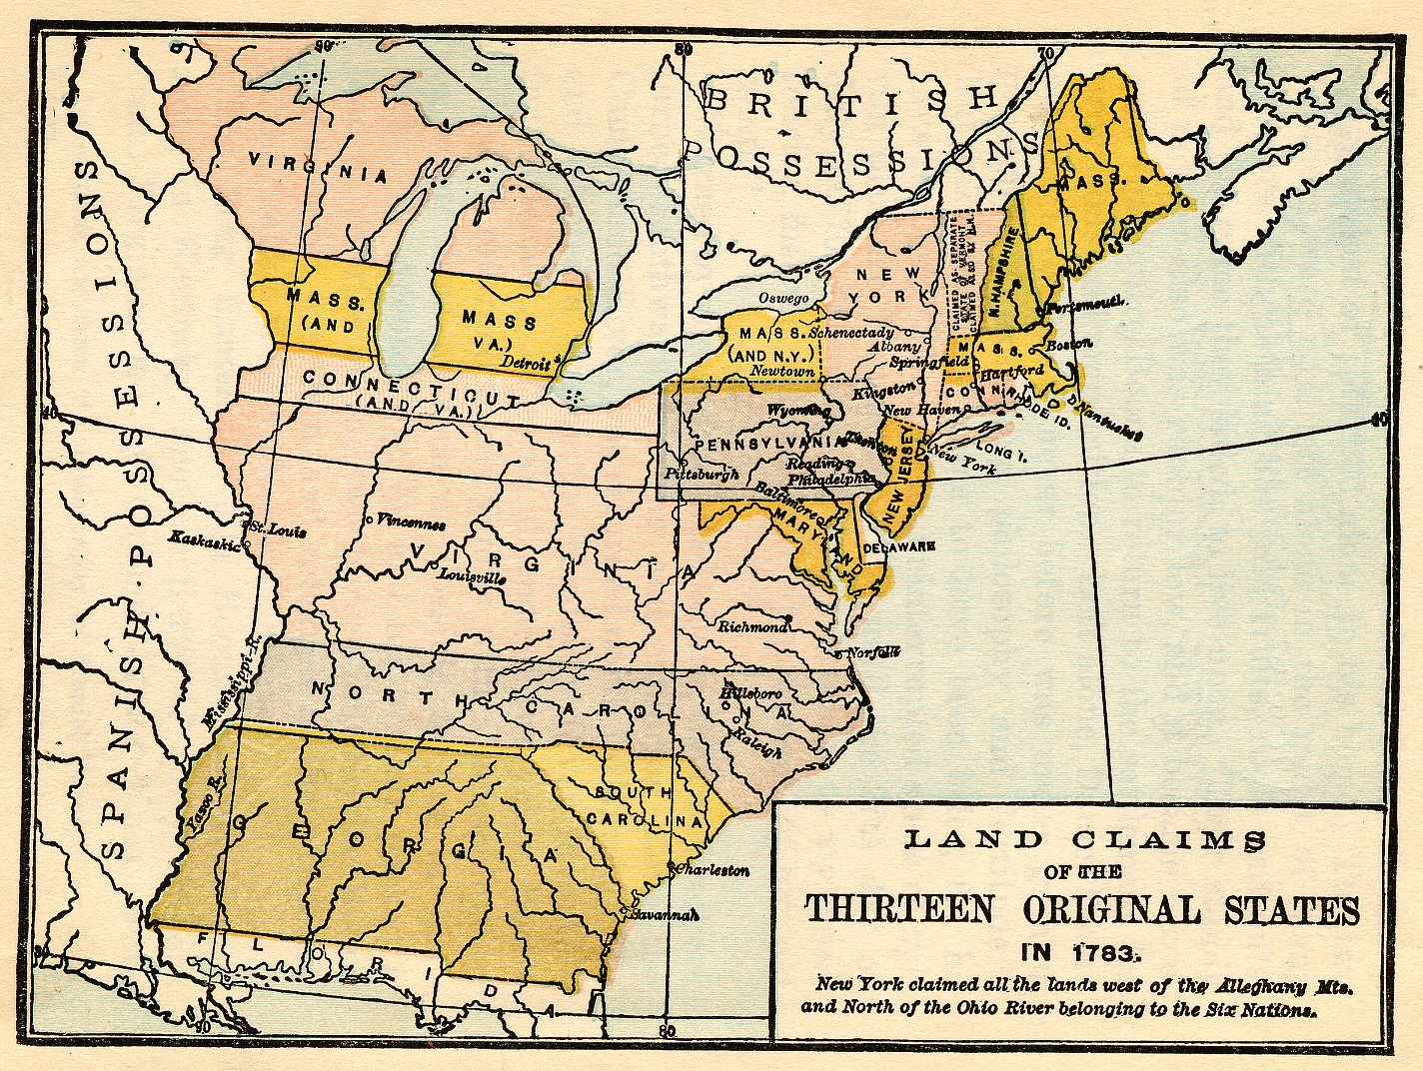
Original 13 Colonies

Slide 3
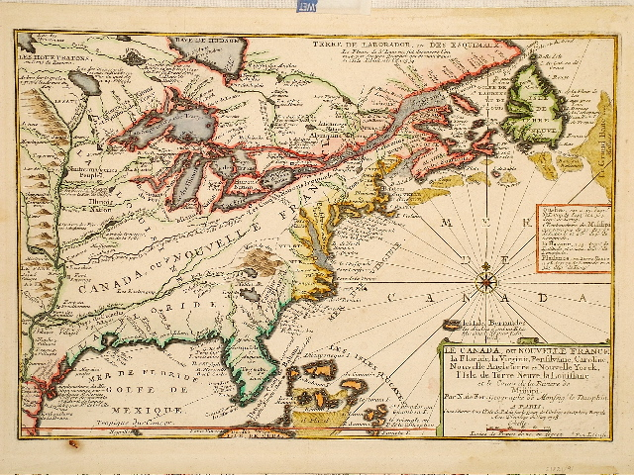
1705 French Map

Slide 4
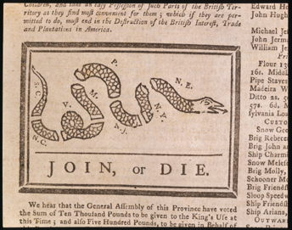
Image from Ben Franklin’s Pennsylvania Gazette, 1754

Slide 5
Articles of Association
1774
… And we do solemnly bind ourselves and our constituents, under the ties aforesaid, to adhere to this association, until such parts of the several acts of parliament passed since the close of the last war … are repealed.
Journals of the Continental Congress
October 20, 1774

Slide 6
“Volumes have been written on the subject of the struggle between England and America.
The sun never shined on a cause of greater worth. ‘Tis not the affair of a city, a country, a province, or a kingdom, but of a continent …
Now is the seed time of continental union, faith and honor.”
Thomas Paine
Common Sense
1776

Slide 7
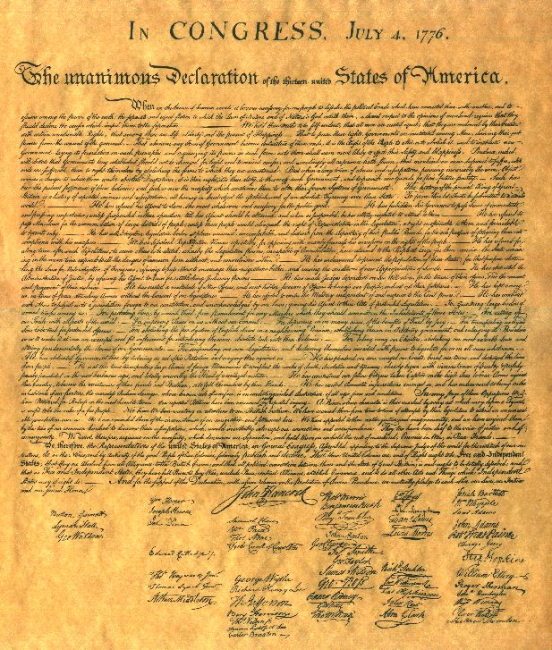
“The unanimous Declaration of the thirteen united States of America”

Slide 8
We, therefore, the Representatives of the united States of America … do, in the Name, and by Authority of the good People of these Colonies, solemnly publish and declare, That these United Colonies are, and of Right ought to be Free and Independent States; that they are Absolved from all Allegiance to the British Crown, and that all political connection between them and the State of Great Britain, is and ought to be totally dissolved; and that as Free and Independent States, they have full Power to levy War, conclude Peace, contract Alliances, establish Commerce, and to do all other Acts and Things which Independent States may of right do …
Declaration of Independence

Slide 9
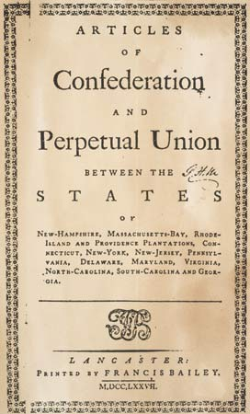
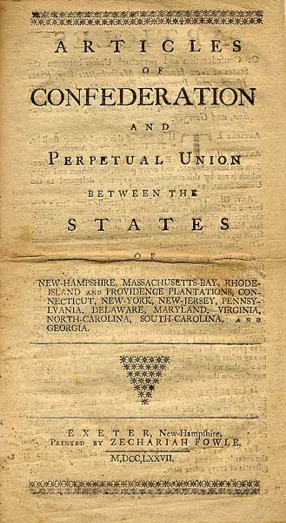
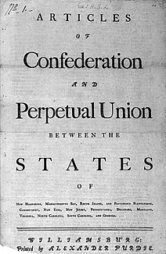
Proposed November 1777
Ratified March 1781
1st Confederation Congress created
Notes:
The men who drafted the Articles of Confederation were quite specific.

Slide 10
“Whereas the Delegates of the United States of America, in Congress assembled, did … in the Second Year of the Independence of America, agree to certain articles of Confederation and perpetual Union …
ARTICLE I. The Stile of this confederacy shall be “The United States of America.”
ARTICLE II. Each state retains its sovereignty, freedom and independence …
ARTICLE III. The said states hereby severally enter into a firm league of friendship with each other …”
Articles of Confederation, March 1, 1781

Slide 11
Article XIII
… the Articles of this Confederation shall
be inviolably observed by every State,
and the Union shall be perpetual
Notes:
… but the union was clearly perpetual

Slide 12
Washington’s Rhetorical Inconsistencies
“ … the tranquility of the United States …
.. my final blessing to that Country, in whose service I have spent the prime of my life …
The Citizens of America …
Our Republic assumed its rank among the Nations; The foundation of our Empire was not laid in the gloomy age of Ignorance and Superstition … “
Circular to State Governments, June 8, 1783

Slide 13
Notes from the Constitutional Convention
August 21, 1787
“The true question at present is whether the Southern states shall or shall not be parties to the Union. If the Northern states consult their interest, they will not oppose the increase of slaves …”
Mr. John Rutledge, South Carolina Delegate
Notes:
Here are notes take by James Madison at the Constitutional convention. Note the prominence of South Carolina delegates in this debate about continuation of the slave trade. Note also that many delegates thought that slavery was on the decline and would soon be abolished throughout the new nation.

Slide 14
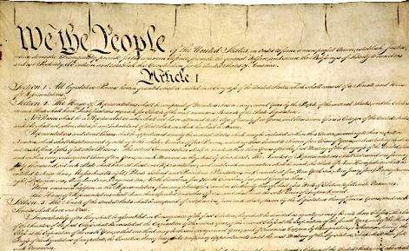
“Who authorized them to speak the language of, We, the people, instead of, We, the states? … If the states be not the agents of this compact, it must be one, great, consolidated, national government, of the people of all states. Here is a resolution as radical as that which separated us from Great Britain.”
Patrick Henry at the Virginia Ratifying Convention

Slide 15
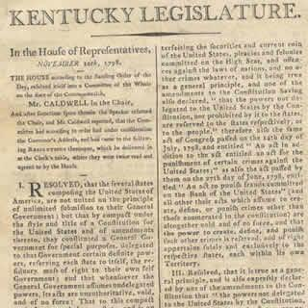
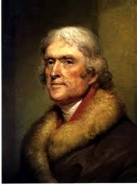
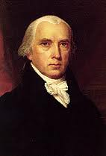
"
“… the germ of nullification and secession”
James Garfield

Slide 16
“Our country …
A rising nation, spread over a wide and fruitful land …
We are all republicans – we are federalists. If there be any among us who would wish to dissolve this Union or to change its republican form, let them stand undisturbed as monuments of the safety with which error of opinion may be tolerated where reason is left free to combat it.”
Thomas Jefferson
First Inaugural Address
March 4, 1801

Slide 17
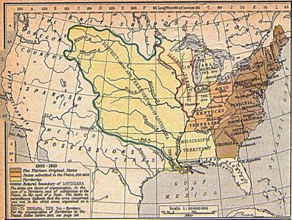
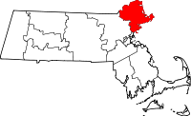
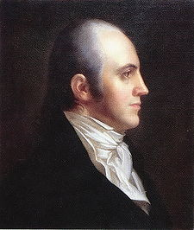
Essex County, Massachusetts
Aaron Burr
Louisiana Purchase, 1803

Slide 18
“Therefore resolved-That it be and hereby is recommended to the Legislatures of the several States represented in this Convention to adopt all such measures as may be necessary effectually to protect the citizens of said States from the operation and effects of all acts which have been or may be passed by the Congress of the United States …”
Hartford Convention, 1814

Slide 19
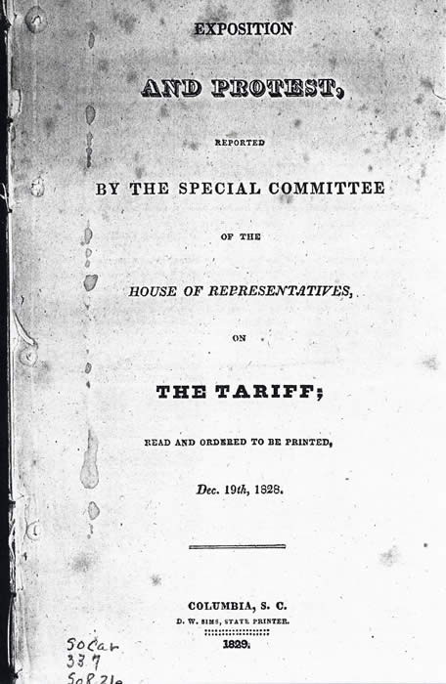
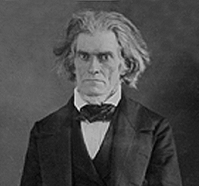

Slide 20
… the representatives of the good people of this commonwealth, anxiously desiring to live in peace with their fellow-citizens, and to do all that in them lies to preserve and perpetuate the Union of the States and the liberties of which it is the surest pledge – but feeling it to be their bounden duty to expose and resist all encroachments upon the true spirit of the Constitution …
John C. Calhoun
“South Carolina Exposition and Protest”
1828

Slide 21
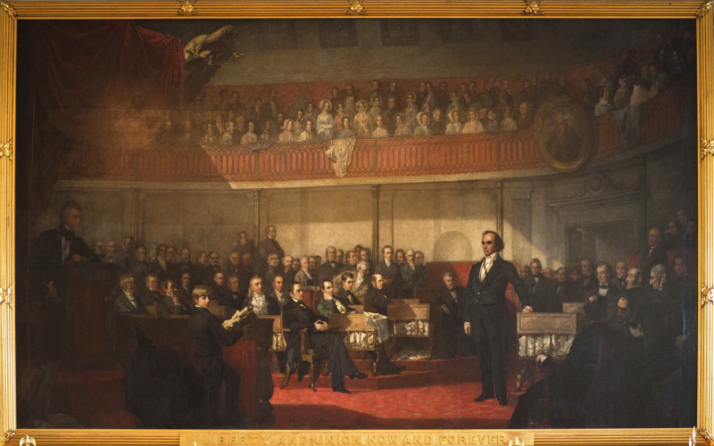
Webster-Hayne debate, 1830

Slide 22
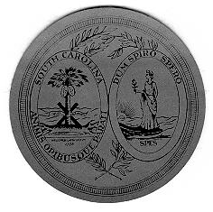
Ordinance of Nullification
The People of South Carolina
November 24, 1832
We, therefore, the people of the State of South Carolina, in convention assembled, do declare and ordain ... [That these acts] ... are unauthorized by the Constitution of the United States and violate the true meaning and intent thereof, and are null, void, and no law, nor binding upon this State, its officers, or citizens …
Notes:
The Nullification crisis stemmed from disagreements about tariffs. It was the first but not the last time that South Carolina threatened to secede.

Slide 23
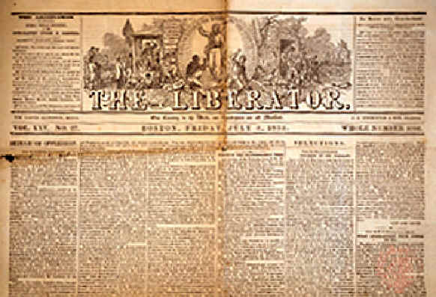
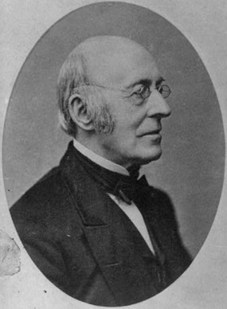
“No Union with Slaveholders!”

Slide 24
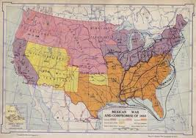
“Resolved, that the slaveholding states cannot and will not submit to the enactment by Congress of any law imposing onerous conditions or restraints upon the rights of masters to remove with their property into the territories of the United States.”
Text from Resolutions of the Nashville Convention of 1850

Slide 25
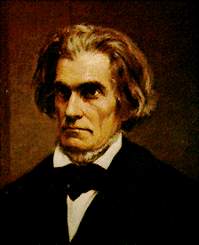
“That a State, as a party to the constitutional compact, has the right to secede—acting in the same capacity in which it ratified the constitution—cannot, with any show of reason, be denied by any one who regards the constitution as a compact—if a power … should fail to fulfill the ends for which it was established.”
John C. Calhoun
A DISCOURSE ON THE CONSTITUTION AND GOVERNMENT OF THE UNITED STATES, 1851

Slide 26
“Your purpose, then, plainly stated, is that you will destroy the Government, unless you be allowed to construe and enforce the Constitution as you please, on all points in dispute between you and us. You will rule or ruin in all events. …
But you will not abide the election of a Republican president! In that supposed event, you say, you will destroy the Union; and then, you say, the great crime of having destroyed it will be upon us! …
It is exceedingly desirable that all parts of this great Confederacy shall be at peace, and in harmony, one with another.”
Abraham Lincoln
Cooper Union Address
February 27, 1860

Slide 27
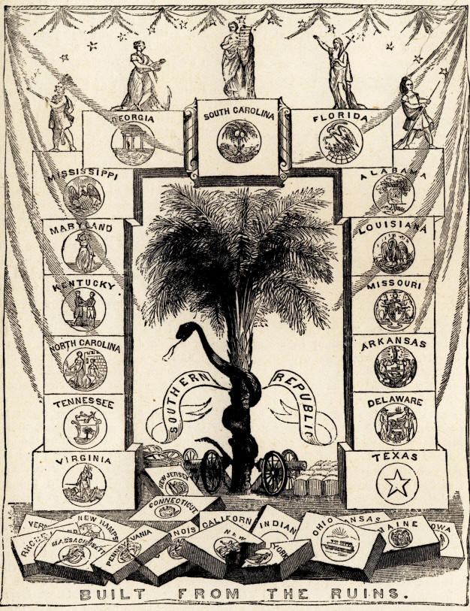
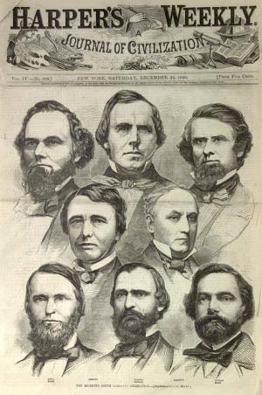
Banner of the South Carolina Secession Convention
January 5, 1861 depiction of “The Seceding South Carolina Delegation”
Notes:
As promised, the people of South Carolina responded to Lincoln’s victory in the election by summoning a convention to discuss secession.

Slide 28
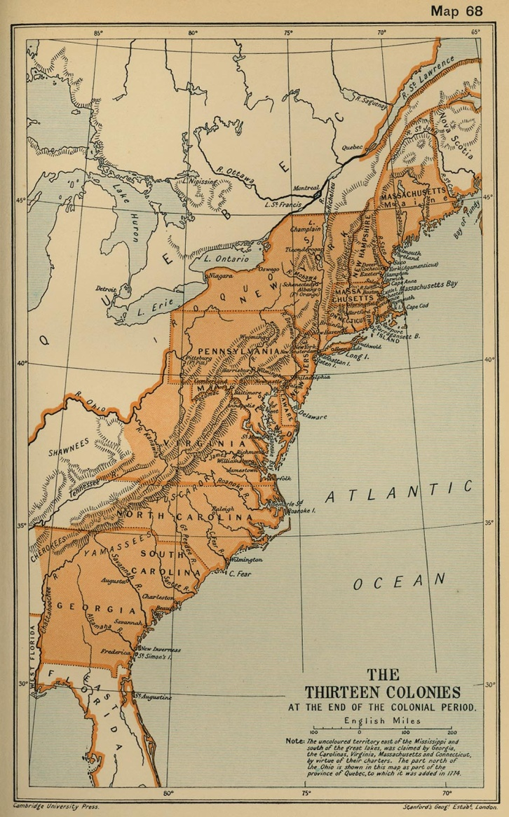
“In legal contemplation, the Union is perpetual, confirmed by the history of the Union itself. The Union is much older than the Constitution. It was formed, in fact, by the Articles of Association in 1774. It was matured and continued by the Declaration of Independence in 1776.”
Abraham Lincoln
First Inaugural Address
March 4, 1861
Notes:
Many people, including Abraham Lincoln, claimed that the founding fathers took it for granted that the commitment to a perpetual union remained in force when the new Constitution was drafted. Others disagreed.

Slide 29
“Plainly, the central idea of secession, is the essence of anarchy. A majority, held in restraint by constitutional checks, and limitations, and always changing easily, with deliberate changes of popular opinions and sentiments, is the only true sovereign of a free people. Whoever rejects it, does of necessity, fly to anarchy or to despotism.”

Slide 30
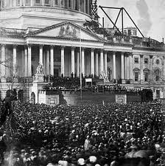
“I have no purpose, directly or indirectly, to interfere with the institution of slavery in the States where it exists. I believe I have no lawful right to do so, and I have no inclination to do so.”
Notes:
By the time Lincoln took office, seven states had seceded. He hoped to win them back by promising not to interfere with slavery where it existed. However, the burning issue was the expansion of slavery.

Slide 31
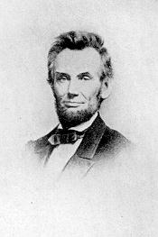
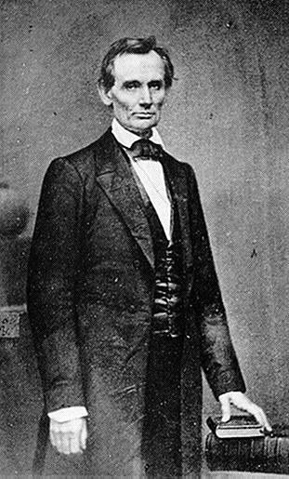
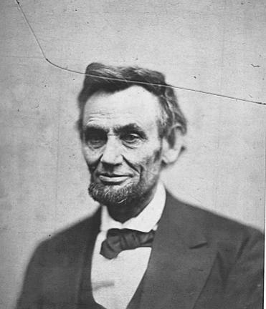
1863
1860
1865

